Slide 1
Top palliative studies of 2021
and their impacts on practice
CABS October 1, 2022
Dr Dionne Walsh & Angela Gee
Notes:
We’d like to thank the CSHP-AB branch education committee for inviting us here this morning. We’ll be reviewing our top palliative studies of 2021 and their impacts on practice.

Slide 2
Goal is maximized comfort while maintaining maximized communication
How much sedation is appropriate?
Notes:
Agitated delirium is common at end of life & it’s quite distressing for patients, caregivers, and clinicians. In our goal to maximize comfort while also maintaining maximal communication, where is that balance? How much sedation is appropriate?
Fluctuating nature

Slide 3
Personalized Sedation Goals
Method: Preplanned secondary analysis of double-blind parallel group RCT on terminal agitated delirium
Adults with Advanced cancer
Refractory agitated delirium with RASS +1 or greater, despite low dose haloperidol
Notes:
This was a Preplanned secondary analysis of double-blind parallel group RCT on terminal agitated delirium, done at the MD Anderson Cancer Center (Texas). They enrolled adults with advanced cancer who were experiencing Refractory agitated delirium with RASS +1 or greater, despite receiving low dose haloperidol
Medical power of attorney or legal representative
Enrollment July 2017 – July 2019
Delirium by DSM-5 criteria
Low dose = 1-8mg/day scheduled or >=4mg/day rescue over previous 24 hours
Trial doses:
haloperidol 2mg iv q4h
chlorpromazine 25mg iv q4h
haloperidol 1mg + chlorpromazine 12.5mg iv q4h
Rescue = same trial med & dose q1h prn
Titrated up or down, based on symptoms

Slide 4
Notes:
The RASS score is here as a reminder. Patients experiencing a RASS of +1 or greater would be in the restless, agitated, to combative categories.

Slide 5
Personalized Sedation Goals
Enrolled: 42 caregivers & 39 bedside nurses
Perception at baseline:
Patient ability to communicate coherently
Patient ability to communicate meaningfully
Frequency of restlessness / agitation over the previous 2 days
Distress level of respondent related to the agitation
Notes:
In total, they enrolled 42 caregivers and 39 bedside nurses in this study. The respondents were asked to rate the patient’s ability to communicate both coherently and meaningfully, the frequency of restlessness they had noted over the previous 2 days, and the level of distress they were feeling related to the agitation.
: 64% spouses, 26% children

Slide 6
Personalized Sedation Goals
At enrollment: What would be your preferred level of alertness to ensure that he/she is comfortable?
Do not give any medicines that would affect her level of alertness, even when she is restless or agitated. She may continue to be awake most of the day and can be quite restless / agitated at times (RASS 0 or higher)
Use medicines to help her sleep a bit more. When asleep, she may open her eyes when you call on her and make eye contact. She may not be able to communicate with you. She may still have long periods of awakening with some moments of restlessness / agitation (RASS -1 or -2)
Use medicines to help her sleep a majority fo the time. When asleep, she may open eyes when you call on her but without eye contact and be unable to communicate with you. When she is awake (10-20% of the time), there may be moments of restlessness / agitation (RASS -3)
Use medicines to help her sleep almost all the time. When asleep (90-99% of the time), she will not respond to voices but may have some movement or eye opening when you touch her. She will have almost no restlessness / agitation (RASS -4)
Use medicines to help her to sleep all the time. When asleep (100% of the time), she will be in deep sleep and may rarely be able or not at all be able to be awakened (RASS -5)
Notes:
I recognize that this is a busy slide, with a lot of text. However, I wanted to include the wording used in this study, as it may be useful to you in guiding future discussions with loved ones. Essentially, the respondents were asked about preferred sedation levels, with varying levels of alertness and communication ability. Scores intentionally omitted from discussions / written survey and only the descriptions were provided.

Slide 7
Personalized Sedation Goals
Introduced three hypothetical scenarios
For each situation, asked caregiver and bedside nurse to choose PSG, assuming patient had “days to live” and “weeks to live”
1. Significant restlessness and agitation (awake, quite agitated, pulling Foley, climbing out of bed) and no meaningful communication for days
2. Restlessness and agitation at times (awake at night, caregiver awakened 3 times due to restlessness) and no meaningful communication for days
3. Restlessness and agitation at times (awake at night, caregiver awakened 3 times due to restlessness) and had a few brief but meaningful conversations
Notes:
To control for variability in patient characteristics, three hypothetical scenarios were also presented to respondents. Scenarios described various levels of agitation and ability to communicate. For each of these situations , respondents were asked to choose PSG, assuming patient had “days to live” and also “weeks to live”.

Slide 8
Personalized Sedation Goals
Results:
Length of life remaining impacts sedation goal
Decreased communication ability leads to desire for higher sedation
Communication is perceived more favourably by caregivers than nurses
Delirium-related distress leads to desire for higher sedation
Caregivers prefer lighter sedation than nurses, even when it is distressing
Large variance in preference for level of sedation
Notes:
What they found was that greater levels of sedation were preferred when prognosis was shorter, communication ability decreased, and respondents experienced greater levels of distress. However, caregivers were more likely than nurses to perceive communication ability favourably, and preferred lighter sedation than nurses did, even when distressed.
Overall, there was a large variance in preferences.
Limitation: Examined PSG only at baseline and did not examine stability over time: may shift with time
RASS scored at fixed times: 0, 0.5, 1, 2, q2h x 24h then q4h until death/discharge/withdrawal
Caregivers mostly preferred PSGs corresponding to RASS scores of –1 to –2 (36%) and –3 (38%)
Nurses preferred RASS scores of –3 (38%) and –4 (40%).
Respondents were significantly more likely to prefer a deeper level of sedation if patients in the scenarios were not able to communicate (OR, 3.1- 4.4; P < .001) and if the expected survival was in terms of days instead of weeks (OR, 1.7; 95% CI, 1.2-2.5; P = .002).
Nurses were also significantly more likely than caregivers to prefer a deeper level of sedation (OR, 2.5; 95% CI, 1.8-3.6; P < .0001)
The 2 groups observed similar frequencies of restlessness / agitation
Caregivers reported significantly more delirium-related distress than nurses and were also more likely to report that the patient was able to communicate coherently and meaningfully with them
A deeper level of sedation was preferred among respondents who reported a higher level of delirium-related distress
Nurses were also more likely than caregivers to prefer a deeper level of sedation

Slide 9
Personalized Sedation Goals
Impact:
Be aware of bias regarding our own goals around sedation
RASS can be a useful standardized framework to select a sedation goal
Using language similar to that presented here can help guide families and healthcare providers
Check in regularly over time to confirm preferences
Active dose titration to ensure meeting goals
Notes:
What we took away from this study is to be aware of personal biases around sedation goals. RASS can be a useful standardized framework, along with the language presented here, to hep guide families and healthcare providers in these conversations. One of the limitations of this study was that they only examined sedation goals at baseline, and did not examine stability over time. We feel that checking in regularly with caregivers would be important, as is actively titrating doses to ensure we’re meeting the goals set for each patient.

Slide 10
Death rattle is common and potentially distressing to caregivers
Can we reduce the prevalence of this distressing symptom at end of life?
Notes:
The next paper is on the use of prophylactic sc scop butylbromide on death rattle. We know that noising breathing at the end of life is common and can cause distress to caregivers. So the question we’re asking here is whether we can reduce the prevalence of this distressing symptom at the end of life.
Death rattle prevalence is 12-92%
Patient and family impact
Management: repositioning, education/reassurance
Anticholinergics: no evidence of benefit in some studies
Decrease mucus production, don’t get rid of what is there

Slide 11
Scopolamine butylbromide
Method: Double-blind, randomized, placebo-controlled
Multicenter: 6 inpatient hospice sites in the Netherlands
Trial started at recognition of dying phase according to clinical judgment (Bedbound, sips only, not swallowing meds, appears semicomatose)
Administered scopolamine butylbromide 20mg s.c. QID (or placebo), and provided standardized monitoring q4h
Until death, or
Until endpoint was reached (i.e. grade 2 or higher death rattle at 2 consecutive time points), or
If greater than 8 days passed, excluded as assumed not in dying phase
Notes:
This study was a double blind, randomized, placebo-controlled multicenter trial. At recognition of the dying phase, patients were administered scop butylbromide (aka hyoscine butylbromide or Buscopan) at a dose of 20mg sc four times daily or placebo. Patients were monitored every four hours for symptoms. And this continued until death, the endpoint was reached (defined as a grade 2 or higher death rattle at 2 consecutive time points) or if greater than 8 days had passed, at which point patients were excluded from the trial under the assumptoion that they weren’t actually in the dying phase. Note that grade 2 death rattle means that this was audible from the end of the patient’s bed (on a range of 0 to 3)
April 2017-Dec 2019 (2 ½ years)
Patients consented in advance
Care Program for the Dying q4h: physical, psychological, social and spiritual (includes pain, dyspnea, N/V, dry mouth, urinary retention, restlessness)
Death rattle scale
0: no rattle
1: audible close to patient
2: audible at end of bed
3: audible at door
Vancouver Interaction and Calmness Scale for restlessness
Use of sedatives
Endpoints not reported: QOL last 3d, Quality of dying (RN), QOL and QOD according to relatives, bereavement of relatives, experience of relatives with patients participation in RCT
Life expectancy ≥3days, capable of understanding information provided
No tracheostomy, active respiratory infection, use of anticholinergics or octreotide

Slide 12
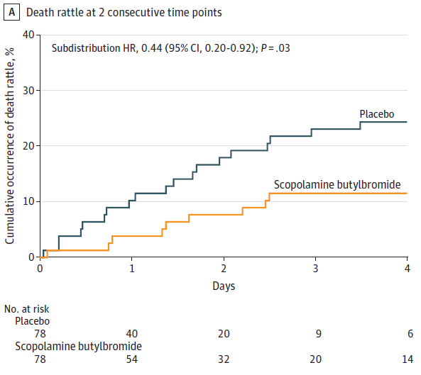
Scopolamine butylbromide
Results:
157 patients, 86% cancer
Treatment 13% rattle vs Placebo 27%
Delayed time to death rattle
Restlessness 28% vs 23%
Dry mouth 10% vs 15%
Urinary retention 23% vs 17%
Longer dying phase 42.8 hr vs 29.5 hr
No difference pain, SOB, N/V, use of opioids/haloperidol/sedatives
Notes:
They enrolled 157 patients, most of whom had cancer. We can see that the curves separated early and the impact was sustained. 13% of patients in the treatment group experienced death rattle vs 27% in the placebo group, which was significant. As secondary outcomes, the investigators also looked at common side effects of restlessness, dry mouth, and urinary retention, none of which were considered significant. What did come up as significant was a longer dying phase in patients who received active treatment at 42.8 hours vs 29.5 hours in the placebo arm. This was consistent with other previous trials.
79 scop / 78 placebo
Decreased rattle P0.2 = significant
Curve separated early, sustained
Some rattle before dying phase recognized. Not all rattle can be prevented.
Secondary & exploratory outcomes
Dry mouth = (increased frequency of mouthcare needed)
SB 42.8 hours to death, P 29.5 hours (consistent with another trial)
Group considered to be higher risk for secretions (lung ca, copd, smoking) actually had less death rattle than the rest of the placebo group.

Slide 13
Scopolamine butylbromide
Impact to practice:
Consideration given to prophylactic subcutaneous scopolamine butylbromide in specific scenarios
Explore fears and goals with families to determine who would be a good candidate:
Consider for families with distressing experience or fear of death rattle
Avoid in families distressed by long dying phase
Notes:
As a result of this paper, we consider the use of prophylactic sc scop butylbromide in specific scenarios. Similar to the last article, we suggest exploring fears and goals with patients and families. We would consider using this treatment when families express a distressing experience or fear of death rattle. We would avoid its use in families who express concern of a long dying phase.

Slide 14
“Clinicians in palliative care… spend a substantial amount of time managing
opioid misuse or use disorder”
How should we be treating cancer-related pain in patients who are taking Suboxone® or methadone for OUD?
Notes:
The third article we’re reviewing today is about the management of cancer pain in individuals with opioid use disorder. We know that clinicians in palliative care spend a substantial amount of time managing opioid misuse or use disorder, so our question we are looking to answer is how to manage cancer pain in patients who are taking Suboxone or methadone for opioid use disorder.

Slide 15
Pain and OUD
Method: 3-round modified Delphi process
Recruited 120 PC and addictions clinicians
Respondents split in 2 panels (randomly, balanced by expertise)
Perspectives on different approaches to the management of pain and OUD in patients with advanced cancer
Notes:
This expert consensus statement was devised through a three round modified Delphi process, involving 120 clinicians with specialties in palliative care and/or addictions. These respondents were split between 2 panels to determine perspectives on approaching the management of pain and opioid use disorder in patients with advanced cancer.
115/120 were physicians, 5 were NPs

Slide 16
Notes:
The two panels were provided the same patient scenarios: A 50-year-old patient with advanced cancer who is taking active anticancer treatment. They have pain related to cancer or its treatment and they have concurrent OUD. In the first scenario, this patient is taking buprenorphine-naloxone regularly. In the second, the patient is taking methadone. Their OUD is managed and stable.
Panel A was told these patients have a prognosis of weeks to months
Panel B was told these patients have a prognosis of months to years
I do want to note that these images were taken from the original article and modified slightly.

Slide 17
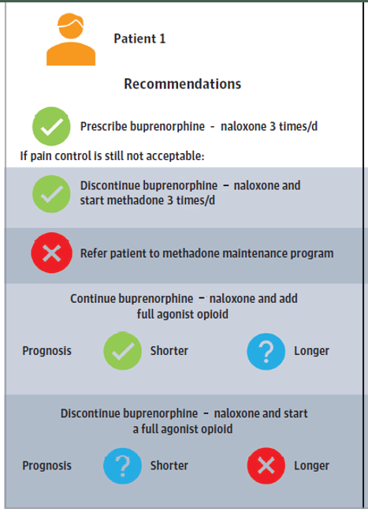
Pain and OUD
Safety of adding a full agonist opioid: dependent on good long-term relationship between the patient and practitioner, close monitoring, and the plan for full agonist was only short term
Concerns about relapse with a full agonist, especially without buprenorphine-naloxone for OUD treatment.
Notes:
Patient 1, our suboxone patient, is experiencing pain. The first recommendation from this group is to divide the dose three times daily. If that is insufficient, they recommend:
1. Switching to methadone tid, assuming the QTc normal.
2. Continuing Suboxone and adding a full agonist opioid, depending on a good longterm relationship between the patient and practitioner, the ability to closely monitor therapy, and the plan to use the opioid for a short time (around surgery, for example). This was felt to be more appropriate in patients with shorter life expectancies.
3. Stop Suboxone and convert to a full agonist opioid. Concerns about relapse made this inappropriate for patients with longer prognoses.
However, it was felt that maintenance programs: concerns about the hardship of daily methadone clinic visits in someone with a serious illness, fragmentation of care by adding a new team of clinicians, and clinics’ ability to address pain

Slide 18
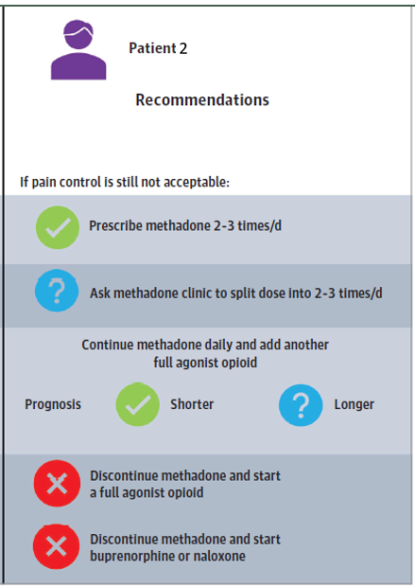
Pain and OUD
Buprenorphine-naloxone was felt to be inferior for pain (no head-to-head trials)
Challenges with transitioning methadone to burprenorphine-naloxone complicated by methadone’s long and variable half-life
Notes:
Patient 2 is stabilized on methadone, but is experiencing pain. This group suggests 1. Splitting the methadone dose two or three times daily OR
2. Continuing methadone and adding another full agonist opioid, with the same caveats as the last scenario
They did not recommend converting to Suboxone, as it was felt this product was inferior for pain, despite no head-to-head trials. There were also challenges with doing this conversion safely, associated with methadone’s long and variable half-life.
-American restrictions on prescribing methadone & monitoring clinics

Slide 19
Pain and OUD
Impact:
Many patients are coming to us on Suboxone or Methadone for OUD
Split opioid agonist therapy to BID-TID & titrate
Add full agonist (e.g. hydromorphone) prn for breakthrough pain, with a goal of ≤ 3 doses/day, with safety measures in place, generally for shorter prognoses or acute pain
Notes:
Many patients are coming to us already on Suboxone or Methadone for OUD. Our first step is to split the opioid agonist therapy to BID-TID & potentially titrate, if appropriate. We do sometimes add a full agonist opioid, such as hydromorphone, prn for breakthrough pain. Our goal is to use no more than 3 doses daily, and we are more likely to use this for patients with shorter prognoses or those with acute pain episodes.
good long-term relationship between the patient and practitioner, close monitoring, and the plan for full agonist was only short term
Aberrant medication taking behaviours (AMTBs): any use of prescription opioids in a manner other than intended by the prescribing physician and pharmaceutical manufacturer
OUD: problematic patterns of opioid use, which result in clinically significant impairment or distress.

Slide 20
Guidelines recommend a pharmacist on
the PC team, but in varying roles
Question: What is the impact of a pharmacist on the Palliative Care team?
Notes:
Many national consensus and guidelines on palliative care either mandate or encourage a pharmacist team member, but in varying roles: consultation vs direct patient care
Many pharmacists are questioned on what individual interventions they bring to the team to justify the cost and the time

Slide 21
Pharmacist
Methods: Retrospective Multicentered study
557 Adult hospitalized inpatients seen by PC pharmacists, of 2500 total consults
Fully integrated members of a multidisc team – regular in person assessments alone or with MD/RN
Pharmacists with specialized training in pain / PC
Outcomes: Pharmacist interventions, symptoms at baseline, 24, 48, 72 hours, LOS
Notes:
3 sites in California
FYI - It seems that the board certifications for pharmacotherapy and oncology are recognized in Canada now.

Slide 22
Results:
Improved pain
Improved constipation
No sig improvement nausea, anxiety, delirium
Decreased LOS by 12 days if pharmacist involved within 72 hours vs delayed referral!
Many Non-symptom interventions
Notes:
Improved number of patients rating pain at goal at 72 hours
Faster time to achieve pain control: 72 hours vs 4-7days
Improved number of patients achieving constipation goal
No difference in nausea goal attainment
Few medications recommended for anxiety, mainly non-pharmacologic therapies
Few medications recommended for delirium (mostly mild), some recommended at the 24 hour assessment
Many nonsymptom interventions are tracked by AHS in the standards, but not goals of care planning or psychosocial interventions:
Education, interactions, adherence, discharge planning, goals of care, psychosocial intervention

Slide 23
Pharmacist
Summary: Pharmacists are effective for both symptom and non-symptom management, and decrease the length of stay
Impact:
Involve pharmacist EARLIER!
Consider expanding pharmacy scope to include more than symptom management eg. discussions including goals of care, team leadership
Notes:
Limits: no comparator group
Sampling bias (not all patients seen by pharm)
(?primarily symptom based PC needs / less complexity)

Slide 24
Clinicians don’t have the capacity to see everyone in their homes, especially in rural areas
Question: Is virtual care effective for Palliative Care?
Notes:
Only 1/6 people who died received PC at home (2016/17)
Palliative care teams are not available in all cities
Patient travel can result in physical, psychological, and financial stress
Telehealth can improve access and alleviate hardship from travel
Some unique rural benefits
Ideally patients should have access to all PC team members over telehealth
Financial models can encourage or discourage virtual care
But – does it meet the emotional needs of patients and families?

Slide 25
Virtual Care
Methods: Qualitative study – semi-structured interviews
Healthcare providers (8): prior to implementation
Patients (3): 0,3,6 months
Themes identified, analyzed for differences between HCPs/Patients
Notes:
Rural based palliative care hospice at home service and PCT at hospital in UK
Physicians, nurses, case worker, psychotherapist
Patients living at least 40mins from hospital

Slide 26
Virtual Care
 | Providers | Patients
Autonomy | Opportunity to self manage symptoms Improved Understanding | Empowered: comfortable at home, so more confident to ask questions Liberated: decreased burden of travel, less fatigue, more energy for other activities
Competence | - Age barrier | Initially thought age would be barrier Developed a sense of mastery
Notes:
Autonomy:
Providers Condition Centred
Patients holistic patient-centered

Slide 27
Virtual Care
 | Providers | Patients
Relatedness | distance, absence of touch, remote nature Prevent trusting relationship, understanding of emotional needs, ability to support emotions | Developed close connections and trusting relationships Relaxing and familiar environment Sense of privacy Confidence to discuss feelings without concern about reaction from provider
Notes:
Relatedness
Providers – fear of lack of therapeutic presence
Patients – talking to a computer is more anonymous, speak more freely than with another person in the room.

Slide 28
Virtual Care
Summary:
For clinicians and patients - the environment of the other seems unfamiliar and challenging
In person contact is proposed as more patient centred, but may actually be more for the psychological benefit of the provider than the patient
Impact:
Don’t make assumptions based on age, offer virtual care to all!
Don’t assume I know what is “patient centered”

Slide 29
Nudging = “the framing of information that can significantly influence behavior without
restricting choice.” = Libertarian Paternalism
Question: Is it OK to nudge in palliative care?
Notes:
Richard Thaler won the nobel prize in 2017 for his work on nudging.
Wrote the book Nudge, which has had a big impact on my personal views and medical practice, and I often recommend it to residents.
The principle is that while autonomy and patient centred decision making is important, it’s OK and even recommended to guide a course of action to a patient if it is the right choice for them. Especially because we have more information than they do, so providing blind choice is not in the patients best interest.

Slide 30
Nudging
Methods: Qualitative Study, Multidisciplinary team in Italy
Provided articles on Nudging to read in advance, and then Focus Group held
Questions:
Do you think that clinical nudging occurs in your daily care relationship?
Does the PC approach differ from clinical nudging? If yes, how?
Are there ways to oppose nudging?
Notes:
7 HCPS from inpatient palliative care team and psycho-oncology unit: physicians, advanced practice nurses, psychologist

Slide 31
Nudging
Results: Nudging is “diabolically beautiful”, and “attractive but dangerous”
PC providers should move toward a neutral space
“The intrinsic meaning of PC approach does not justify nudging”
Nudging does not help ensure an informed decision or raise awareness of patient values and beliefs
Notes:
Difficult not to nudge, are we already nudging – Attractive, reassuring, time saving
unconsciously? Partially consciously? Consciously?
If we are honest with ourselves, are we really neutral?
Some patients “do not know how to relate their own values to the choices they have to make do”
- Proposed in the best interest of the patient, while on the contrary it can develop in pure paternalism

Slide 32
Notes:
Paternalism – HCP tells the patient the choice they consider the right one
“Resuscitation would be futile, so I’m ordering M1 goals of care”
“The guideline says no feeding tubes in dementia, so we will not put a feeding tube in”
Autonomy – “what goals of care do you want” or “OK, you want everything, so R1”
“do you want a feeding tube?” “do you want to do everything we can?”
Nudging – Physician influences the patient’s choice in a “gentle” manner, pays attention to patient’s wishes, but steers patient toward the solution considered more correct. Palliative patients are vulnerable. “Palliative Paternalism”
“If your heart or lungs fail, because of your advanced cancer, the chances of you recovering to a state where you get off the breathing machine and are able to get back home living independently is very small, therefore I recommend that we fix everything we can fix, but that we not use a breathing tube to breathe for you or restart your heart when it stops. Does that sound reasonable to you?”
“Feeding tubes in dementia have not been shown to improve quality or length of life, they still have risks of aspiration, and can be bothersome to patients – so I recommend that we not insert a feeding tube. Does that sound reasonable to you?”
Patients’ autonomy in relational context – focus is on respecting patients values and wishes, with QOL according to the patient at the centre, with the aim of helping them make autonomous choices
“What’s most important to you right now? What are your worries? What are you willing to trade for more time? What are the things in life that are so important to you that if you couldn’t do them then you might not want more time?
Based on what you’ve told me, I can see that you are a person who is willing to go through a lot for even a small possibility of more time. Unfortunately I’m concerned that your cancer is advancing, and when you get so sick to the point that your heart or lungs fail, there is only a very small chance that using a breathing tube or shocking the heart will bring you back. If it does, there’s a high chance you may end up dying on a machine, or coming off the machine but with changes in your ability to move or to speak. Knowing that, does it impact your thoughts about prioritizing more time?”
“What’s do you think would be most important to your dad right now? To you? What are your worries? What would he be willing to trade for more time? What are the things in life that he would have said are so important that if he couldn’t do them then he might now want more time?
Based on what you’ve told me, I can understand that your dad was a strong and persistent man who always wanted to fight longer and harder than anyone thought he could. Unfortunately I’m concerned that a feeding tube may still result in food refluxing up into the lungs and increasing his risk of pneumonia which you’ve told me he seemed really scared when he had trouble breathing last time. There’s also a risk with his forgetfulness and fidgeting that he might pull on the tube and dislodge it. Hearing all of this, how does this impact your thoughts about a feeding tube?”

Slide 33
Nudging
Impact: Don’t nudge?
Be aware when I am nudging, and when patients are vulnerable
Prioritize patient values over “correct” medical choices when making recommendations
Be aware of my own personal and professional values
Notes:
Limitations: one centre, small numbers

Slide 34
Which of these is most likely to impact your practice?

Slide 35
Questions?
Notes:
We’d like to thank you for joining us today for this overview of palliative studies that have impacted our practices. We’d like to open up for questions now.

