Slide 1
Treatment of COVID-19: A Journey Through Time
David Williamson
and
Dan Landry

Slide 2
Disclosures
David:
Grants/Honoraria: CIHR, FRQ-S, RQRM, RQRD, New Frontiers in Research Fund, CR-CIUSSSNIM, CSHP
Clinical studies/research: Principal investigator: DEX-TBI, CAM-POT, ExTatic
Clinical studies/research: Co-investigator: REVISE, Lifting, REVIVe, CARBI, ECMO-Rx, MPIC-ICU, OPUM, IATROGENIC, INDex-PK, COMA, SNOW-FALL
Presentations/Honoraria: APES, INESSS
Other: Member Ontario COVID-19 ICU drug task force and INESSS drug shortages for sedatives, analgesics, neuromuscular blockers
Dan:
Baxter Canada: Honorarium (presentation) and research subsidy
Seqirus: Honorarium (presentation)
No commercial support for this presentation

Slide 3
Learning Objectives
At the end of this session, participants will be able to:
Evaluate the principles of evidence-based medicine
Recall once promising treatment options that have since been discarded
Discuss platform trials, and their contribution to COVID research
Review how COVID therapies have evolved during the pandemic

Slide 4
Madness at the beginning of the pandemic
Image: commit.works

Slide 5
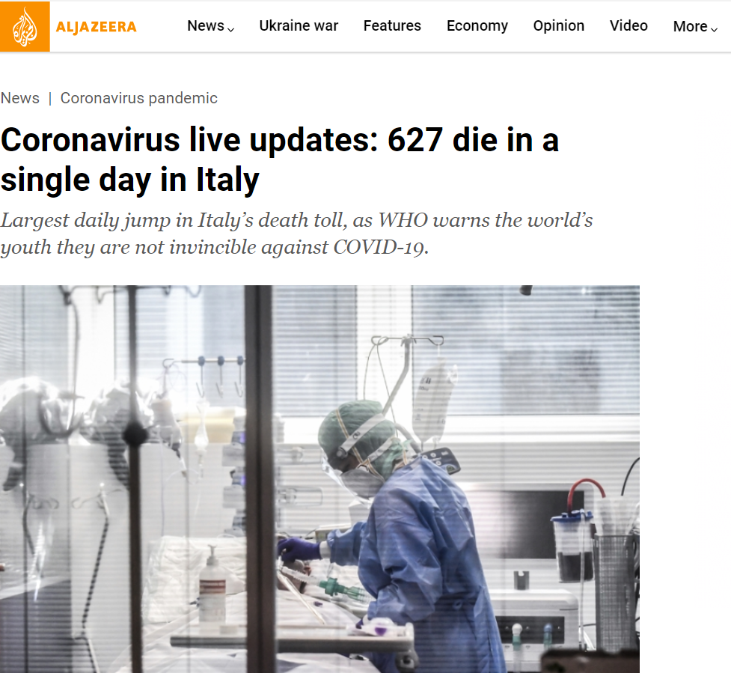

Slide 6
Madness at the outset
Pandemic unmatched since 1918
↑ ↑ ↑ Stress
A desire to be able to offer “something” to patients

Slide 7
How do you prepare for the unknown?
Initially, based recommendations on similar diseases…
SARS
Influenza
And repurposing treatments that were already available…

Slide 8
Timeline – Treatments for COVID-19
2020
2021
2022
The trash can of initial treatments

Slide 9
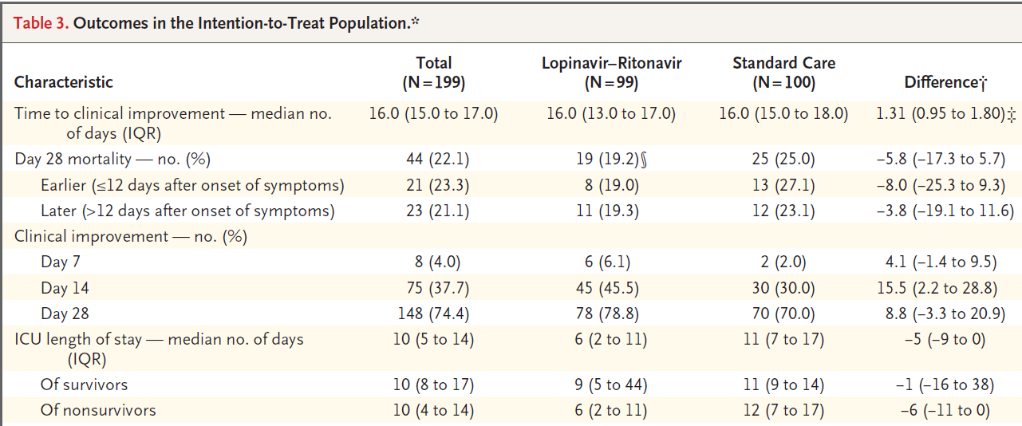
The trash can of initial treatments
Cao et al. NEJM. 2020

Slide 10
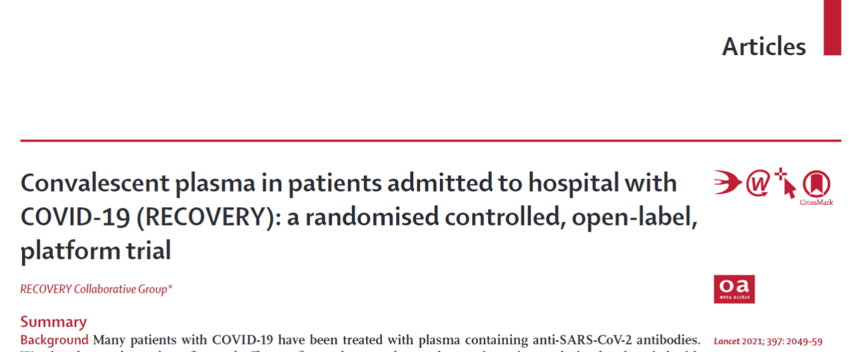
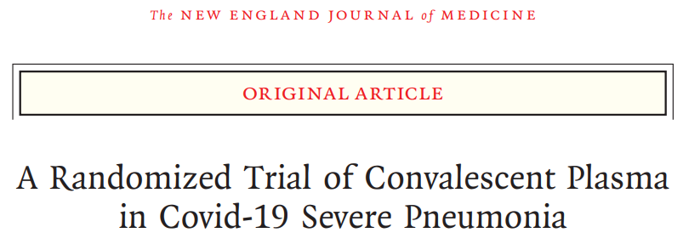
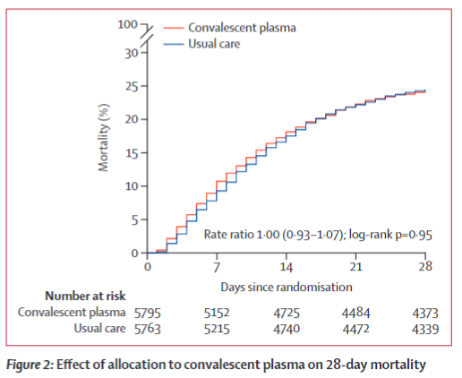
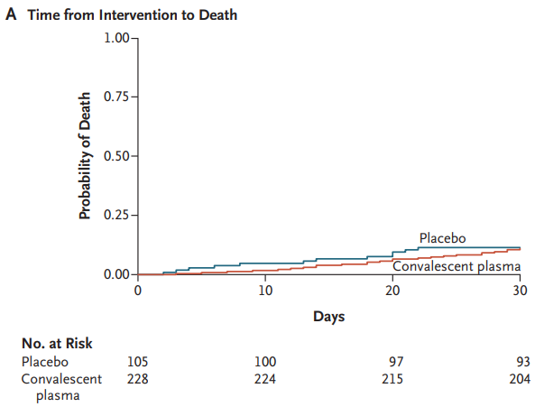
The trash can of initial treatments
RECOVERY. Lancet 2021
Ventura et al. NEJM 2021

Slide 11
Image: FranceInfo

Slide 12
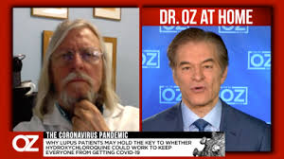
Image: CBS
Image: LaProvence
“... he is said to keep a marble statue of himself.”
-NY Times

Slide 13
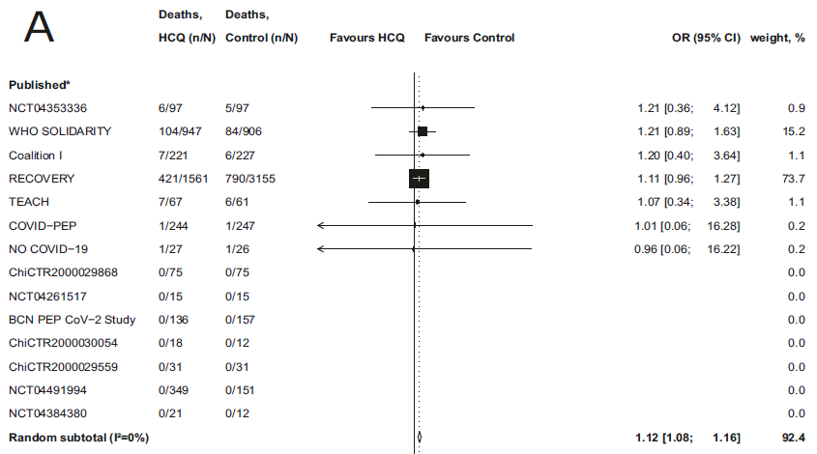
The trash can of initial treatments
Axfors et al. Nature Comm 2021

Slide 15
Evidence-based practice
EBP
Best available evidence
Patient values and circumstances
Clinical expertise
Contextual practice information
Mayer, D. (2010). Essential evidence-based medicine (2nd ed.). Cambridge: Cambridge University Press.

Slide 16
Identifying information types
Systematic reviews of RCTs
Ex: Cochrane systematic reviews
RCT
Controlled clinical studies
Observational studies
Case studies, anecdotes, personal opinions

Slide 17
Deficiencies in evidence-based practice
EBP hijacked by external interests (ex: industry)
The volume of evidence is unmanageable
Statistically significant results can be marginal at the clinical level
Evidence-based guidelines often do not fit well with complex comorbidities
Greenhalgh et al. BMJ 2014;38:g3725.

Slide 18
Back to basics
Make ethical patient care your top priority
Require individualized evidence in a format understandable to clinicians and patients
Clinical Judgment > Mechanical Rules
Share decisions with patients through meaningful discussions
Bring back human aspects of care
Greenhalgh et al. BMJ 2014;38:g3725.

Slide 19
Clinical Trials vs. Adaptive studies
Adobe Stock
Adobe Stock

Slide 20
Adaptive Platform Studies
General objective
Finding the best treatment for a disease by simultaneously investigating multiple treatments,
Master protocols allow for the addition of new interventions
Accumulated data can be used to adjust randomization to better performing treatments
Frequent use of Bayesian probabilities to determine decision algorithms
Interactions between different interventions in different areas can be assessed
JAMA 2015;313:1619-20

Slide 21
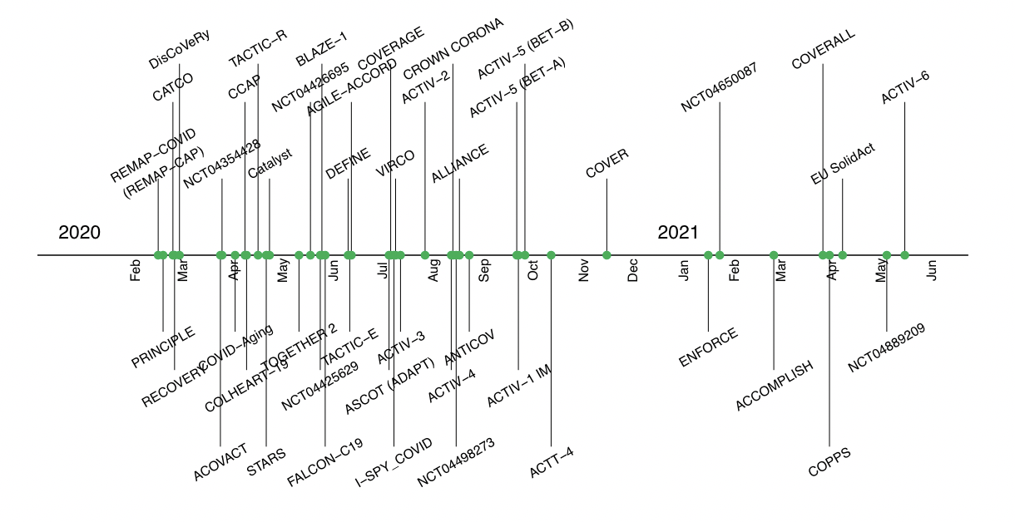
Platform studies in COVID-19
Between 2001 and 2019, 16 platform studies were registered
Between January 2020 and May 2021, 58 were registered
Contemporary Clinical Trials 112;2022:10662

Slide 22
Timeline – Treatments for COVID-19
Dexamethasone
2020
2021
2022
- Lopinavir/ritonavir
- Hydroxychloroquine
- Convalescent plasma

Slide 23
Corticosteroids

Slide 24
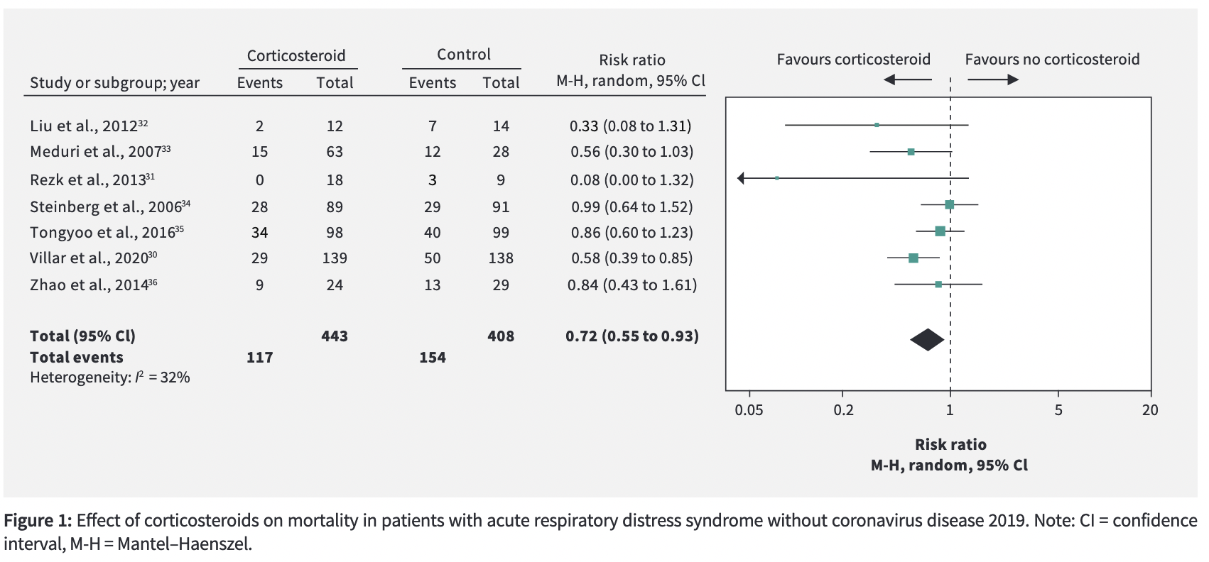
CMAJ 2020 July 6;192:E756-67

Slide 25
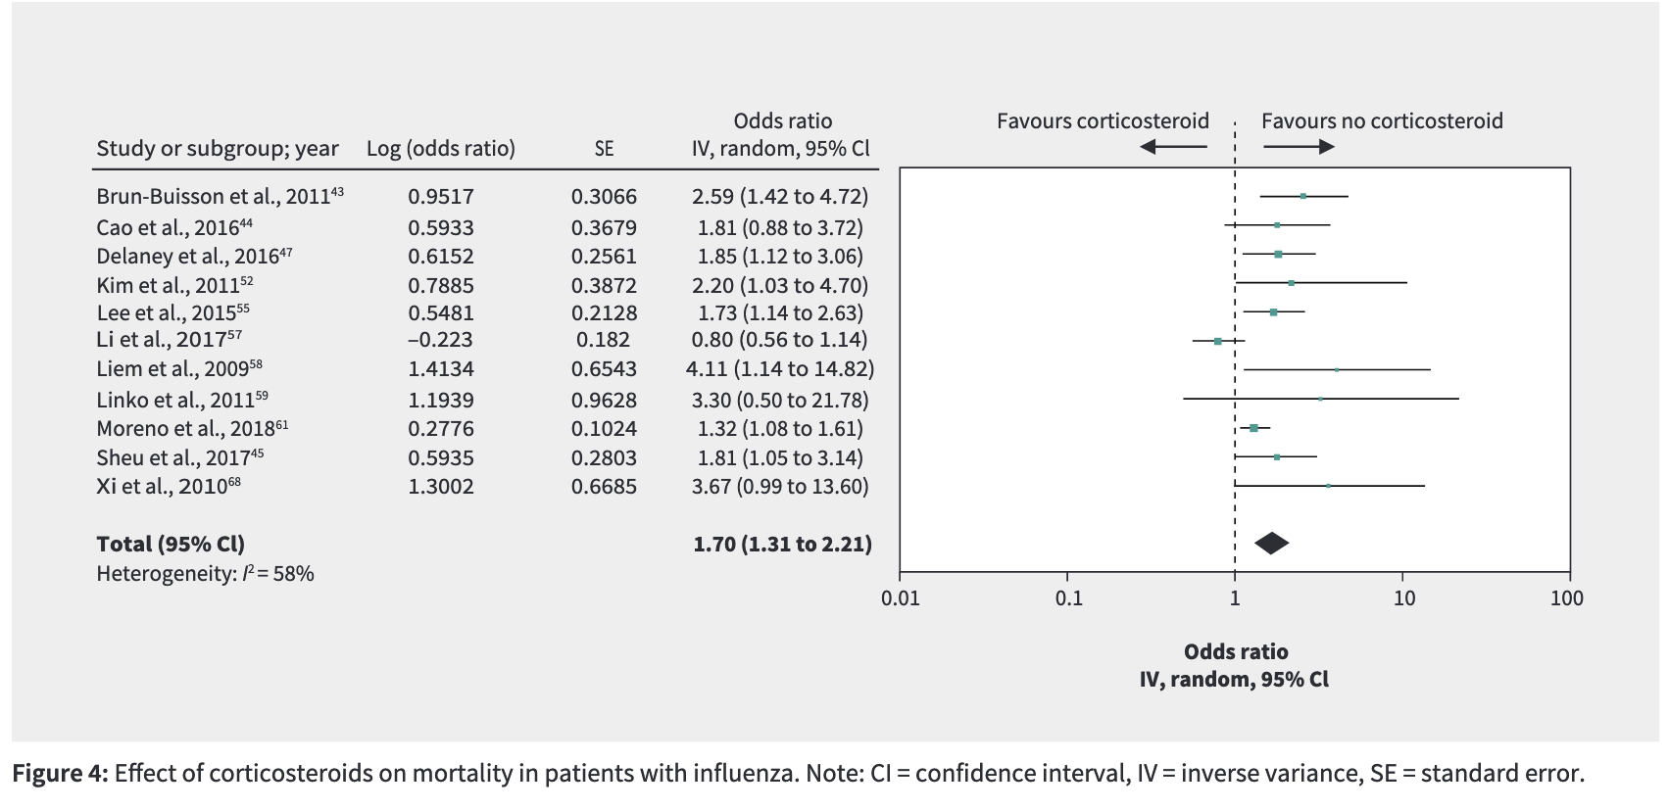
CMAJ 2020 July 6;192:E756-67

Slide 26
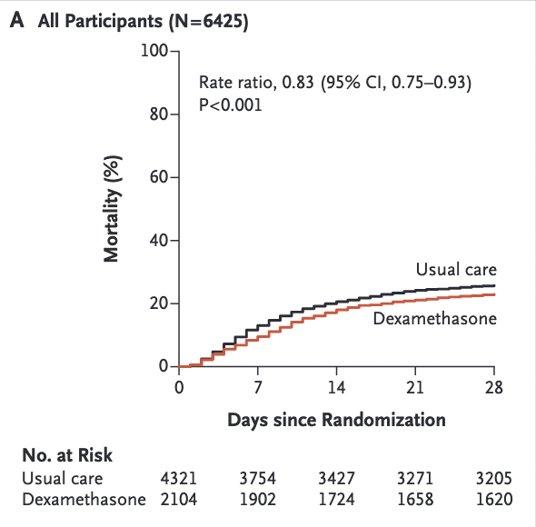
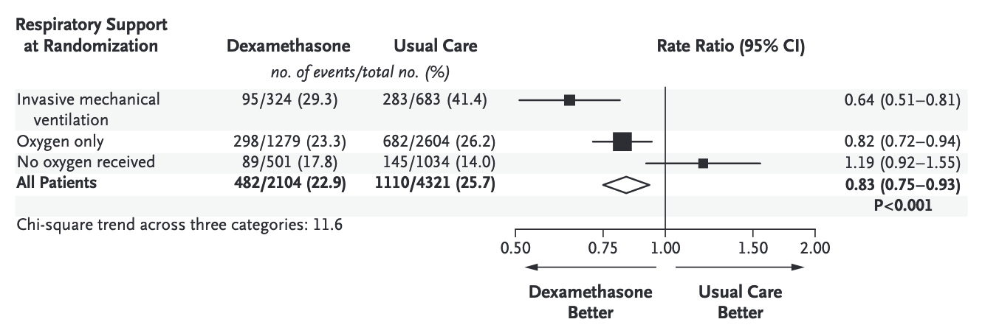
Open-label RCT in 176 UK sites
Hospitalized with COVID-19
Dexamethasone 6 mg X 10 days
2:1 randomization
Primary outcome: 28-day mortality
N Engl J Med 2021;384:693-704.

Slide 27
Timeline – Treatments for COVID-19
Dexamethasone
Tocilizumab
2020
2021
2022
- Lopinavir/ritonavir
- Hydroxychloroquine
- Convalescent plasma

Slide 28
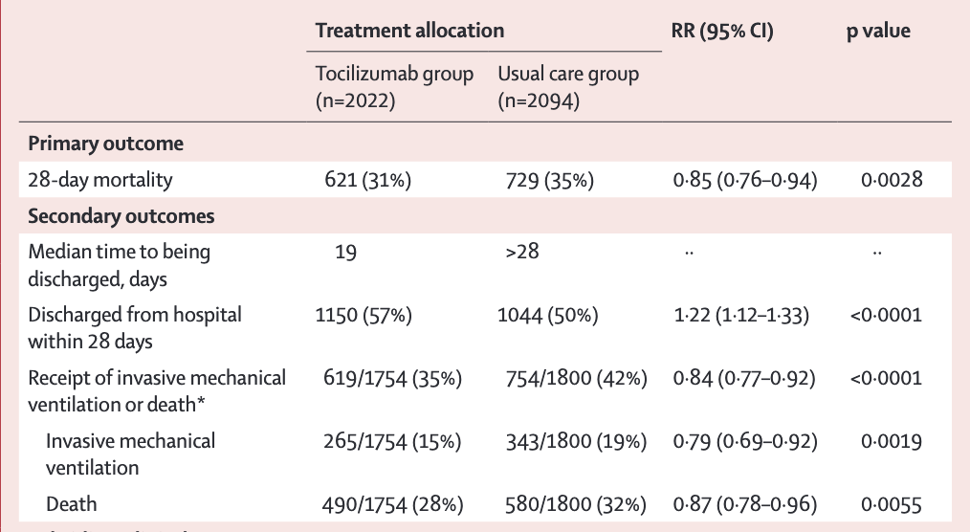
Open-label RCT
COVID-19
Sp0₂ < 92% or suppl. O₂
CRP ≥ 75 mg/L
Tociluzimab 400-800mg
28-day mortality
Lancet 2021; 397: 1637–45

Slide 29
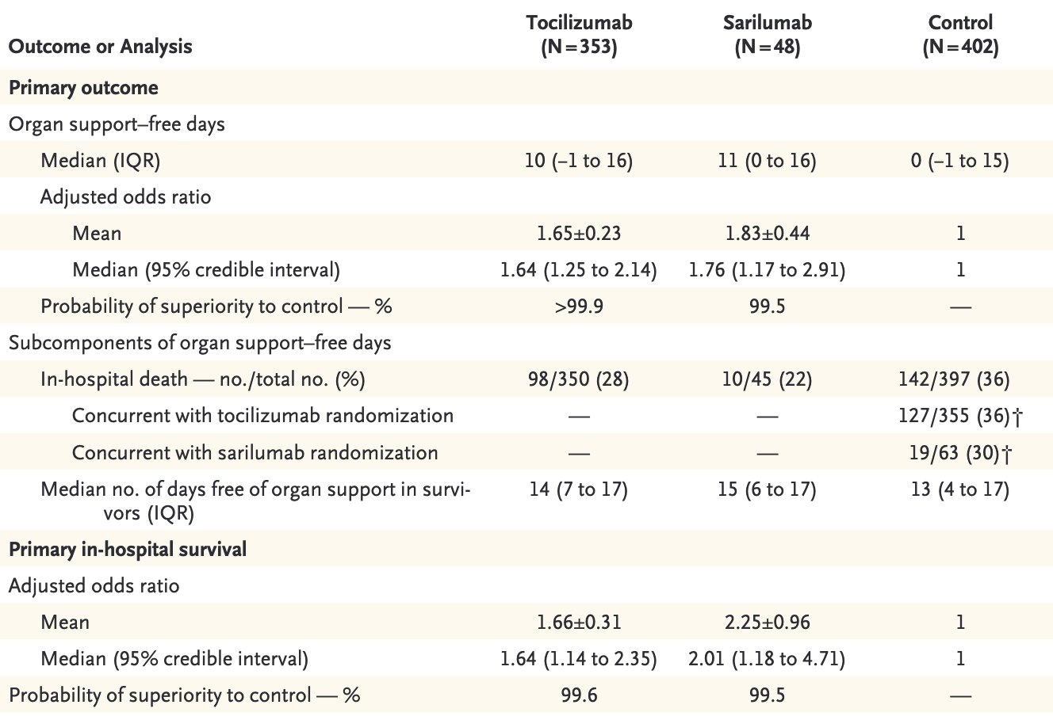
Platform open-label RCT
< 24h ICU with COVID-19
MV, NIV, CV support
Tociluzimab 8mg/kg IV
Sarilumab 400mg IV
Primary endpoint:
Composite in-hospital mortality
and organ support-free days to
day 21
N Engl J Med 2021;384:1491-502.

Slide 30
Timeline – Treatments for COVID-19
Dexamethasone
Tocilizumab
2020
2021
2022
- Lopinavir/ritonavir
- Hydroxychloroquine
- Convalescent plasma
- Colchicine
- Ivermectin

Slide 31
Colchicine - COLCORONA
Press release
Results
Image: Business Insider

Slide 32
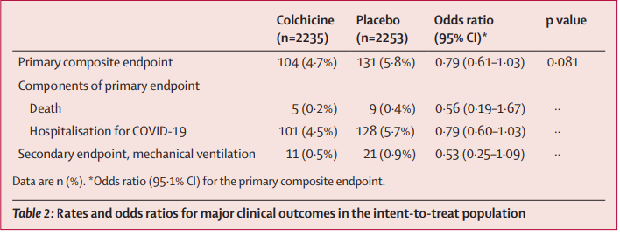
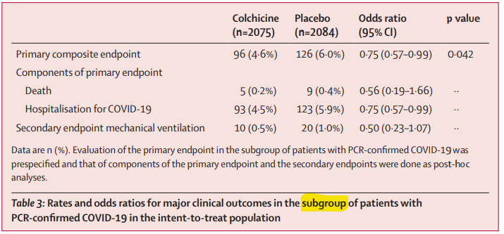
VERY fragile results
*Stopped prematurely
Tardif et al. Lancet 2021

Slide 34
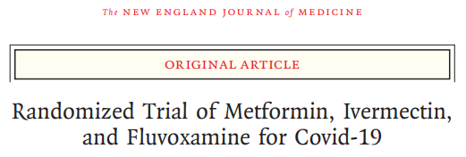
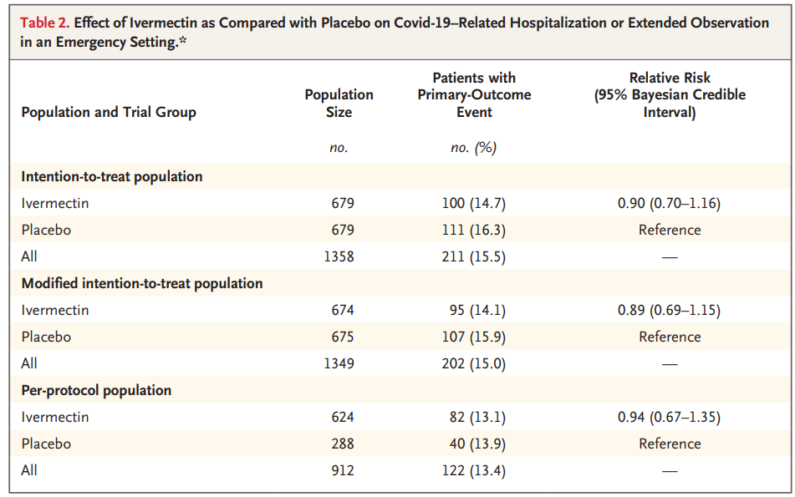
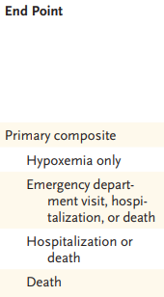
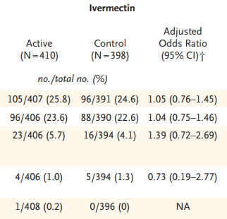
TOGETHER. NEJM 2022
COVID-OUT. NEJM 2022

Slide 35
Timeline – Treatments for COVID-19
Dexamethasone
Tocilizumab
Baricitinib
2020
2021
2022
- Lopinavir/ritonavir
- Hydroxychloroquine
- Convalescent plasma
- Colchicine
- Ivermectin

Slide 36
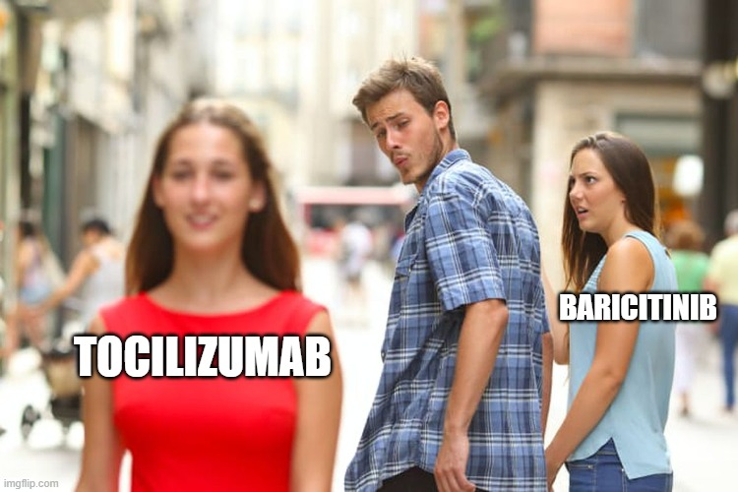
Baricitinib
JAK inhibitor
Initially studied with remdesivir
ACTT-2

Slide 37
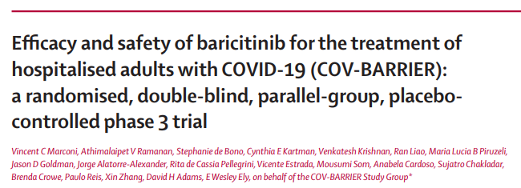
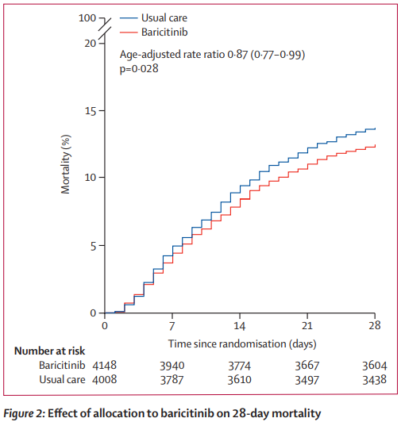
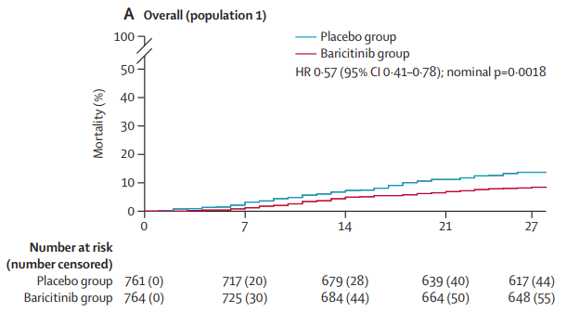
N= 8156
N= 1525
Marconi. Lancet Respir Med 2021
RECOVERY. Lancet 2022

Slide 38
Timeline – Treatments for COVID-19
Dexamethasone
Tocilizumab
Baricitinib
Anticoagulation
2020
2021
2022
- Lopinavir/ritonavir
- Hydroxychloroquine
- Convalescent plasma
- Colchicine
- Ivermectin

Slide 39
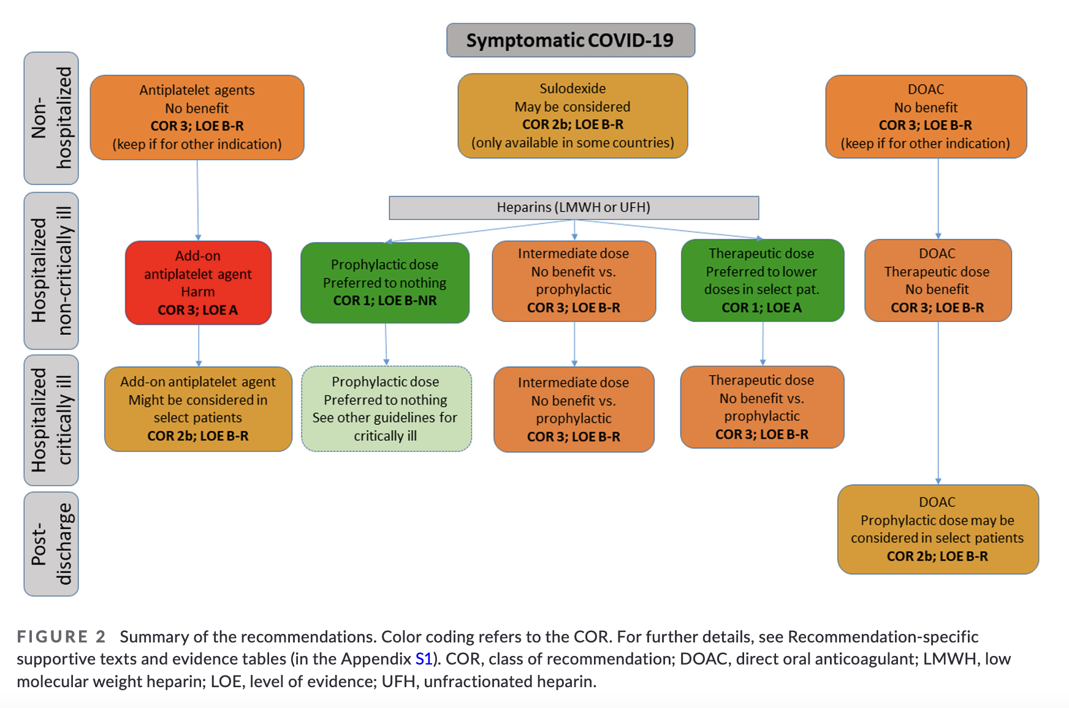
Anticoagulation
J Thromb Haemost. 2022;20:2214–2225

Slide 40
Timeline – Treatments for COVID-19
Dexamethasone
Tocilizumab
Baricitinib
Anticoagulation
2020
2021
2022
- mAbs
- Lopinavir/ritonavir
- Hydroxychloroquine
- Convalescent plasma
- Colchicine
- Ivermectin
- Fluvoxamine

Slide 41
mAbs anti-SARS-CoV-2

Slide 42
Anti-SARS-CoV-2 mAbs
Bamlanivimab approved
Sotrovimab approved
Sotrovimab no longer recommended
Bamlanivimab no longer recommended
2020
2021
2022
Casirivimab / imdevimab approved
Casirivimab / imdevimab no longer recommended
Wuhan
Delta
Omicron BA.2
Alpha
Omicron BA.1
Omicron BA.5

Slide 43
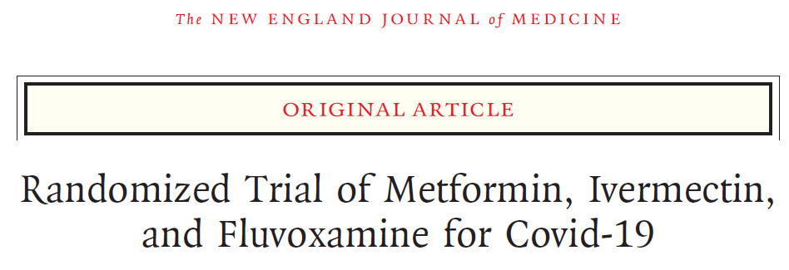
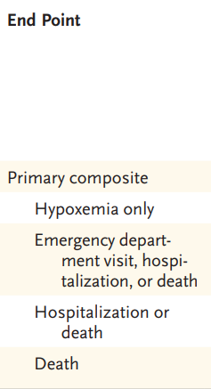
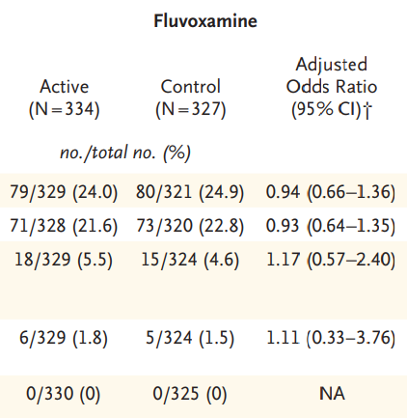
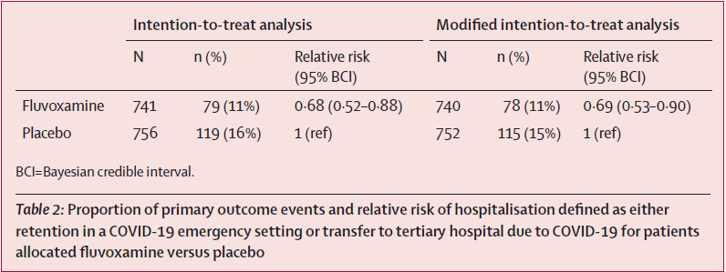
Fluvoxamine
Reis. Lancet Glob Health 2021
Bramante. NEJM 2022

Slide 44
Timeline – Treatments for COVID-19
Remdesivir Nirmatrelvir/ritonavir
Dexamethasone
Tocilizumab
Baricitinib
Anticoagulation
2020
2021
2022
- mAbs
- Lopinavir/ritonavir
- Hydroxychloroquine
- Convalescent plasma
- Colchicine
- Ivermectin
- Fluvoxamine

Slide 45
Remdesivir

Slide 46
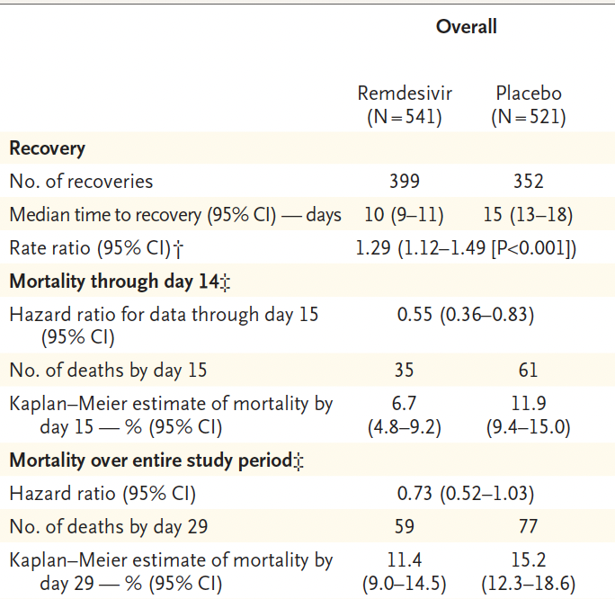
Primary outcome
Time to recovery, defined by
discharge from the hospital or
hospitalization for
infection-control purposes only.
Randomization stratified by
study site and disease severity
at enrollment.
Median time (IQR)
from symptom onset to
randomization was 9 (6-12) days
N Engl J Med 2020;383:1813-26.

Slide 47
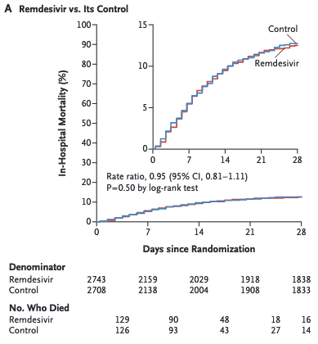
405 hospitals in 30 countries
Hospitalized with COVID-19
Remdesivir 200mg X 1
then 100mg X 9 d
Primary outcome:
In-hospital mortality at day 28
N Engl J Med 2021;384:497-511.

Slide 48
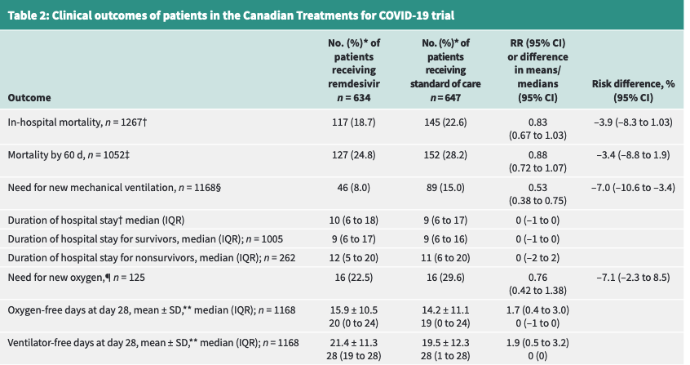
CMAJ 2022;194:E242-5

Slide 49
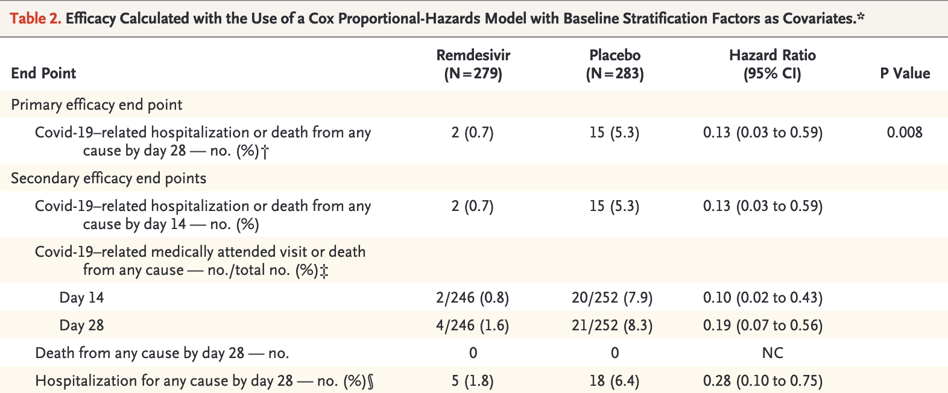
60 years of age or older OR
One preexisting risk factor for progression to severe Covid-19
Risk factors: hyper- tension, cardiovascular or cerebrovascular dis- ease, diabetes mellitus, obesity (BMI ≥30), immune compromise, chronic mild or moderate kidney disease, chronic liver disease, chronic lung disease, current cancer, or sickle cell disease.
N Engl J Med 2022;386:305-15.

Slide 50
Nirmatrelvir/ritonavir
TenorGIF

Slide 51
Nirmatrelvir/ritonavir
EPIC-HR
Unvaccinated high risk patients
2246 participants
During the Delta wave
Results
↓ hospitalisations/death from COVID-19
8/1039 (0.77%) vs. 66/1046 (6.31%); p<0.001
RRR 87.8%
ARR 5.54%; NNT 19
EPIC-HR. NEJM 2022

Slide 52
EPIC-SR
“Standard Risk”
Non-published, non peer-reviewed study
Preliminary results (80% enrollment) only available via press release…
Unvaccinated patients WITHOUT risk factors and vaccinated patients with ≥1 risk factor
No statistically significant impact on hospitalisation
Nirmatrelvir/ritonavir 3/428 (0.7%) vs. Placebo (10/426) 2.4%
RR 0.3 (95%CI 0.08-1.08)
Komorowski AS 2022; Pfizer

Slide 53
Nirmatrelvir/ritonavir
Retrospective study
2260 patients (all vaccinated)
↓ in [ED visits, hospitalisation or death] in treated patients
89/1130 (7.9%) vs. 163/1130 (14.4%) p<0.001
RRR 45%
ARR 6.5%; NNT 16
However…
Ganatra. CID 2022

Slide 54
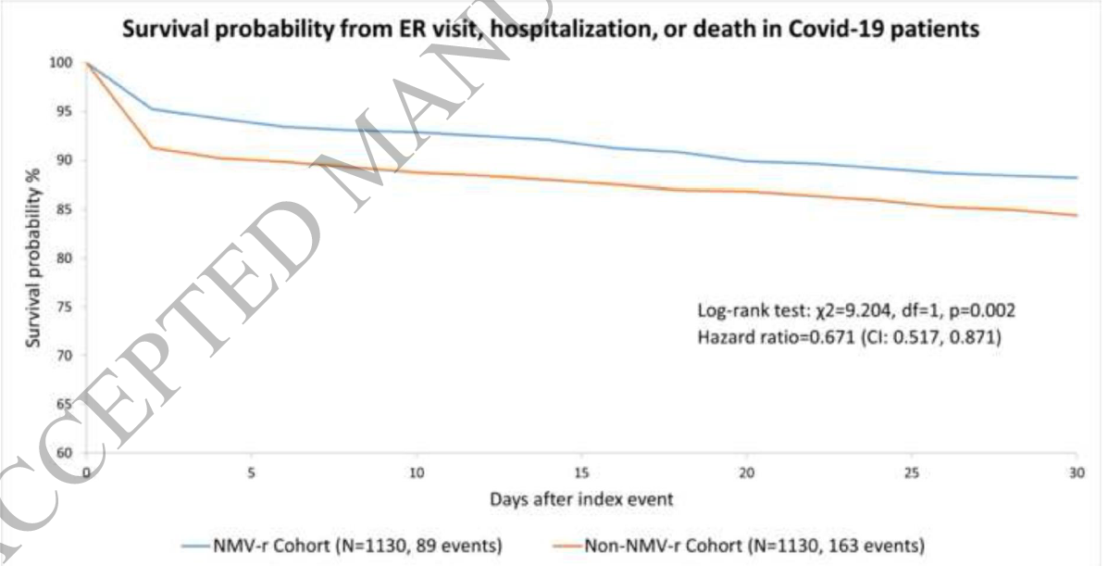
Nirmatrelvir/ritonavir
It is a retrospective study
When we review the Kaplan-Meier curves, it seems like the groups split rapidly within 1-2 days of treatment initiation
Immortal time bias?
Indication bias?
Ganatra. CID 2022

Slide 55
Treatment protocols

Slide 56
Severity of infection | Antiviral | Immunomodulators | Others
Mild-to-moderate Ambulatory NO oxygen requirements | Nirmatrelvir/ritonavir x 5 days or Remdesivir IV x 3 days | None | *Some recommend inhaled corticosteroids (only for symptomatic treatment)
Severe Hospitalized Low flow oxygen | Remdesivir IV x 5 jours | Dexamethasone x 10 days +/- Tocilizumab or baricitinib | Therapeutic anticoagulation can be considered (if not, thromboprophylaxis)
Critical Hospitalized (intensive care) High flow oxygen/ventilation | None | Dexamethasone x 10 days AND Tocilizumab or baricitinib | Thromboprophylaxis

Slide 57
Post-COVID (« long covid »)
We do not know the true incidence
No treatment has been shown to be effective

Slide 58
References
Cao B et al. A Trial of Lopinavir–Ritonavir in Adults Hospitalized with Severe Covid-19. NEJM. 2020. DOI: 10.1056/NEJMoa2001282
RECOVERY Collaborative Group. Convalescent plasma in patients admitted to hospital with COVID-19 (RECOVERY): a randomised controlled, open-label, platform trial. Lancet 2021; 397: 2049–59
Ventura A et al. A Randomized Trial of Convalescent Plasma in Covid-19 Severe Pneumonia. NEJM. 2021; 384:619-629.
Axfors C, Schmitt AM, Janiaud P et al. Mortality outcomes with hydroxychloroquine and chloroquine in COVID-19 from an international collaborative meta-analysis of randomized trials. Nat Commun 12, 2349 (2021). https://doi.org/10.1038/s41467-021-22446-z
Tardif JC et al. Colchicine for community-treated patients with COVID-19 (COLCORONA): a phase 3, randomised, double-blinded, adaptive, placebo-controlled, multicentre trial. Lancet. 2021: doi.org/10.1016/S2213-2600(21)00222-8
Reis G et al (TOGETHER Investigators). Effect of Early Treatment with Ivermectin among Patients with Covid-19. NEJM 2022; 386:1721-1731. DOI: 10.1056/NEJMoa2115869
Marconi VC et al. Efficacy and safety of baricitinib for the treatment of hospitalised adults with COVID-19 (COV-BARRIER): a randomised, double-blind, parallel-group, placebo-controlled phase 3 trial. Lancet Respir Med 2021; 9: 1407–18
RECOVERY Collaborative Group. Baricitinib in patients admitted to hospital with COVID-19 (RECOVERY): a randomised, controlled, open-label, platform trial and updated meta-analysis. Lancet 2022; 400: 359–68
Reis et al (TOGETHER Investigators). Effect of early treatment with fluvoxamine on risk of emergency care and hospitalisation among patients with COVID-19: the TOGETHER randomised, platform clinical trial. Lancet Glob Health 2021. https://doi.org/10.1016/S2214-109X(21)00448-4
Bramante CT et al (COVID-OUT Trial Team). Randomized Trial of Metformin, Ivermectin, and Fluvoxamine for Covid-19. N Engl J Med 2022;387:599-610.
Hammond J et al (EPIC-HR Investigators). Oral Nirmatrelvir for High-Risk, Nonhospitalized Adults with Covid-19. N Engl J Med 2022; 386:1397-1408
Komorowski AS, Tseng A, Vandersluis S, et al. Evidence-based recommendations on the use of nirmatrelvir/ritonavir (Paxlovid) for adults in Ontario. Science Briefs of the Ontario COVID-19 Science Advisory Table. 2022;3(57). https://doi.org/10.47326/ocsat.2022.03.57.1.0
Ganatra S, et al. Oral Nirmatrelvir and Ritonavir in Non-hospitalized Vaccinated Patients with Covid-19. Clin Infect Dis. 2022. doi: 10.1093/cid/ciac673

