Slide 1
Cystic Fibrosis Therapies: A Review of CFTR Modulators in Canada
Lexi Symonds
PharmD, ACPR Candidate

Slide 2
Disclosures
No disclosures or conflicts of interest with the presented material.
Notes:
Cystic fibrosis-related diabetes: novel pathogenic insights opening new therapeutic avenues
Raquel Barrio

Slide 3
Objectives
Describe the pathophysiology of cystic fibrosis through review of Cystic Fibrosis Transmembrane Regulator (CFTR) dysfunction.
Review some common CF genotypes and their resultant CFTR defects.
Describe the mechanisms of action of current CFTR modulators (potentiators and correctors).
Review the evidence for each of the currently available CFTR modulators in Canada: Kalydeco (ivacaftor), Orkambi (lumacaftor/ivacaftor), Symdeko (tezacaftor/ivacaftor), and Trikafta (ivacaftor/tezacaftor/elexacaftor)
Outline indications, administration, and relevant pearls for pharmacy professionals who may encounter CFTR modulators.

Slide 4
What is Cystic Fibrosis?
Rare disease affecting more than 4,300 Canadians
Multisystem, most morbidity & mortality from lung and digestive system effects.
Defects in the Cystic Fibrosis Transmembrane Regulator (CFTR) protein causes thick mucus and protein build up that damages the lung, digestive tract, pancreas, liver, etc.
Secondary complications: micro and macronutrient malabsorption, CF Related Diabetes (CFRD), infertility, osteoporosis, chronic sinusitis, nephrolithiasis, Distal Intestinal Obstruction Syndrome (DIOS), CF-associated Liver Disease (CFLD), psychiatric complications
Estimated median age of survival in Canada is increasing as treatments improve
35.9 in 2001
57.3 in 2021
Notes:
97-98% congenital absence of vas deferens causing azoospermia,
Poor nutrition reduces quality ovulation, thicker cervical mucus can cause reduced but usually not complete female infertility

Slide 5
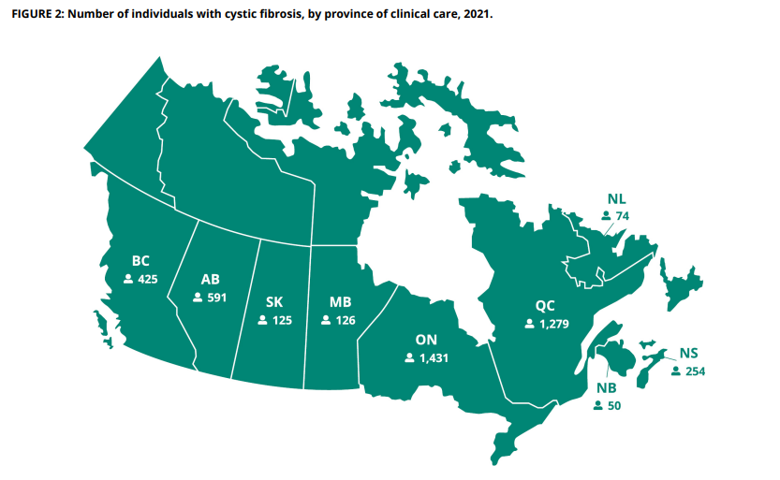

Slide 6
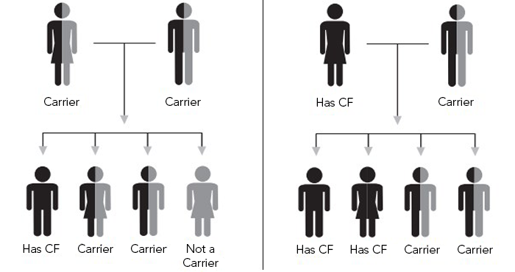
Cystic Fibrosis Genetics
An autosomal recessive condition
Both parents must be carriers
If both carriers:
25% risk baby has CF
50% risk baby is carrier
If one CF, other carrier:
50% risk baby has CF
50% risk baby is carrier
Carrier rates:
1 in 30 Caucasian-Americans
1 in 46 Hispanic-Americans
1 in 65 African-Americans
1 in 90 Asian-Americans
Notes:
Could add # of live births in Canada with CF

Slide 7
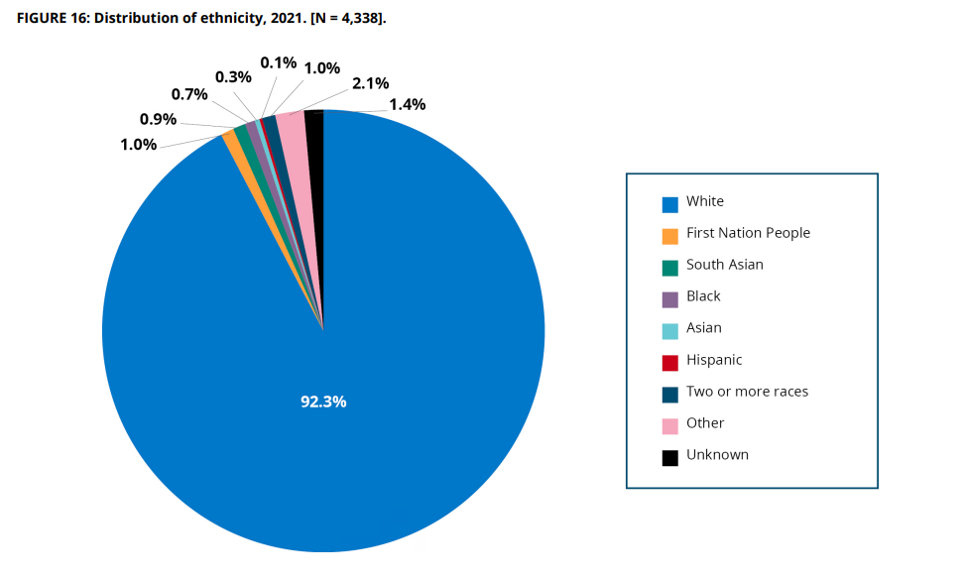
Distribution of Ethnicity in Canada

Slide 8
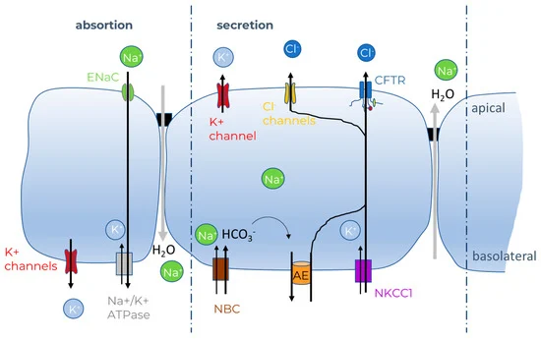
Pathogenesis: CFTR function
CFTR gene discovered in 1989
CFTR expressed in many tissues, mainly affects chloride transport
Gene mutations result in defects in CFTR production and/or function
Ineffective CFTR – reduced chloride excretion = thick mucous secretions

Slide 9
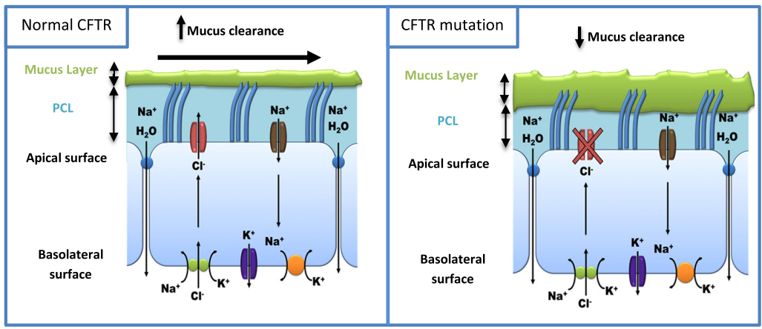
Pathogenesis: CFTR dysfunction
PCL – periciliary liquid

Slide 10
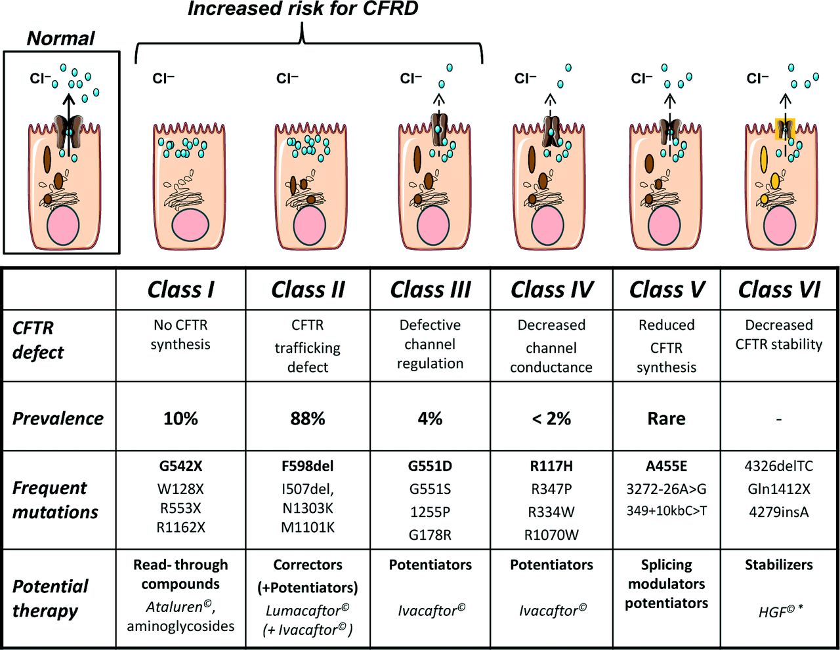
No CFTR made
CFTR doesn’t get to surface
CFTR doesn’t open at all
CFTR doesn’t open very well
Not enough CFTR made
CFTR is physically unstable
Notes:
Cystic fibrosis-related diabetes: novel pathogenic insights opening new therapeutic avenues
Raquel Barrio
Delta 508 is mostly a trafficking defect, but also exhibits issues with gating,

Slide 11
Genotype vs Phenotype
Genotype – the type of mutation you have (ex. G551D, F508del)
Phenotype – the way the disease presents (features, severity, onset)
In general, more severe mutations (type I-III) typically result in more severe disease compared to less severe mutations (type IV-VI)
Phenotype = (genotype x other modifying genetic factors x environment)
Pancreatic insufficiency highly reliant on genotype, lung disease more multifactorial
Note: F508del usually results in both lung disease and pancreatic insufficiency. Main mutation is lack of stable protein at surface, though gating defects also contribute.

Slide 12
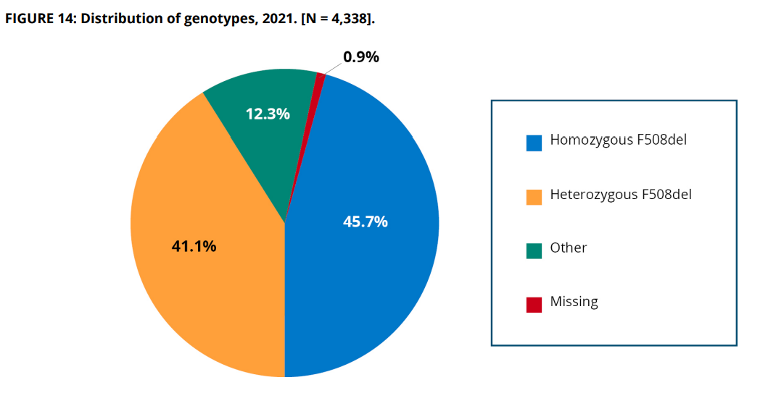
Genotypes in Canada
G551D is the 3rd most common at 3.2%
Notes:
Cystic fibrosis-related diabetes: novel pathogenic insights opening new therapeutic avenues
Raquel Barrio

Slide 13
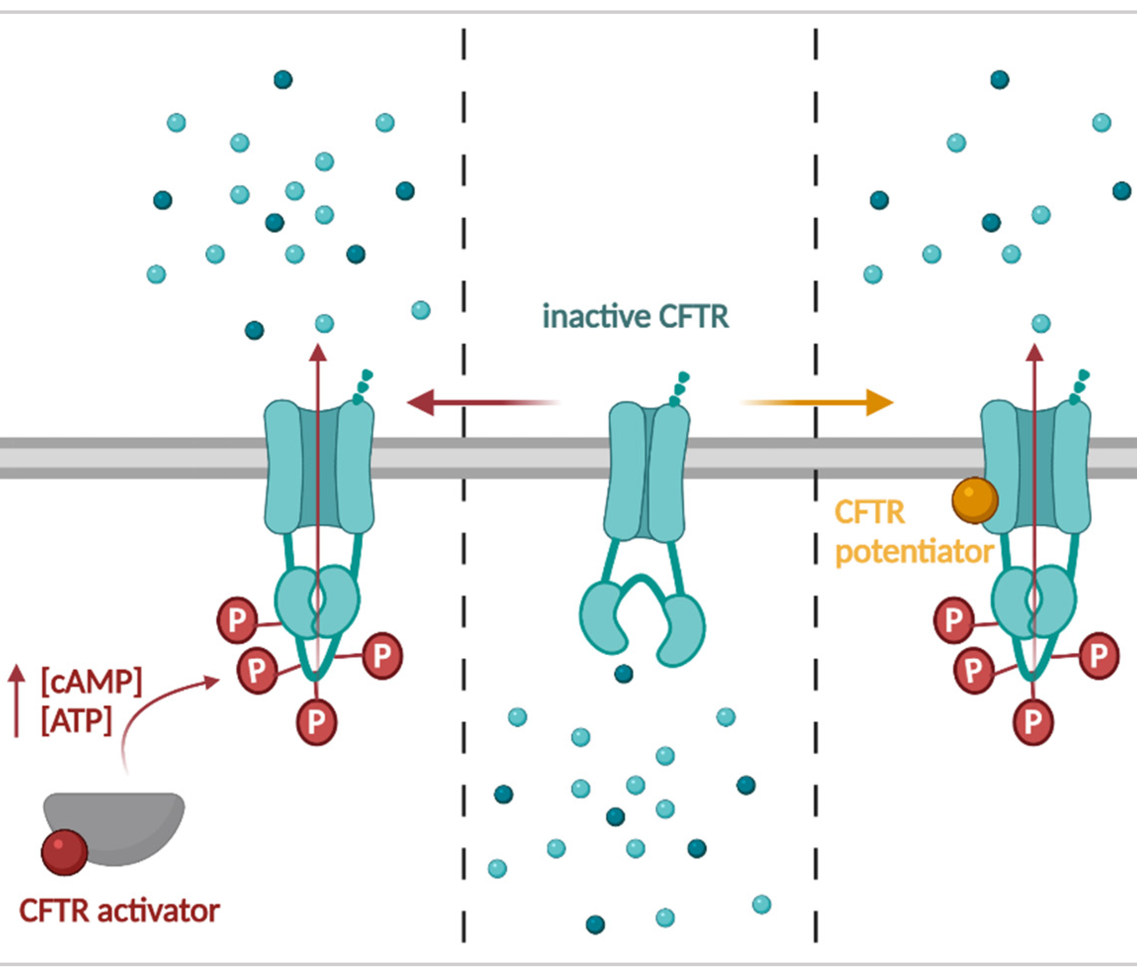
CFTR Modulators: Potentiators
Potentiators aid with channel FUNCTION
No effect on protein stability, trafficking
Increases probability that CFTR channel is open
Not helpful alone if there’s no CFTR protein available
Examples: ivacaftor

Slide 14
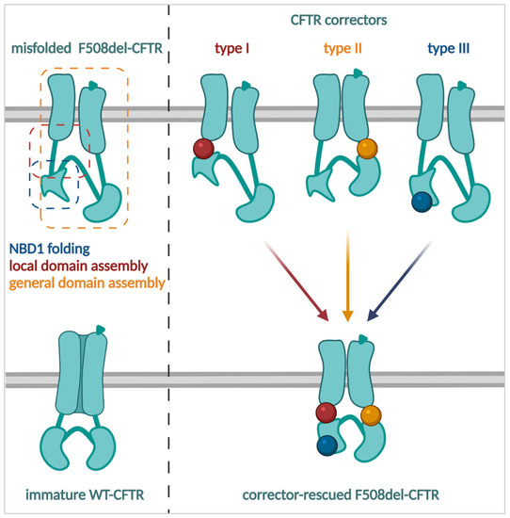
CFTR Modulators: Correctors
Correctors aid with protein STABILITY & TRAFFICKING
Improves protein folding to increase stability
Aids in CFTR processing, stability and transport of protein to cell surface
Different types target different protein binding sites to create conformational change
Examples:
Type 1: lumacaftor, tezacaftor
Type 3: elexacaftor
Notes:
Type 1 – luma and teza
Type 3 - elexacaftor

Slide 15
CFTR Modulators in Canada
potentiator +
2nd gen corrector + next gen corrector
Kalydeco (ivacaftor)
Orkambi (lumacaftor/ ivacaftor)
Symdeko (tezacaftor/ ivacaftor)
Trikafta (elexacaftor/ tezacaftor/ivacaftor)
Approved in 2012
Additional mutations approved 2014
Approved in 2016
Approved in 2018
Approved in 2021 (12+)
Age 6+ approved 2022
National drug coverage Sept 2022
Homozygous F508del (or heterozygous F508del + residual function mutation)
Heterozygous F508del
At least one G551D or other gating defect (10)
4% of CF population
Homozygous F508del
46% of CF population
50% of CF population
90% of CF population
4 months or older
1 year or older
12 years or older
potentiator +
1st gen corrector
potentiator +
2st gen corrector
potentiator

Slide 16
Remember: Genotypes in Canada
Symdeko
or
Orkambi
Trikafta
G551D is the 3rd most common at 3.2%
← Kalydeco
Notes:
Cystic fibrosis-related diabetes: novel pathogenic insights opening new therapeutic avenues
Raquel Barrio

Slide 17
CFTR Modulator Review of Evidence
The Trials
A review of each phase 3 trial for the 4 CFTR modulators prior to submission for approval in Canada
Trial Results: Efficacy
Efficacy data highlights
Trial Results: Safety
Safety data highlights

Slide 18
Kalydeco (ivacaftor) Phase 3 Trial
P: | 161 patients with CF at least 12 years or older who have at least one G551D mutation
I: | Ivacaftor 150 mg PO BID
C: | Placebo
O: | Estimated mean change in FEV₁ from baseline at 24 weeks (+ maintenance of effect at 48 weeks)

Slide 19
Kalydeco (ivacaftor) Trial Results: Efficacy
Outcome | Result | P-value
Change in FEV₁ (absolute) | 10.6% (8.6-12.6%) increase in FEV₁ in treatment group vs. placebo at 24 weeks (10.5% (8.5-12.5%) p < 0.001) at 48 weeks) | <0.001
Change in FEV₁ (relative) | 16.9% (13.6-20.2%) change from baseline in ivacaftor group, 0.1% change in placebo group | <0.001
Risk of pulmonary exacerbation | Hazard ratio 0.455 (55% reduction) in ivacaftor group vs placebo | 0.001
Score on CFQ-R respiratory domain* | Increase of 5.9 points in ivacaftor group, decrease of 2.7 points in placebo group (treatment effect 8.6 points) | <0.001
Sweat chloride change from baseline (mean in both groups ~ 100 mmol/L) | -48.7 mmol/L ivacaftor group, -0.8 mmol/L placebo group (treatment effect = -47.9 mmol/L (-51.3 to -44.5 mmol/L) | <0.001
*A difference of 4 points was considered a clinically significant change
Notes:
Overall, five adverse events led to discontinuation: four in the placebo group (increased hepatic enzyme levels, atrioventricular block, panic attack, and respiratory failure) and one in the ivacaftor group (increased hepatic enzyme levels)

Slide 20
Cystic Fibrosis Questionnaire
A scoring tool of self-reported symptoms to gauge perceived quality of life for patients with CF.
Validated tool, used clinically and in research
Scored 0-100 with higher scores indicating greater quality of life.
Ex. Respiratory section:

Slide 21
Kalydeco (ivacaftor) Trial Results: Safety
Event | Placebo | IVA
Adverse Effect with D/C | 5% | 1%
Serious adverse event | 42% | 24%
Pulmonary exacerbation | 64.1% | 41.0%
Cough | 42.2% | 32.5%
Headache | 16.7% | 22.9%
Nasal congestion | 15.4% | 20.5%
Dizziness | 1.3% | 12.0%
Hemoptysis | 10.3% | 10.8%
Nausea | 11.5% | 15.7%
Rash | 5.1% | 14.5%
Diarrhea | 12.8% | 13.3%
Notes:
Overall, five adverse events led to discontinuation: four in the placebo group (increased hepatic enzyme levels, atrioventricular block, panic attack, and respiratory failure) and one in the ivacaftor group (increased hepatic enzyme levels)

Slide 22
Orkambi (lumacaftor/ivacaftor) Phase 3 Trial
Pooled analysis of 2 studies: TRAFFIC and TRANSPORT (each studied both dosages)
P: | 1108 patients with CF at least 12 years or older who were homozygous for F508del mutations
I: | Lumacaftor 600 mg PO daily + Ivacaftor 250 mg PO BID or Lumacaftor 400 mg po BID + Ivacaftor 250 mg PO BID
C: | Placebo
O: | Estimated mean change in FEV₁ from baseline at 24 weeks

Slide 23
Orkambi (lumacaftor/ivacaftor) Trial Results: Efficacy
Outcome | Result | P-value
Change in FEV₁ (absolute) | 3.3% (2.3 – 4.3%) increase in FEV₁ in LUM 600 mg/day group 2.8% (1.8 – 3.8%) increase in FEV₁ in LUM 400 mg BID group | <0.001 <0.001
Change in FEV₁ (relative) | 5.6% (3.8 – 7.3%) change in FEV₁ in LUM 600 mg/day group 4.8% (3.0 – 6.6%) change in FEV₁ in LUM 400 mg BID group | <0.001 <0.001
Risk of pulmonary exacerbation | 0.70 (0.56-0.87) rate ratio for LUM 600 mg/day group 0.61 (0.49-0.76) rate ratio for LUM 400 mg BID group | 0.001 <0.001
Score on CFQ-R respiratory domain | Increase of 3.1 points (0.8-5.3) in 600 mg/day LUM group Increase of 2.2 points (0.0-4.5) in 400 mg BID LUM group. | 0.007 0.05
*A difference of 4 points was considered a clinically significant change

Slide 24
Orkambi (lumacaftor/ivacaftor) Trial Results: Safety
Event | Placebo | LUM 600 mg/day + IVA | LUM 400 mg BID + IVA
Adverse Effect with D/C | 1.6% | 3.8% | 4.6%
Serious adverse event | 28.6% | 22.8% | 17.3%
Pulmonary exacerbation | 49.2% | 39.3% | 35.8%
Cough | 40.0% | 32.8% | 28.2%
Headache | 15.7% | 15.7% | 15.7%
Increase in sputum | 18.9% | 14.9% | 13.0%
Dyspnea | 7.8% | 14.9% | 13.0%
Hemoptysis | 13.5% | 14.1% | 13.6%
Nausea | 7.6% | 7.9% | 12.5%
Chest tightness | 5.9% | 10.8% | 8.7%
Nasopharyngitis | 10.8% | 6.2% | 13.0%

Slide 25
Symdeko (tezacaftor/ivacaftor) Phase 3 Trial
P: | 510 patients with CF at least 12 years or older who were homozygous for F508del mutations
I: | Tezacaftor 100 mg PO daily + Ivacaftor 150 mg PO BID
C: | Placebo
O: | Estimated mean change in FEV₁ from baseline at 24 weeks
Notes:
Tezacaftor-Ivacaftor in Patients with Cystic Fibrosis Homozygous for Phe508del - PubMed (nih.gov)

Slide 26
Symdeko (tezacaftor/ivacaftor) Trial Results: Efficacy
Outcome | Result | P-value
Change in FEV₁ (absolute) | 4.0% (3.1-4.8%) increase in FEV₁ points in TEZ/IVA group vs placebo (3.4% (2.7-4.0) increase with TEZ/IVA vs -0.6% (-1.3-0.0%) with placebo) maintained to 24 weeks | <0.001
Change in FEV₁ (relative) | 6.8% (5.3-8.3%) relative difference from baseline with TEZ/IVA group vs placebo (6.3% (5.1-7.4) increase with TEZ/IVA vs -0.5% (-1.7-0.6%) with placebo) maintained to 24 weeks | <0.001
Risk of pulmonary exacerbation | 0.65 (0.48 – 0.88) risk ratio TEZ/IVA vs placebo maintained to 24 weeks | 0.005
Score on CFQ-R respiratory domain* | 5.1 (3.2-7.0) point differences in TEZ/IVA vs placebo (5.0 (3.5-6.5) increase with TEZ/IVA vs -0.1 (-1.6-1.4) with placebo) maintained to 24 weeks
*A difference of 4 points was considered a clinically significant change
Notes:
Overall, five adverse events led to discontinuation: four in the placebo group (increased hepatic enzyme levels, atrioventricular block, panic attack, and respiratory failure) and one in the ivacaftor group (increased hepatic enzyme levels)

Slide 27
Symdeko (tezacaftor/ivacaftor) Trial Results: Safety
Event | Placebo | TEZ/IVA
Adverse Effect with D/C | 3.1% | 2.8%
Serious adverse event | 18.2% | 12.4%
Pulmonary exacerbation | 37.2% | 29.9%
Cough | 32.6% | 26.3%
Headache | 14.3% | 17.5%
Increase in sputum | 16.3% | 14.3%
Pyrexia | 12.4% | 11.2%
Hemoptysis | 13.6% | 10.4% *
Nasopharyngitis | 15.1% | 16.7%
Fatigue | 12.0% | 6.4%
Oropharyngeal Pain | 11.2% | 8.8%
Nausea | 7.0% | 9.2%
*One patient in TEZ/IVA group had a life-threatening episode of hemoptysis

Slide 28
Trikafta (ivacaftor/tezacaftor/elexacaftor) Phase 3 Trial
P: | 403 patients with CF at least 12 years or older who are heterozygous for F508del and a minimal function mutation*
I: | Elexacaftor 200 mg PO daily + Tezacaftor 100 mg PO daily + Ivacaftor 150 mg PO BID
C: | Placebo
O: | Estimated mean change in FEV₁ from baseline at 4 weeks (up to 24 weeks)
*Minimal function = no protein created or lack of response to CFTR modulators
Notes:
Elexacaftor–Tezacaftor–Ivacaftor for Cystic Fibrosis with a Single Phe508del Allele | NEJM
Nanomolar-potency ‘co-potentiator’ therapy for cystic fibrosis caused by a defined subset of minimal function CFTR mutants | Scientific Reports (nature.com)
Phase 2 study worked in the heterozygous population so they went on to confirm in the phase 3
The nature article described what minimal function is

Slide 29
Trikafta (elexacaftor/tezacaftor/ivacaftor) Trial Results: Efficacy
Outcome | Result | P-value
Change in FEV₁ (absolute) to week 4 (95% CI) | 13.8% (12.1-15.4%) increase in FEV₁ in ELX/TEZ/IVA group vs placebo (13.6% (12.4-14.8%) for ELX/TEZ/IVA vs -0.2% (-1.3-1.0%) for placebo) at week 4 | <0.001
Change in FEV₁ (absolute) to week 24 (95% CI) | 14.3% (12.7-15.8%) increase in FEV₁ in ELX/TEZ/IVA vs placebo (13.9% (12.8-15.0%) for ELX/TEZ/IVA vs -0.4% (-1.5-0.7%) for placebo) at week 24 | <0.001
Risk of pulmonary exacerbation | 0.37 (0.25-0.55) risk ratio for ELX/TEZ/IVA vs placebo (0.37 event rate vs annualized estimated event rate with ELX/TEZ/IVA vs 0.98 event rate vs AEER with placebo) through week 24 | <0.001
Notes:
Overall, five adverse events led to discontinuation: four in the placebo group (increased hepatic enzyme levels, atrioventricular block, panic attack, and respiratory failure) and one in the ivacaftor group (increased hepatic enzyme levels)

Slide 30
Trikafta (elexacaftor/tezacaftor/ivacaftor) Trial Results: Efficacy (etc)
Outcome | Result | P-value
Score on CFQ-R respiratory domain* through week 24 (95% CI) | 17.5 (15.6 to 19.5) point change in CFQR in ELX/TEZ/IVA group vs -2.7 (-4.6 to -0.8) point change in CFQR in placebo group. Treatment effect 20.2 (17.5 to 23.0) at week 24 | <0.001
Sweat chloride at week 4 (95% CI) | -41.2 (-43.1 to -39.2) mmol/L change in ELX/TEZ/IVA group vs 0.1 (-1.9 to 2.0) in placebo group at week 4 | <0.001
Absolute change in BMI at week 24 (95% CI) | 1.13 (0.99 to 1.26) in ELX/TEZ/IVA group vs 0.09 (-0.05 to 0.22) in placebo group. Treatment effect 1.04 (0.85 to 1.23) | <0.001
*A difference of 4 points was considered a clinically significant change
Notes:
Overall, five adverse events led to discontinuation: four in the placebo group (increased hepatic enzyme levels, atrioventricular block, panic attack, and respiratory failure) and one in the ivacaftor group (increased hepatic enzyme levels)

Slide 31
Trikafta (elexacaftor/tezacaftor/ivacaftor) Trial Results: Safety
Event | Placebo | ELX/TEZ/IVA
Adverse Effect with D/C | 0% | 1.0%
Serious adverse event | 20.9% | 13.9%
Pulmonary exacerbation | 47.3% | 21.8%
Cough | 38.3% | 16.8%
Increase in sputum | 19.8% | 19.4%
Hemoptysis | 13.9% | 5.4%
Fatigue | 10.0% | 4.5%

Slide 32
Trikafta (elexacaftor/tezacaftor/ivacaftor) Trial Results: Safety
Event | Placebo | ELX/TEZ/IVA
Headache | 14.9% | 17.3%
Nasopharyngitis | 12.9% | 10.9%
Oropharyngeal pain | 12.4% | 9.9%
Upper Respiratory Tract Infection | 10.9% | 11.9%
Increased LFTs | 4.0% | 10.9%
Rash | 6.5% | 10.9%

Slide 33
CFTR Modulator Pearls for Pharmacy Professionals
Administration, side effects, drug interactions

Slide 34
Kalydeco (ivacaftor)
Indication | Approved in Canada for patients 4 months or older (and > 5 kg) with at least one G551D, G1244E, G1349D, G178R, G551S, S1251N, S1255P, S549N, S549R, or R117H mutation. (not effective for homozygous F508del)
Dosage Forms | Oral granules: 25 mg/packet, 50 mg/packet, 75 mg/packet Oral tablets: 150 mg tablets
Dosing | Weight based BID dosing using packets until ≥ 25 kg, then 150 mg PO BID
Dosage adjustment | Renal: No dosage adjustment until < 30 mL/min, then use with caution (not studied) Hepatic: dose adjustments for Child-Pugh Class B, not recommended for Class C

Slide 35
Kalydeco (ivacaftor)
Administration | Granules dissolved in 5 mL soft food or liquid at or below room temperature Take tablets or granules with fat-containing food (improves absorption) Do not chew, crush or split tablets
Drug interactions | 3A4 substrate – dosage adjustments in monograph when combined with strong and moderate inhibitors
Adverse Effects | Headache (17%), URTI (16%), nasal congestion (16%), nausea (10%), rash (10%), rhinitis (6%), dizziness (5%), arthralgia (5%), increased LFTs (<1%), hypoglycemia (<1%), abdominal pain (<1%)
Monitoring | Ophthalmologist follow up (possible association with cataracts w/o impact on vision in children) Monitor AST, ALT prior to starting and q3/12 for first year, then annually Ivacaftor affected male and female fertility in doses >200 mg/kg/day in animal studies

Slide 36
Orkambi (lumacaftor/ivacaftor)
Indication | Approved in Canada for patients 1 year or older who are homozygous for the F508del mutation
Dosage Forms | Oral granules: 75 mg IVA/94 mg LUM packet, 100 mg LUM/125 mg IVA packet, 150 mg LUM/188 mg IVA packet Oral Tablets: 100 mg LUM/125 mg IVA tablets, 200 mg LUM/125 mg IVA tablets
Dosing | < 6 years old: Weight based BID dosing using packets 6-11 years: 100 mg LUM/125 mg IVA tablets: 2 tabs po BID > 12 years: 200 mg LUM/125 mg IVA tablets: 2 tabs po BID
Dosage adjustment | Renal: No dosage adjustment until < 30 mL/min, then use with caution (not studied) Hepatic: dose adjustments for Child-Pugh Class B, not recommended for Class C
Notes:
Not studied post transplant

Slide 37
Orkambi (lumacaftor/ivacaftor)
Administration | Granules dissolved in 5 mL soft food or liquid at or below room temperature Take tablets or granules with fat-containing food (improves absorption) Do not chew, crush or split tablets
Drug interactions | Ivacaftor – 3A4 substrate Lumacaftor – strong 3A4 inducer. Substantial decrease in hormonal contraceptive exposure.
Adverse Effects | Dyspnea (13% - especially if FEV₁ < 40%), nasopharyngitis (13%), nausea (13%), diarrhea (12%), URTI (10%). Possible, incidence < 1%: pneumonia, hemoptysis, increased LFTs, hepatic encephalopathy
Monitoring | Monitor AST, ALT and bilirubin prior to starting and q3/12 for first year, then annually Blood pressure monitoring periodically (can increase BP) Additional respiratory status monitoring if FEV₁ < 40% Ophthalmologist follow up (possible association with cataracts w/o impact on vision in children)
Notes:
Not studied post transplant

Slide 38
Symdeko (tezacaftor/ivacaftor)
Indication | Approved in Canada for patients 12 years or older who are homozygous for F508del mutation OR heterozygous + one 15 approved residual function mutations (P67L, D110H, R117C, L206W, R352Q, A455E, D579G, 711+3A→G, S945L, S977F, R1070W, D1152H, 2789+5G→A, 3272-26A→G, and 3849+10kbC→T)
Dosage Forms | Oral Tablets: 100 mg TEZ/150 mg IVA tablet + 150 mg IVA tablet
Dosing | 12+ years: One 100 mg TEZ/150 mg IVA tab po AM, one 150 mg IVA tab po PM
Dosage adjustment | Renal: No dosage adjustment until < 30 mL/min, then use with caution (not studied) Hepatic: dose adjustments starting at Child-Pugh Class B and up

Slide 39
Symdeko (tezacaftor/ivacaftor)
Administration | Take with fat-containing food (improves absorption) Do not chew, crush or split tablets
Drug interactions | Ivacaftor and tezacaftor: 3A4 substrates – dosage adjustments in monograph when combined with strong and moderate inhibitors Tezacaftor: P-gp substrate, mild P-gp inhibitor, mild 3A4 inhibitor
Adverse Effects | Headache (14%), nasopharyngitis (12%), dizziness (3%), sinus congestion (3%), nausea (8%), increased LFTs (similar incidence to placebo)
Monitoring | Ophthalmologist follow up (possible association with cataracts w/o impact on vision in children) Monitor LFTs prior to starting and q3/12 for first year, then annually

Slide 40
Trikafta (elexacaftor/tezacaftor/ivacaftor)
Indication | Approved in Canada for patients 6 years or older who have at least one F508del mutation
Dosage Forms | Two strengths of oral tablets: 50 mg ELX/25 mg TEZ/37.5 mg IVA tablet + 150 mg IVA tablet 100 mg ELX/50 mg TEZ/75 mg IVA tablet + 150 mg IVA tablet
Dosing | 6 to <12 years (<30 kg): Two tablets 50/25/37.5 mg AM, one tablet 150 mg IVA PM 6 to <12 years (≥ 30 kg): Two tablets 100/50/75 mg AM, one tablet150 mg IVA PM ≥ 12 years: Two tablets 100/50/75 mg AM, one tablet150 mg IVA PM
Dosage adjustment | Renal: No dosage adjustment until < 30 mL/min, then use with caution (not studied) Hepatic: dose adjustments for Child-Pugh Class B (use with caution), not recommended for Class C

Slide 41
Trikafta (elexacaftor/tezacaftor/ivacaftor)
Administration | Take with fat-containing food (improves absorption) Do not chew, crush or split tablets
Drug interactions | Elexacaftor, tezacaftor and ivacaftor are 3A4 substrates – dosage adjustments in monograph when combined with strong and moderate inhibitors Tezacaftor: P-gp substrate, mild P-gp inhibitor, mild 3A4 inhibitor
Adverse Effects | URTI (16% ), headache (17%), diarrhea (13%), increase in AST (9%), ALT (10%), bilirubin (5%), abdominal pain (10%), influenza (7%), rhinorrhea (17%) rash (10% → F>M and + if taking hormonal contraception), post market case reports: acne
Monitoring | Ophthalmologist follow up (possible association with cataracts w/o impact on vision in children) Blood pressure monitoring periodically (can increase BP) Monitor LFTs and bilirubin prior to starting and q3/12 for first year, then annually “Purge”: coughing and sputum production transiently increases for first few days-weeks. Believed to be clearing mucus that was previously too thick.

Slide 42
Upcoming Research
Studies researching whether or not patients may stop their other CF therapies, such as mucolytics or inhaled antibiotics for Pseudomonas colonization
Therapies for nonsense mutations which causes no functional CFTR protein to be made
Inhaled therapies delivering functional CFTR mRNA to the lung regardless of mutation

Slide 43
Thank you!
Lexi Symonds
Lexi.Symonds@HorizonNB.ca

Slide 44
References
“2021 Annual Data Report - The Canadian Cystic Fibrosis Registry,” n.d.
Barrio, Raquel. “MANAGEMENT OF ENDOCRINE DISEASE: Cystic Fibrosis-Related Diabetes: Novel Pathogenic Insights Opening New Therapeutic Avenues.” European Journal of Endocrinology 172, no. 4 (April 1, 2015): R131–41. https://doi.org/10.1530/EJE-14-0644.
“Carrier Testing for Cystic Fibrosis | Cystic Fibrosis Foundation.” Accessed April 20, 2023. https://www.cff.org/intro-cf/carrier-testing-cystic-fibrosis.
“Cystic Fibrosis Canada.” Accessed April 20, 2023. https://www.cysticfibrosis.ca/.
“Cystic Fibrosis Carrier Fact Sheet.” State of Wisconsin Department of Health Services Division of Public Health, August 2014. https://www.dhs.wisconsin.gov/publications/p4/p40081.pdf.
“Drug Product Monograph: Kalydeco (Ivacaftor).” Health Canada, n.d.
“Drug Product Monograph: Orkambi (Lumacaftor/Ivacaftor).” Health Canada, n.d.
“Drug Product Monograph: Symdeko (Tezacaftor/Ivacaftor).” Health Canada, n.d.
“Drug Product Monograph: Trikafta (Elexacaftor/Tezacaftor/Ivacaftor).” Health Canada, n.d.
Elborn, J. Stuart. “Cystic Fibrosis.” The Lancet 388, no. 10059 (November 19, 2016): 2519–31. https://doi.org/10.1016/S0140-6736(16)00576-6.
“Elexacaftor–Tezacaftor–Ivacaftor for Cystic Fibrosis with a Single Phe508del Allele | NEJM.” Accessed April 24, 2023. https://www.nejm.org/doi/full/10.1056/nejmoa1908639.
Ensinck, Marjolein M., and Marianne S. Carlon. “One Size Does Not Fit All: The Past, Present and Future of Cystic Fibrosis Causal Therapies.” Cells 11, no. 12 (January 2022): 1868. https://doi.org/10.3390/cells11121868.
Filburn, Amy, Thomas Lahiri, and Clement Ren. Handbook of Cystic Fibrosis. Adis, 2016.
Henry, Bernadette, Pierre Aussage, Cécile Grosskopf, and Jean-Marie Goehrs. “Development of the Cystic Fibrosis Questionnaire (CFQ) for Assessing Quality of Life in Pediatric and Adult Patients.” Quality of Life Research: An International Journal of Quality of Life Aspects of Treatment, Care and Rehabilitation 12, no. 1 (February 2003): 63–76. https://doi.org/10.1023/a:1022037320039.
Kumar, Shankar, Anand Tana, and Anu Shankar. “Cystic Fibrosis--What Are the Prospects for a Cure?” European Journal of Internal Medicine 25, no. 9 (November 2014): 803–7. https://doi.org/10.1016/j.ejim.2014.09.018.
Lopes-Pacheco, Miquéias. “CFTR Modulators: The Changing Face of Cystic Fibrosis in the Era of Precision Medicine.” Frontiers in Pharmacology 10 (2020). https://www.frontiersin.org/articles/10.3389/fphar.2019.01662.
“Lumacaftor–Ivacaftor in Patients with Cystic Fibrosis Homozygous for Phe508del CFTR | NEJM.” Accessed April 24, 2023. https://www.nejm.org/doi/full/10.1056/nejmoa1409547.
Mardi, Mark Gubar, Julia. “Trikafta/Kaftrio: World’s First Triple Therapy for Cystic Fibrosis • BioPharma Media.” BioPharma Media, December 9, 2021. https://biopharma.media/trikafta-kaftrio-worlds-first-triple-therapy-for-cystic-fibrosis-2535/.
Phuan, Puay-Wah, Joseph-Anthony Tan, Amber A. Rivera, Lorna Zlock, Dennis W. Nielson, Walter E. Finkbeiner, Peter M. Haggie, and Alan S. Verkman. “Nanomolar-Potency ‘Co-Potentiator’ Therapy for Cystic Fibrosis Caused by a Defined Subset of Minimal Function CFTR Mutants.” Scientific Reports 9 (November 27, 2019): 17640. https://doi.org/10.1038/s41598-019-54158-2.
Ramalho, Anabela Santo, Mieke Boon, Marijke Proesmans, François Vermeulen, Marianne S. Carlon, and Kris De Boeck. “Assays of CFTR Function In Vitro, Ex Vivo and In Vivo.” International Journal of Molecular Sciences 23, no. 3 (January 2022): 1437. https://doi.org/10.3390/ijms23031437.
Ramsey, Bonnie W., Jane Davies, N. Gerard McElvaney, Elizabeth Tullis, Scott C. Bell, Pavel Dřevínek, Matthias Griese, et al. “A CFTR Potentiator in Patients with Cystic Fibrosis and the G551D Mutation.” New England Journal of Medicine 365, no. 18 (November 3, 2011): 1663–72. https://doi.org/10.1056/NEJMoa1105185.
Stanford Medicine Children’s Health. “The Genetics of Cystic Fibrosis.” Accessed April 20, 2023. https://www.stanfordchildrens.org/en/topic/default?id=the-genetics-of-cystic-fibrosis-90-P02933.
Taylor-Cousar, Jennifer L., Anne Munck, Edward F. McKone, Cornelis K. van der Ent, Alexander Moeller, Christopher Simard, Linda T. Wang, et al. “Tezacaftor–Ivacaftor in Patients with Cystic Fibrosis Homozygous for Phe508del.” New England Journal of Medicine 377, no. 21 (November 23, 2017): 2013–23. https://doi.org/10.1056/NEJMoa1709846.
Zaher, Anas, Jude ElSaygh, Dalal Elsori, Hassan ElSaygh, Abdulsabar Sanni, Anas Zaher, Jude ElSaygh, Dalal Elsori, Hassan Elsaygh, and Abdulsabur Sanni. “A Review of Trikafta: Triple Cystic Fibrosis Transmembrane Conductance Regulator (CFTR) Modulator Therapy.” Cureus 13, no. 7 (July 3, 2021). https://doi.org/10.7759/cureus.16144.
Zielenski, J. “Genotype and Phenotype in Cystic Fibrosis.” Respiration; International Review of Thoracic Diseases 67, no. 2 (2000): 117–33. https://doi.org/10.1159/000029497.

