Slide 1
GLP-1 RECEPTOR AGONISTS FOR WEIGHT LOSS
Meagan London
Pharmacy Resident
May 29, 2023

Slide 2
Objectives
Describe obesity in Canada
Discuss mechanism of action, indications, contraindications, efficacy, duration of therapy, and limitations of GLP-1 receptor agonists
Discover a new class of medications GLP-1/GIP agonists
Compare GLP-1 receptor agonists and GLP-1/GIP agonists
Review relevant literature on GLP-1 receptor agonists and GLP-1/GIP agonists
Develop a monitoring plan for GLP-1 receptor agonists for weight loss
Provide clinical pearls for pharmacy professionals on GLP-1 receptor agonists and GLP-1/GIP agonists in practice

Slide 3
Background
Publicization of glucagon-like peptide 1 (GLP-1) receptor agonists for weight loss has taken over various media platforms
Ozempic (semaglutide) has not been formally approved for weight loss in Canada
More than 3.5 million prescriptions were filled in Canadian retail drug stores in 2022
Climbing from 81 000 in 2018
Social media continues to increase the demand of GLP-1 receptor agonists for weight loss leading to drug shortages in some countries

Slide 4
oBESITY
Obesity is a prevalent chronic disease in Canada with approximately 1 in 4 adults classified as obese, having a body mass index (BMI) of 30 mg/kg2 or greater
Approximately 650 million adults are affected worldwide
Obesity is characterized by excess body fat and is associated with physical inactivity, which impairs health and increases the risk of death
Obesity is associated with an increased risk of heart disease, type 2 diabetes, and osteoarthritis
Increase rate of obesity largely explains the recent tripling in the prevalence of type 2 diabetes
Many challenges in achieving and maintaining weight loss despite the benefits of weight reduction and its correlation with improving weight-related conditions
Weight loss is difficult to maintain with lifestyle intervention alone
Notes:
Diet and exercise prompt physiological counterregulatory mechanisms that limit weight reduction and impede weight maintenance has led to the realization that obesity is a complex, multicomponent metabolic disease of energy homeostasis involving central and peripheral mechanisms. Once obesity is present, those mechanisms render a return to lower weight difficult.
Although lifestyle intervention represents the cornerstone of weight management, sustaining weight loss over the long term is challenging
Many patients have an initial large weight loss, but weight regain often occurs unless a structured weight-maintenance program is followed
Rapid weight regain may be due to a reduction in total energy expenditure, beyond that predicted from the loss of lean and fat mass, and to increased appetite

Slide 5
GLP-1 AND OBESITY
GLP-1 receptor agonists are a promising new way to manage obesity
Originally developed to treat type 2 diabetes
Achieved weight loss varies between GLP-1 receptor agonists and is dose-dependent
Aid to improve overall health and quality of life when used in combination with calorie deficit and physical activity
Studies demonstrate that GLP-1 receptor agonists are associated with weight loss averaging 5-15 kg or a 5-10% reduction of body mass
GLP-1 receptor agonists must be prescribed and monitored by a physician
Notes:
These medications should not be regarded as a trendy drug or magic weight-loss hack

Slide 6
Mechanism of action
The exact mechanism of action is unclear
GLP-1 receptor agonists provide a safe and effective management option to achieve and maintain weight targets by acting on appetite and energy intake leading to satiety
GLP-1 receptor agonists are suggested to be associated with:
Reductions in appetite and hunger
Lower preference for high-energy foods
Alteration in food reward pathways
Decrease in food cravings
Improvement in eating control
Notes:
Studies investigating the mechanism of action of GLP-1 receptor agonists therapy suggest that they are associated with:

Slide 7
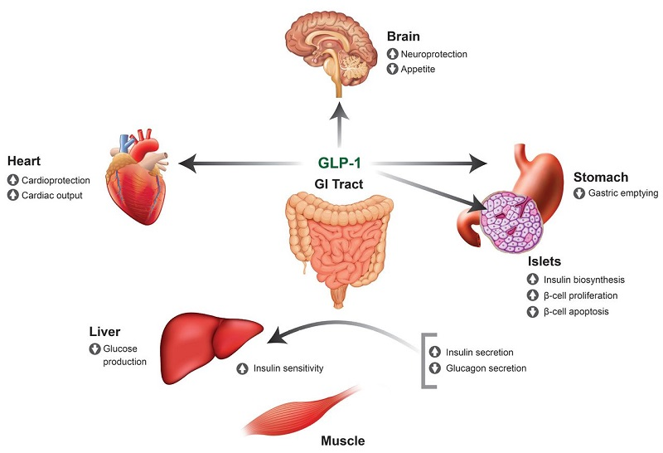
Fitch et al., 2021

Slide 8
Who can get these?
INDICATIONS
CONTRAINDICATIONS
Obesity – BMI of 30 kg/m² or greater
Overweight – BMI of 27 kg/m² or greater and suffering from weight-related conditions (e.g., hypertension, diabetes, or sleep apnea)
Acute pancreatitis
History of thyroid cancer

Slide 9
Adverse effects
COMMON
SERIOUS
Gastrointestinal (nausea, vomiting, diarrhea, constipation, abdominal pain)
Fatigue
Headache
Nasopharyngitis
Pancreatitis
Gallbladder Disease
Biliary Tract Disease
Acute Kidney Injury
Hypoglycemia

Slide 10
Duration of therapy
Lifelong adherence is encouraged
Weight can be regained, and metabolic cycling can occur when stopped
Taken to achieve weight loss and improve metabolic health and must be continued to maintain weight loss and metabolic improvements
May be exceptions with significant lifestyle changes while taking GLP-1 receptor agonists
Notes:
DISCUSS ABOUT MUSCLE AND FAT DIFFERENTIATION

Slide 11
Mounjaro (tirzepatide)
Soon to be approved medication for weight loss that acts similarly to GLP-1 receptor agonists with greater results
Belongs to a new class called GLP-1/GIP agonists by mimicking both GLP-1 and glucose-dependent insulinotropic polypeptide (GIP)
GIP regulates energy balance through cell surface receptor signaling in the brain and adipose tissue
Both GIP and GLP receptor agonism theoretically may lead to greater efficacy in weight reduction
GIP activation appeared to act synergistically with GLP-1 receptor activation with greater weight reduction than with GLP-1 receptor monoagonism
Notes:
Mounjaro (tirzepatide) demonstrated a greater reduction in hemoglobin A1c levels and resulted in more weight loss compared to Ozempic (semaglutide).

Slide 12
Drug | Target Dose | Dosage Form | Frequency | Indication | Age | Other Benefits
Ozempic (semaglutide) | 2 mg | Subcutaneous Injection | Weekly | Type 2 Diabetes | 18+ | Heart, Kidneys, Weight Loss
Rybelsus (semaglutide) | 14 mg | Oral Tablet | Daily | Type 2 Diabetes | 18+ | Weight loss
Wegovy (semaglutide) | 2.4 mg | Subcutaneous Injection | Weekly | Weight Loss | 12+ | N/A
Victoza (liraglutide) | 1.8 mg | Subcutaneous Injection | Daily | Type 2 Diabetes | 10+ | Heart, Kidneys, Weight Loss
Saxenda (liraglutide) | 3 mg | Subcutaneous Injection | Daily | Weight Loss | 12+ | N/A
Trulicity (dulaglutide) | 4.5 mg | Subcutaneous Injection | Weekly | Type 2 Diabetes | 10+ | Heart, Kidneys, Weight Loss
Byetta (exenatide) | 10 mcg | Subcutaneous Injection | Twice daily | Type 2 Diabetes | 18+ | Weight loss
Bydureon BCise (exenatide) | 2 mg | Subcutaneous Injection | Weekly | Type 2 Diabetes | 10+ | Weight loss
Mounjaro (tirzepatide) | 15 mg | Subcutaneous Injection | Weekly | Type 2 Diabetes | 18+ | Weight loss

Slide 13
Let’s look at the literature

Slide 14
Wilding et al., 2021

Slide 15
SemaglutidE
Mean change in body weight was −14.9% (semaglutide) and −2.4% (placebo)
Estimated treatment difference = −12.4%
More participants in the semaglutide group than placebo group achieved weight reductions of
5% or more (86.4% vs. 31.5%), 10% or more (69.1% vs. 12.0%), 15% or more (50.5% vs. 4.9%)
Mean change in body weight was −15.3 kg (semaglutide) and−2.6 kg (placebo)
Estimated treatment difference = −12.7 kg
Semaglutide had a greater improvement in cardiometabolic risk factors and physical functioning
Nausea and diarrhea were the most common adverse events
Transient and mild-to-moderate in severity and subsided with time
More treatment discontinuations with semaglutide (4.5%) than placebo (0.8%) from gastrointestinal events
Wilding et al., 2021

Slide 16
Wilding et al., 2021

Slide 17
Bottom Line
“Among adults with overweight or obesity (without diabetes), once weekly subcutaneous semaglutide plus lifestyle intervention was associated with substantial, sustained, clinically relevant mean weight loss of 14.9%, with 86% of participants attaining at least 5% weight loss.”
Wilding et al., 2021

Slide 18
Sunyer et al., 2015

Slide 19
LIRAGLUTIDE
Mean change in body weight was 8.4±7.3 kg (liraglutide) and 2.8±6.5 kg (placebo)
Difference = −5.6 kg
63.2% (liraglutide) and 27.1% (placebo) lost at least 5% of their body weight
33.1% (liraglutide) and 10.6% (placebo) lost more than 10% of their body weight
Mild or moderate nausea and diarrhea were the most common adverse events with liraglutide
Serious events occurred in 6.2% (liraglutide) and 5.0% (placebo)
Sunyer et al., 2015

Slide 20
Sunyer et al., 2015
Notes:
Panel A shows the mean body weight for patients in the full-analysis set who completed each scheduled visit, according to presence or absence of prediabetes
at screening. I bars indicate standard error, and the separate symbols above the curves represent the 56- week weight change using last-observation-carried-forward (LOCF) imputation. The full-analysis set comprised patients who underwent randomization, were exposed to at least one treatment dose, and had at
least one assessment after baseline (69 patients were
excluded from the full-analysis set: 61 owing to lack of an assessment and 8 owing to no exposure).
Panel B shows the proportions of patients who lost at least 5%, more than 10%, and more than 15% of their baseline body weight. Data shown are the observed means for the full-analysis set (with LOCF). Findings from logistic- regression analysis showed an odds ratio of 4.8 (95% confidence interval [CI], 4.1 to 5.6) for at least 5% weight loss and an odds ratio of 4.3 (95% CI, 3.5 to 5.3) for more than 10% weight loss; the analysis of more than 15% weight loss was performed post hoc (odds ratio, 4.9 [95% CI, 3.5 to 6.7]).
Panel C shows the cumulative percentage of patients with those changes in body weight after 56 weeks of treatment.

Slide 21
Bottom Line
“3.0 mg of once-daily subcutaneous liraglutide, as an adjunct to diet and exercise, was associated with clinically meaningful weight loss in overweight or obese patients, with concurrent reductions in glycemic variables and multiple cardiometabolic risk factors, as well as improvements in health-related quality of life.”
Sunyer et al., 2015

Slide 22
Rubino et al., 2022

Slide 23
Semaglutide vs. liraglutide
Mean weight change was –15.8% (semaglutide) and –6.4% (liraglutide)
Difference of –9.4% weight change with pooled placebo was –1.9%
Participants had significantly greater odds of achieving 10% or more, 15% or more, and 20% or more weight loss with semaglutide vs. liraglutide
10% or more - 70.9% of participants vs 25.6% [odds ratio = 6.3]
15%or more - 55.6% vs 12.0% [odds ratio = 7.9]
20% or more - 38.5% vs 6.0% [odds ratio = 8.2]
Gastrointestinal adverse events were reported by 84.1% (semaglutide) and 82.7% (liraglutide)
Proportions of participants discontinuing treatment for any reason were 13.5% (semaglutide) and 27.6% (liraglutide)
Rubino et al., 2022

Slide 24
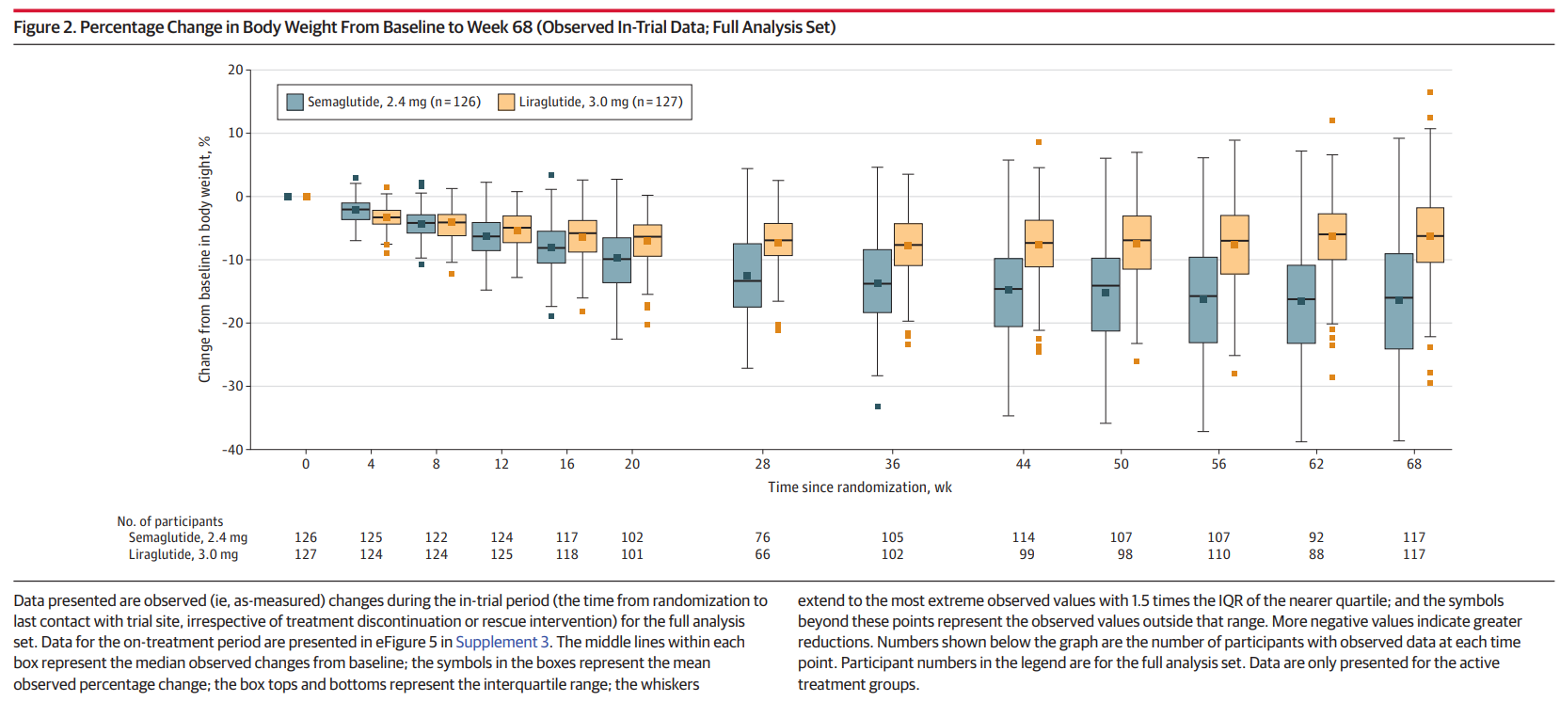
Rubino et al., 2022

Slide 25
Rubino et al., 2022

Slide 26
Bottom lINE
“Among adults with overweight or obesity without diabetes, once-weekly subcutaneous semaglutide compared with once-daily subcutaneous liraglutide, added to counseling for diet and physical activity, resulted in significantly greater weight loss at 68 weeks.”
Rubino et al., 2022

Slide 27
Jastreboff et al., 2022

Slide 28
Tirzepatide
Mean change in weight was −15.0% (5 mg tirzepatide), −19.5% (10 mg tirzepatide) and −20.9% (15 mg tirzepatide) and −3.1% (placebo)
The percentage of participants who had weight reduction of 5% or more was 85% (5 mg tirzepatide), 89% (10 mg tirzepatide), and 91% (15 mg tirzepatide) and 35% (placebo)
50% (10 mg tirzepatide) and 57% (15 mg tirzepatide) had a reduction in body weight of 20% or more compared with 3% (placebo)
Improvements in all cardiometabolic measures were observed with tirzepatide
Gastrointestinal adverse events were the most common with tirzepatide
Most were mild to moderate in severity
Primarily during dose escalation
Adverse events caused treatment discontinuation in 4.3% (5 mg tirzepatide), 7.1% (10 mg tirzepatide), 6.2% (15 mg tirzepatide), and 2.6% (placebo)
Jastreboff et al., 2022

Slide 29
Jastreboff et al., 2022

Slide 30
Bottom line
“In participants with obesity, 5 mg, 10 mg, or 15 mg of tirzepatide once weekly provided substantial and sustained reductions in body weight.”
Jastreboff et al., 2022

Slide 31
Frias et al., 2021

Slide 32
Semaglutide vs. Tirzepatide
Mean reductions in body weight were −7.6 kg (5 mg tirzepatide), −9.3 kg (10 mg tirzepatide), −11.2 kg (15mg tirzepatide) and −5.7 kg (semaglutide)
Tirzepatide was superior to semaglutide with estimated treatment differences of −1.9 kg (5 mg tirzepatide), −3.6 kg (10 mg tirzepatide), and −5.5 kg (15 mg tirzepatide)
65 to 80% (tirzepatide) and 54% (semaglutide) had reductions in body weight of at least 5%
34 to 57% (tirzepatide) and 24% (semaglutide) had reductions in body weight of at least 10%
15 to 36% (tirzepatide) and 8% (semaglutide) had reductions in body weight of at least 15%
Gastrointestinal were the most common adverse events
Primarily mild to moderate in severity
Serious adverse events were reported in 5 to 7% (tirzepatide) and 3% (semaglutide)
Frias et al., 2021
Notes:
Nausea - 17 to 22% (tirzepatide) and 18% (semaglutide), diarrhea - 13 to 16% (tirzepatide) and 12% (semaglutide), vomiting - 6 to 10% (tirzepatide) and 8% (semaglutide)

Slide 33
Frias et al., 2021
Notes:
Least-squares means (―SE) are presented, unless otherwise noted. Error bars indicate the standard error. Panel A shows the change
from baseline in body weight at 40 weeks, as assessed with analysis of covariance with multiple imputation for treatment for missing
weight at 40 weeks (treatment-regimen estimand). ETDs are least-squares means (95% confidence interval) at 40 weeks in the modified
intention-to-treat population. Panel B shows the change from baseline in body weight over time, derived from a mixed-model repeatedmeasures
analysis (efficacy estimand). The percent changes from baseline values at 40 weeks are shown in parentheses. Arrows indicate
the times at which the maintenance doses of tirzepatide (5 mg, 10 mg, or 15 mg) and semaglutide 1 mg were achieved. Panel C shows
the percentage of patients who had body-weight reductions of at least 5%, 10%, or 15% from baseline to week 40 (treatment-regimen
estimand). The percentage was calculated with the use of Rubin’s rules by combining the percentages of patients who met the target in
imputed data sets. Panel D shows the percent change (―

Slide 34
Bottom Line
“Reductions in body weight with tirzepatide were dose-dependent. With the use of the efficacy estimate, more patients who received tirzepatide than those who received semaglutide had at least 10% weight loss.”
Frias et al., 2021

Slide 35
Novo Nordisk, 2023

Slide 36
Oral semaglutide
Statistically significant weight loss
Weight loss of 15.1% (oral semaglutide 50 mg) compared to 2.4% (placebo)
84.9% (oral semaglutide 50 mg) compared to 25.8% (placebo) achieved a weight loss of 5%
Oral semaglutide 50 mg appeared to have a safe and well-tolerated profile
Gastrointestinal adverse events were the most common
Majority were mild to moderate and diminished over time and were consistent with the GLP-1 receptor agonist class
Most prominent during dose escalation
Novo Nordisk, 2023

Slide 37
“We are very pleased with the weight loss demonstrated by the once-daily oral formulation of semaglutide in obesity. The results show comparable weight loss as in the STEP 1 trial with injectable semaglutide 2.4 mg in obesity branded as Wegovy®” “The choice between a daily tablet or weekly injection for obesity has the potential to offer patients and healthcare providers the opportunity to choose what best suits individual treatment preferences”
– Martin Holst Lange, VP for Development at NovoNordisk
Novo Nordisk, 2023

Slide 38
MONITORING
What | Who | How | When
Efficacy
Weight reduction (> 5 %) | Physician Pharmacist Patient | % body weight Total body weight | ~ 1 year
Safety
Gastrointestinal (abdominal pain, nausea, vomiting, constipation, diarrhea) | Patient Pharmacist | Self Assessment Follow up | Daily 28 days
Acute Kidney Injury | Physician | Serum Creatinine | 3 months
Gallbladder Disease/Biliary Tract Disease/Pancreatitis | Physician | Blood Work Physical Examination | 3 months

Slide 39
CLINICAL PEARLS/takeaways
GLP-1 receptor agonist use is limited by the cost, route of administration, and adverse effects
Age, goals of therapy, underlying conditions (e.g., heart or kidney disease, Type 2 diabetes), preferences (e.g., injections vs. pills), access, and drug coverage must be considered
Cost may restrict access for patients who require these agents for long-term management (~ $500 a month)
Not covered by public plans and only covered by select private plans
Duration of treatment is a large misconception the public has about GLP-1 receptor agonists
Side effects can be minimized by starting at a low dose and titrating up to the target dose
As these established diabetic treatments and novel medications gain popularity in the media and practice, it is crucial for pharmacy professionals to be aware of efficacy, safety, place in therapy, and be able to provide evidence-based information to patients and colleagues.

Slide 41
Questions?
Thank you! ☺
Meagan.London@HorizonNB.ca

Slide 42
References
Ard, J., Fitch, A., Fruh, S., & Herman, L. (2021). Weight Loss and Maintenance Related to the Mechanism of Action of Glucagon-Like Peptide 1 Receptor Agonists. Advances in Therapy, 38(6), 2821–2839. https://doi.org/10.1007/s12325-021-01710-0
Frías, J. P., Davies, M. J., Rosenstock, J., Pérez Manghi, F. C., Fernández Landó, L., Bergman, B. K., Liu, B., Cui, X., & Brown, K. (2021). Tirzepatide versus Semaglutide Once Weekly in Patients with Type 2 Diabetes. New England Journal of Medicine, 385(6), 503–515. https://doi.org/10.1056/NEJMoa2107519
Garvey, W. T., Batterham, R. L., Bhatta, M., Buscemi, S., Christensen, L. N., Frias, J. P., Jódar, E., Kandler, K., Rigas, G., Wadden, T. A., Wharton, S., & the STEP 5 Study Group. (2022). Two-year effects of semaglutide in adults with overweight or obesity: The STEP 5 trial. Nature Medicine, 28(10), 2083–2091. https://doi.org/10.1038/s41591-022-02026-4
Hinnen, D. (2017). Glucagon-Like Peptide 1 Receptor Agonists for Type 2 Diabetes. Diabetes Spectrum, 30(3), 202–210. https://doi.org/10.2337/ds16-0026
Jastreboff, A. M., Aronne, L. J., Ahmad, N. N., Wharton, S., Connery, L., Alves, B., Kiyosue, A., Zhang, S., Liu, B., Bunck, M. C., & Stefanski, A. (2022). Tirzepatide Once Weekly for the Treatment of Obesity. New England Journal of Medicine, 387(3), 205–216. https://doi.org/10.1056/NEJMoa2206038
Lundgren, J. R., Janus, C., Jensen, S. B. K., Juhl, C. R., Olsen, L. M., Christensen, R. M., Svane, M. S., Bandholm, T., Bojsen-Møller, K. N., Blond, M. B., Jensen, J.-E. B., Stallknecht, B. M., Holst, J. J., Madsbad, S., & Torekov, S. S. (2021). Healthy Weight Loss Maintenance with Exercise, Liraglutide, or Both Combined. New England Journal of Medicine, 384(18), 1719–1730. https://doi.org/10.1056/NEJMoa2028198
Pi-Sunyer, X., Astrup, A., Fujioka, K., Greenway, F., Halpern, A., Krempf, M., Lau, D. C. W., Le Roux, C. W., Violante Ortiz, R., Jensen, C. B., & Wilding, J. P. H. (2015). A Randomized, Controlled Trial of 3.0 mg of Liraglutide in Weight Management. New England Journal of Medicine, 373(1), 11–22. https://doi.org/10.1056/NEJMoa1411892
Rubino, D. M., Greenway, F. L., Khalid, U., O’Neil, P. M., Rosenstock, J., Sørrig, R., Wadden, T. A., Wizert, A., Garvey, W. T., STEP 8 Investigators, Arauz-Pacheco, C., Cannon, K., Downey, H. J., Fitz-Patrick, D., Geohas, J., Gerety, G., Gilbert, J., Hollander, P., Klein, E., … Toth, P. (2022). Effect of Weekly Subcutaneous Semaglutide vs Daily Liraglutide on Body Weight in Adults With Overweight or Obesity Without Diabetes: The STEP 8 Randomized Clinical Trial. JAMA, 327(2), 138. https://doi.org/10.1001/jama.2021.23619
Wilding, J. P. H., Batterham, R. L., Calanna, S., Davies, M., Van Gaal, L. F., Lingvay, I., McGowan, B. M., Rosenstock, J., Tran, M. T. D., Wadden, T. A., Wharton, S., Yokote, K., Zeuthen, N., & Kushner, R. F. (2021). Once-Weekly Semaglutide in Adults with Overweight or Obesity. New England Journal of Medicine, 384(11), 989–1002. https://doi.org/10.1056/NEJMoa2032183
https://www.novonordisk.com/news-and-media/news-and-ir-materials/news-details.html?id=166110

