Slide 1
Antirejection Medications: Common and Catastrophic Complications
Jacob Michaud, MD
PGY-3 Internal Medicine

Slide 2
Introduction
PGY3 Internal Medicine at SJRH.
Accepted to Nephrology Fellowship Dalhousie 2024-2026.
Some elements from this talk may be kidney-centric.

Slide 3
COI
None to declare.

Slide 4
Plan
Lung transplant recipient
The usual suspects
Common side effects
COVID-19
Cytopaenias
Loss of an agent
Thrombotic microangiopathy

Slide 5
RP
50 y/o gentleman
End-stage COPD
June 2021, to Toronto UHN for double-lung transplant.

Slide 6
The Usual Suspects
Kant S, Kronbichler A, Geetha D. Principles of Immunosuppression in the Management of Kidney Disease: Core Curriculum 2022 [published correction appears in Am J Kidney Dis. 2023 Jan;81(1):125]. Am J Kidney Dis. 2022;80(3):393-405. doi:10.1053/j.ajkd.2021.12.011
Notes:
Most solid organ transplant f

Slide 7
Sensitization
Etxebarria A, Díez-Martín E, Astigarraga E, Barreda-Gómez G. Role of the Immune System in Renal Transplantation, Types of Response, Technical Approaches and Current Challenges. Immuno. 2022; 2(4):548-570. https://doi.org/10.3390/immuno2040035
Notes:
Rejection presents differently in different organs
CD4 helper T cells
CD8 Cytotoxic

Slide 8
Usual Pillars of Maintenance Immunosuppression
Steroid
Antimetabolite
CNI
Notes:
Back to our gentlerman,
he gets induced and started on the three classic pillars of immunosuppression

Slide 9
Steroids
Protocol depends on organ transplanted.
Start higher doses, taper down to low dose (pred 5 mg daily) or to discontinuation.

Slide 10
MEDICATION GUIDELINES FOR SOLID ORGAN TRANSPLANTS. BC Transplant. May 2021. Accessed Nov 2023 via http://www.transplant.bc.ca/Documents/Health%20Professionals/Clinical%20guidelines/Clinical%20Guidelines%20for%20Transplant%20Medications.pdf
Notes:
Drug counselling, head to toe approach
The side effect that in my practice has most often extended hospitalization was new hyperglycaemia in non-diabetic
Increased risk of infection.

Slide 11
Aberer F, Hochfellner DA, Sourij H, Mader JK. A Practical Guide for the Management of Steroid Induced Hyperglycaemia in the Hospital. J Clin Med. 2021;10(10):2154. Published 2021 May 16. doi:10.3390/jcm10102154

Slide 12
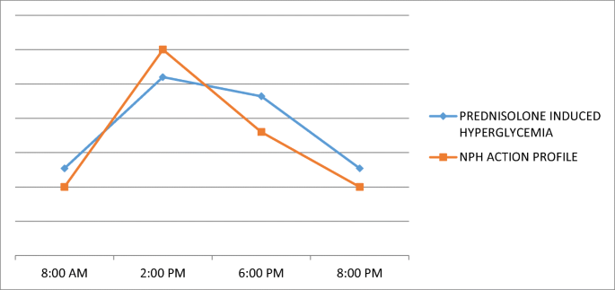
Lakhani, O.J., & Patel, S. (2018). Successful management of a glucocorticoid-induced hyperglycemia in hospitalized patient with use of novel protocol. International Journal of Diabetes in Developing Countries, 38, 509-513.

Slide 13
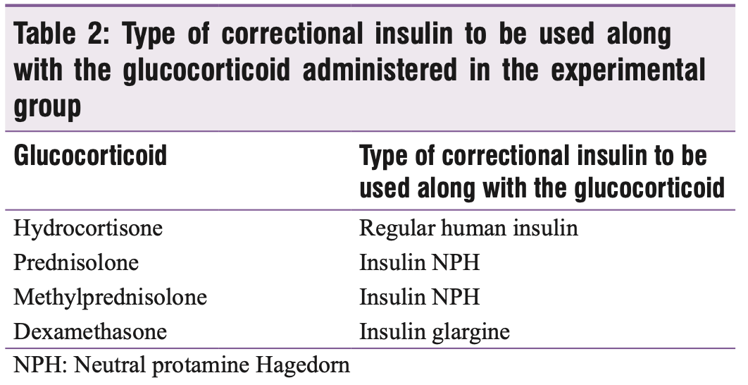
Lakhani OJ, Kumar S, Tripathi S, Desai M, Seth C. Comparison of Two Protocols in the Management of Glucocorticoid-induced Hyperglycemia among Hospitalized Patients. Indian J Endocrinol Metab. 2017;21(6):836-844. doi:10.4103/ijem.IJEM_226_17
Notes:
Interesting RCT in india
compared basal bolus with targeted insulin

Slide 14
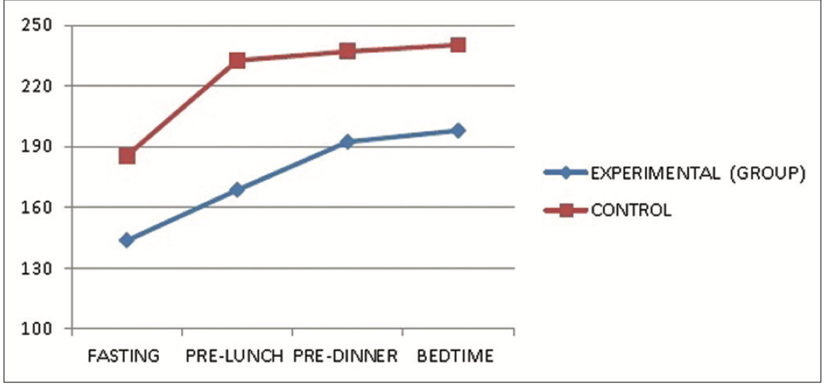
13.9
12.2
10.6
8.9
7.2
5.6
Lakhani OJ, Kumar S, Tripathi S, Desai M, Seth C. Comparison of Two Protocols in the Management of Glucocorticoid-induced Hyperglycemia among Hospitalized Patients. Indian J Endocrinol Metab. 2017;21(6):836-844. doi:10.4103/ijem.IJEM_226_17

Slide 15
Lakhani OJ, Kumar S, Tripathi S, Desai M, Seth C. Comparison of Two Protocols in the Management of Glucocorticoid-induced Hyperglycemia among Hospitalized Patients. Indian J Endocrinol Metab. 2017;21(6):836-844. doi:10.4103/ijem.IJEM_226_17

Slide 16
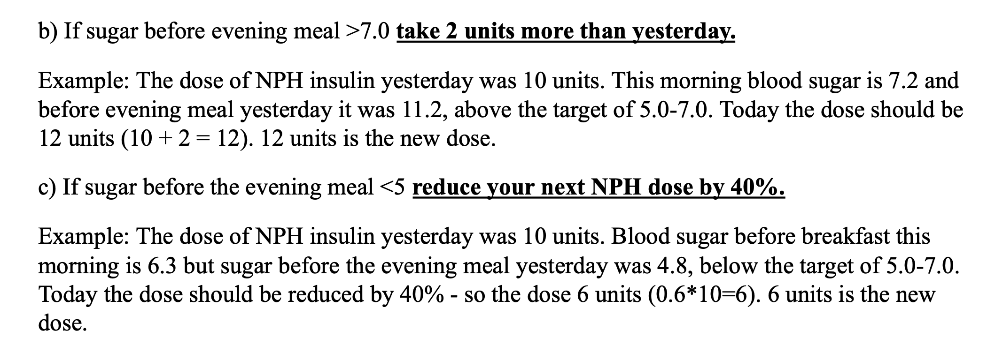
Practical Tip: Google “BC NPH Steroids”
Notes:
It’s the weekend, patient can check sugars and inject insulin, they want to go (cat is getting hungry), good understanding of health and insulin, can use BC diabetes tool
Health literacy; not at grade 6 level

Slide 17
RP
Discharged from TUHN.
Maintenance immunosuppression with tacrolimus ER (Advagraf) 4 mg daily, MMF (CellCept) 1000 mg bid and Prednisone 5 mg daily.
Does well at home, but has unrelenting diarrhoea.

Slide 18
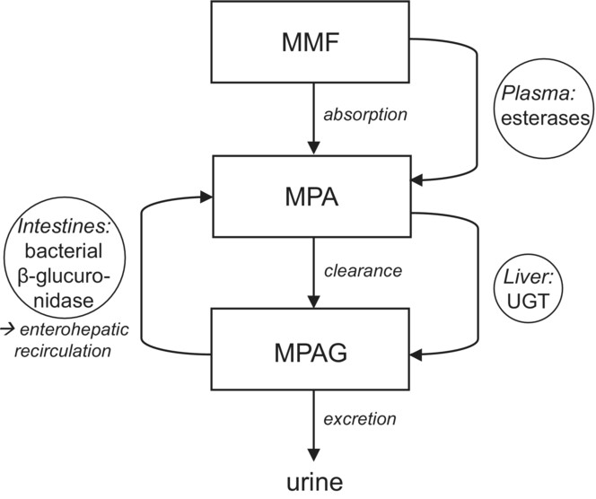
Mycophenolic Acid
Mycophenolate mofetil (CellCept): rapid hydrolyzation to MPA.
Mycophenolate sodium (Myfortic): enteric coated, MPA in small bowel.
MMF and MPS at doses 1000 mg and 720 mg are equimolar, but NOT interchangeable.
MEDICATION GUIDELINES FOR SOLID ORGAN TRANSPLANTS. BC Transplant. May 2021. Accessed Nov 2023 via http://www.transplant.bc.ca/Documents/Health%20Professionals/Clinical%20guidelines/Clinical%20Guidelines%20for%20Transplant%20Medications.pdf
Simoons, M, Naipal, KAT, de Jong, H, den Hoed, CM, de Winter, BCM, Mulder, MB. Oral antibiotics lower mycophenolate mofetil drug exposure, possibly by interfering with the enterohepatic recirculation: A case series. Pharmacol Res Perspect. 2023; 11:e01103. doi:10.1002/prp2.1103
Notes:
Peak 1 h MMF and 1.5-2.5 h MPS; Second recirculation peak 6-12 h later.
MOA – inhibits purine synthesis

Slide 19
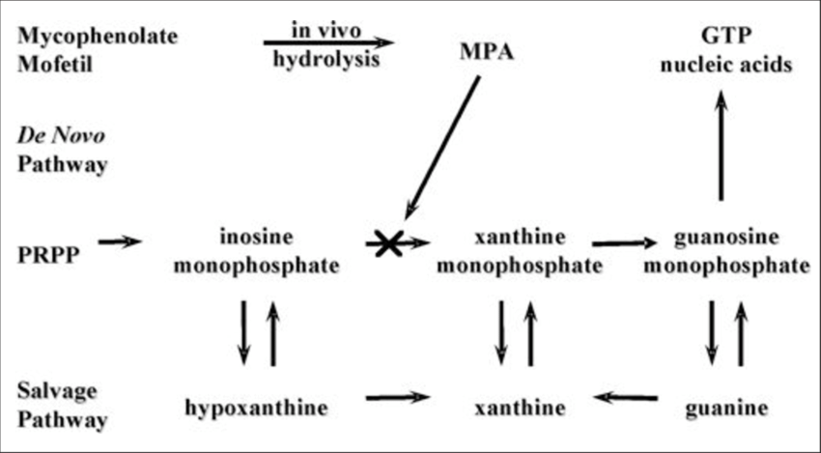
Mycophenolic Acid
Inhibits purine synthesis.
Contraindicated in pregnancy.
Not with anti-acids or cholestyramine.
Watch for accumulation of antivirals in low GFR.
PPI may cause early release of MPS (Myfortic).
Bruchet NK, Ensom MH. Limited sampling strategies for mycophenolic acid in solid organ transplantation: a systematic review. Expert Opin Drug Metab Toxicol. 2009;5(9):1079-1097. doi:10.1517/17425250903114182
Notes:
cholestyramine will decrease second recirculation

Slide 20
MEDICATION GUIDELINES FOR SOLID ORGAN TRANSPLANTS. BC Transplant. May 2021. Accessed Nov 2023 via http://www.transplant.bc.ca/Documents/Health%20Professionals/Clinical%20guidelines/Clinical%20Guidelines%20for%20Transplant%20Medications.pdf
Notes:
Pure red cell aplasia

Slide 21
Managing MMF-associated Diarrhoea
Rule out infectious diarrhoea (stool culture, O&P, C. diff)
Mild (<4 BM per day, no wt loss, <10 days) | Moderate to Severe (>4 BM per day, wt loss, >10 days)
Give MMF with food Split doses in QID Dose reduce if safe | Dose reduce if safe Stop MMF if safe If improves, trial of MPS (Myfortic)
NBPDP: both CellCept and Myfortic are regular benefit.
MEDICATION GUIDELINES FOR SOLID ORGAN TRANSPLANTS. BC Transplant. May 2021. Accessed Nov 2023 via http://www.transplant.bc.ca/Documents/Health%20Professionals/Clinical%20guidelines/Clinical%20Guidelines%20for%20Transplant%20Medications.pdf
Notes:
plus minus CMV.

Slide 22
RP
After negative stool studies, RP is switched from CellCept 1000 mg bid to Myfortic 720 mg bid.
His diarrhoea improves to 3 BM per day. He is satisfied.
Unfortunately, 6 months later, he develops a cough and tests positive for SARS-CoV-2.

Slide 23
COVID-19 in the SOTR
Notes:
Its like walking a tight rope

Slide 24
Minimize risk of rejection
Reduce immunosuppression
Notes:
Covid is an inflammatory state, we think it increases the risk of rejection

Slide 25
What we know…
Hospitalization is higher in transplanted population. Mortality is similar when adjusting for comorbidities (in the age of Omicron).
Pathogenesis of COVID-19 is an interplay of direct viral injury and host response.
Lymphopenia is a risk factor for severe COVID illness.
Mycophenolate, sirolimus, and steroids are associated with increased hospitalization in SOTR. (JAMA 2023)
Hadi YB, Naqvi SFZ, Kupec JT, Sofka S, Sarwari A. Outcomes of COVID-19 in Solid Organ Transplant Recipients: A Propensity-matched Analysis of a Large Research Network. Transplantation. 2021;105(6):1365-1371. doi:10.1097/TP.0000000000003670
Chen G, Wu D, Guo W, et al. Clinical and immunological features of severe and moderate coronavirus disease 2019. J Clin Invest. 2020;130(5):2620-2629. doi:10.1172/JCI137244
Gérard AO, Barbosa S, Anglicheau D, et al. Association Between Maintenance Immunosuppressive Regimens and COVID-19 Mortality in Kidney Transplant Recipients. Transplantation. 2022;106(10):2063-2067. doi:10.1097/TP.0000000000004254
Kolla E, Weill A, Zaidan M, et al. COVID-19 Hospitalization in Solid Organ Transplant Recipients on Immunosuppressive Therapy. JAMA Netw Open. 2023;6(11):e2342006. Published 2023 Nov 1. doi:10.1001/jamanetworkopen.2023.42006

Slide 26
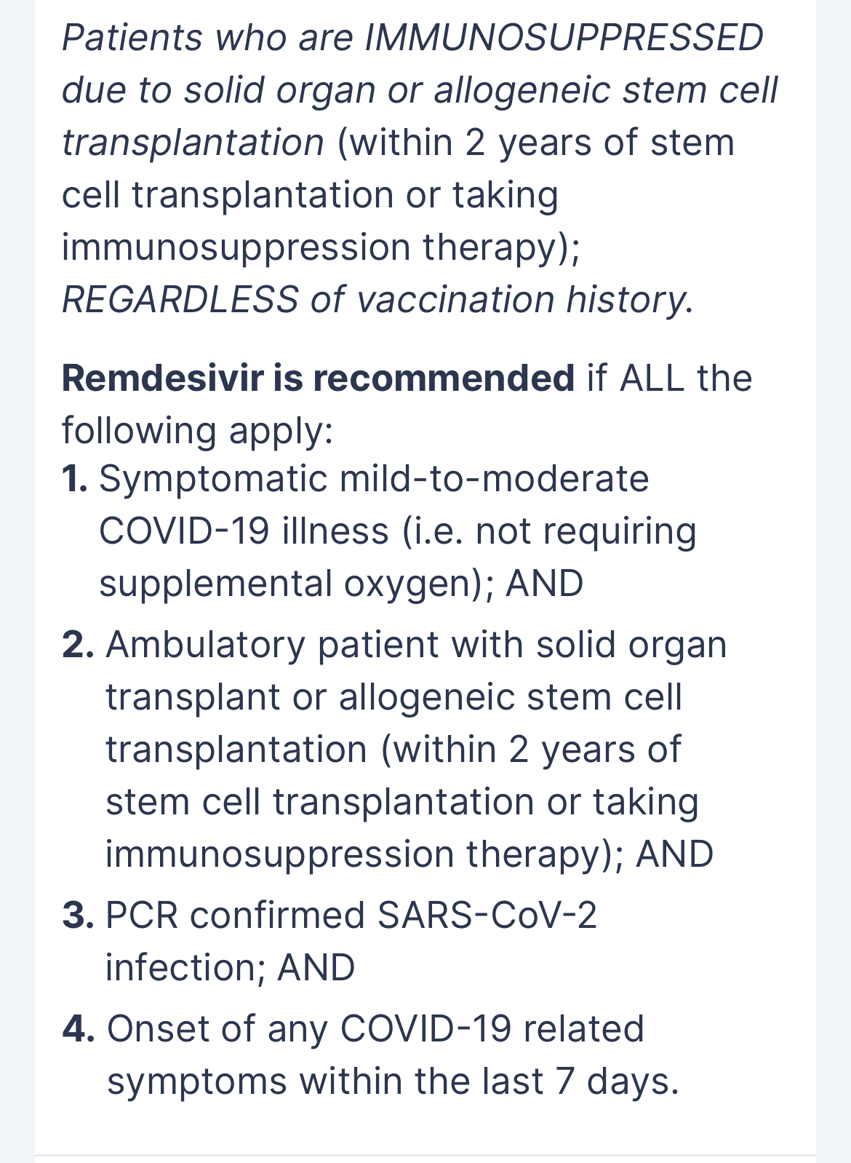
Applying what we know
Generally safe to hold or decrease mycophenolate (especially if lymphopaenic).
CNI generally safe to continue.**
If qualifies for dexamethasone, hold prednisone.
Use recommended anti-COVID therapies depending on degree of symptoms.
Input from organ specialist or transplant team ASAP
Firstline Application. HorizonNB. Clinical Management & Treatment of COVID-19: Mild-to-Moderate Illness Outpatient Management. Accessed 26 Nov 2023
Notes:
CNI has some degree of IL-6 suppression (think tocilizumab). To my knowledge, no evidence for treating COVID with CNI.
Watch for drug interactions (esp Nirmatrelvir/ritonavir)
Anecdotally, ive seen levels of 60
Generally safe if overnight in ER to hold anti-metabolite

Slide 27
RP
RP is admitted. Cough but remains stable on room air.
MPS discontinued on admission.
Dexamethasone 6 mg daily x 10 replaced prednisone.
Continued tacrolimus ER (Advagraf) 4 mg daily.
Received remdesivir 3-day protocol.
Discharged on day 4, MPS restarted at half-dose until dexamethasone runs out, then back to home dose.
Notes:
360 mg bid
after discussion with transplant centre in Toronto

Slide 28
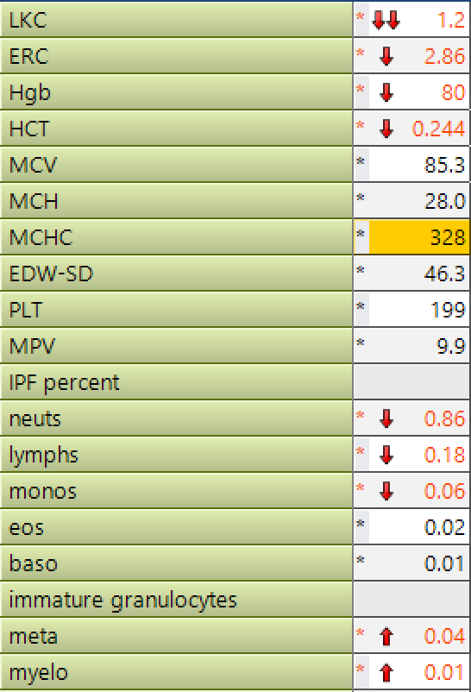
RP
6 months later, feeling unwell, diarrhoea recurring.

Slide 29
Leukopaenia in the SOTR
Rule out infection (++CMV, other viral illness, bacterial illness)
Drug detective

Slide 30
Leukopaenia as an ADE
Valgan
AZA
TMP-SMX
MPA
Notes:
trimethoprim sulfamethoxazole

Slide 31
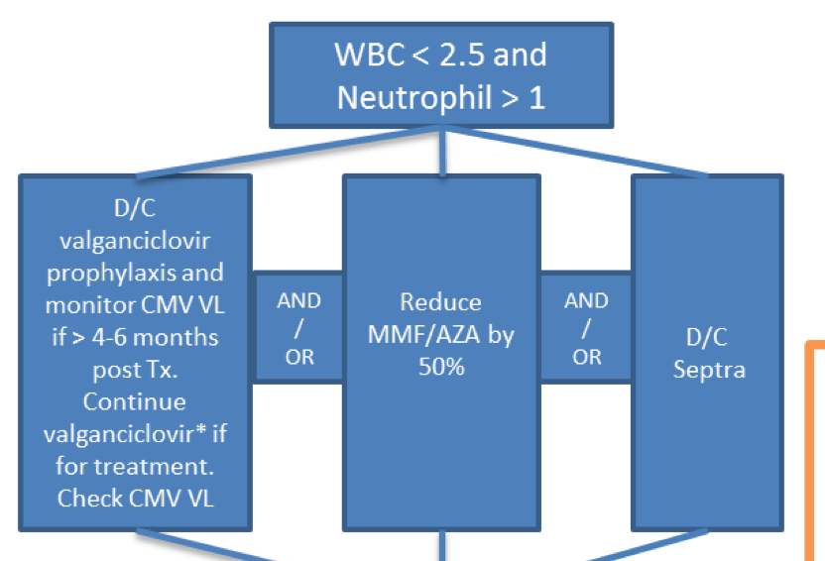
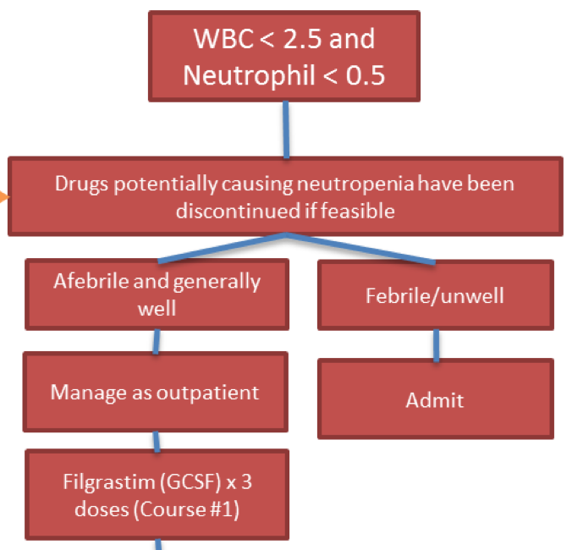
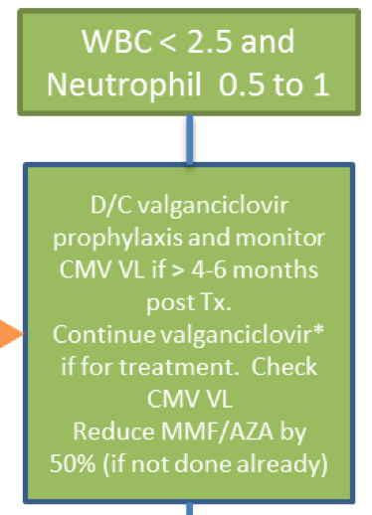
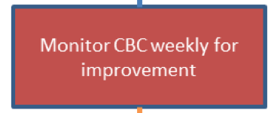
MEDICATION GUIDELINES FOR SOLID ORGAN TRANSPLANTS. BC Transplant. May 2021. Accessed Nov 2023 via http://www.transplant.bc.ca/Documents/Health%20Professionals/Clinical%20guidelines/Clinical%20Guidelines%20for%20Transplant%20Medications.pdf

Slide 32
2 wks
1 wk
Notes:
Stool cultures, Cdiff, BC, CMV viral load
Stopped Myfortic and G-CSF, counts recovered
Restarted Myfortic only, counts deteriorated again
Stopped Myfortic

Slide 33
Loss of an agent, briefly…
Depends on the organ.
Depends on the donor.
CNI are the workhorse and generally have to be replaced (mTOR, belatacept).
If recurrent issues with antimetabolites, transplant team may D/C it indefinitely.
Notes:
Livers are much less immunogenic than lungs
Twin donor, can decrease significantly

Slide 34
RP
Unfortunately lost to follow up.
Baseline creatinine 250-300 umol/L
Routine BW 3 months later, creatinine 650 umol/L.

Slide 35
CNI
Tacrolimus (IR – Prograf, Sandoz; ER – Advagraf, Envarsus)
Very lipophilic.
Metabolized by P450.
IR and ER are NOT interchangeable.
Brands are NOT interchangeable.
Cyclosporin (Neoral)
High degree of inter- and intra-patient variability in plasma concentrations.
Half life approx. 18 hours.
Over 15 metabolites, elimination primarily biliary.
MEDICATION GUIDELINES FOR SOLID ORGAN TRANSPLANTS. BC Transplant. May 2021. Accessed Nov 2023 via http://www.transplant.bc.ca/Documents/Health%20Professionals/Clinical%20guidelines/Clinical%20Guidelines%20for%20Transplant%20Medications.pdf
Notes:
CNI mechanism not well known, isolated to helper T-cell, but no B-cell impact.

Slide 36
CNI Interactions (P450 3A4)
MEDICATION GUIDELINES FOR SOLID ORGAN TRANSPLANTS. BC Transplant. May 2021. Accessed Nov 2023 via http://www.transplant.bc.ca/Documents/Health%20Professionals/Clinical%20guidelines/Clinical%20Guidelines%20for%20Transplant%20Medications.pdf

Slide 37
MEDICATION GUIDELINES FOR SOLID ORGAN TRANSPLANTS. BC Transplant. May 2021. Accessed Nov 2023 via http://www.transplant.bc.ca/Documents/Health%20Professionals/Clinical%20guidelines/Clinical%20Guidelines%20for%20Transplant%20Medications.pdf

Slide 38
MEDICATION GUIDELINES FOR SOLID ORGAN TRANSPLANTS. BC Transplant. May 2021. Accessed Nov 2023 via http://www.transplant.bc.ca/Documents/Health%20Professionals/Clinical%20guidelines/Clinical%20Guidelines%20for%20Transplant%20Medications.pdf

Slide 39
Drug Monitoring
Narrow therapeutic index
MEDICATION GUIDELINES FOR SOLID ORGAN TRANSPLANTS. BC Transplant. May 2021. Accessed Nov 2023 via http://www.transplant.bc.ca/Documents/Health%20Professionals/Clinical%20guidelines/Clinical%20Guidelines%20for%20Transplant%20Medications.pdf

Slide 40
MEDICATION GUIDELINES FOR SOLID ORGAN TRANSPLANTS. BC Transplant. May 2021. Accessed Nov 2023 via http://www.transplant.bc.ca/Documents/Health%20Professionals/Clinical%20guidelines/Clinical%20Guidelines%20for%20Transplant%20Medications.pdf
Notes:
While mechanism of action is similar, molecular structures differ which may explain differences in
in kidney patients, more rejection in head to head CyA - Tac
Maybe decreases effect of MPA

Slide 41
Mechanism of CNI Nephrotoxicity
Mortensen LA, Bistrup C, Thiesson HC. Does Mineralocorticoid Receptor Antagonism Prevent Calcineurin Inhibitor-Induced Nephrotoxicity?. Front Med (Lausanne). 2017;4:210. Published 2017 Nov 24. doi:10.3389/fmed.2017.00210
Notes:
RP I though I had a slam dunk diagnosis
AKI in SOTR
CNI toxicity
Recurrence/Rejection
AKIs of other causes
BK virus or other virus

Slide 42
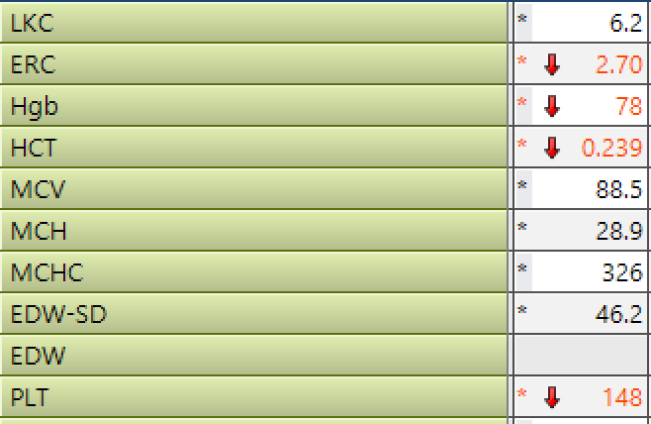
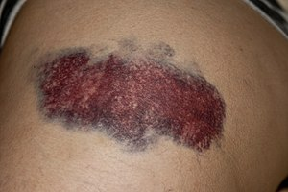
Another Mechanism?

Slide 43
Tacro-Induced Thrombotic Microangiopathy
Notes:
Diagnosed after ruling out TTP (ADAMTS level >20%)
Kidney biopsy in keeping with TMA > chronic CNI toxicity

Slide 44
DITMA Treatment
Problem…
Now on steroid monotherapy for lung transplant
Remove offending agent.
+/- eculizumab
+/- plasmapheresis
If offending agent is tacro, can trial cyclosporin, risk of recurrence.
Better to give ”break” from CNI.
Off label basiliximab vs belatacept vs mTOR
Notes:
***
Anecdotal/observational evidence suggests maybe better to give a "break"

Slide 45
Basiliximab
Belatacept
Chimeric AB that blocks binding to and blocking the interleukin-2 receptor α-chain.
Fusion protein (IgG1 Fc fragment linked + modified extracellular domain of cytotoxic T lymphocyte–associated antigen 4)
In KTx, increased risk in rejection when switching from CNI. Increased risk of infection.
Notes:
2022 Meds Pipeline Monitor

Slide 46
Admission
Stop tacrolimus
Kidney biopsy
Basiliximab 20 mg
Cyclosporin
Dose adjustment
Notes:
Stopped tacrolimus, gave basiliximab 20 mg x 1 dose, started CyA 1 week later

Slide 47
What we didn’t talk about…
Opportunistic infections
CMV (donor-recipient mismatch, prophylaxis and monitoring)
EBV (PTLD)
BK (renal failure)
PJP (prophylaxis)
HSV (prophylaxis)
Skin cancers
Risk is 65- to 100-fold for SCC
mTORi
Notes:
Mammalian target of rapamycin

Slide 48
Excellent Resource in a Pinch
MEDICATION GUIDELINES FOR SOLID ORGAN TRANSPLANTS.
BC Transplant. May 2021. Accessed Nov 2023 via
http://www.transplant.bc.ca/Documents/Health%20Professionals/Clinical%20guidelines/Clinical%20Guidelines%20for%20Transplant%20Medications.pdf

Slide 49
Questions?
Jacob.Michaud@HorizonNB.ca

