Slide 1
Leadership Roles for Pharmacy Professionals:
Keep Calm and Lead On!
Janie Haché
Aimee Kohler
CSHP-NB September 2023
Notes:
Aimee
Welcome everyone,
We called our presentation "Keep Calm and Lead on" because we are both very proud to be pharmacy leaders in New Brunswick and have found that leading others can be a challenging task, but if you do it right, it’s a very calm and rewarding adventure!

Slide 2
Objectives
Identify several types leadership roles for Pharmacy professionals
Know what to do to get involved and take opportunities
Be aware of the benefits and challenges of becoming a leader
Know how a rewarding career can benefit you professionally
Learn how being a positive influence in the workplace can also benefit you in personal life
Notes:
Janie, I'll let you take it from here.
As Aimee just mentioned, being a leader can be quite challenging!
The objective of our presentation today is to identify the different type of leadership roles for pharmacy professionals,
To know what you can do to get involved and how you can take opportunities.
To be aware of the benefits and challenges of becoming a leader
Know how a rewarding career can benefit you professionally
And also how being a positive influence in your workplace can have benefits in your personal life!

Slide 3
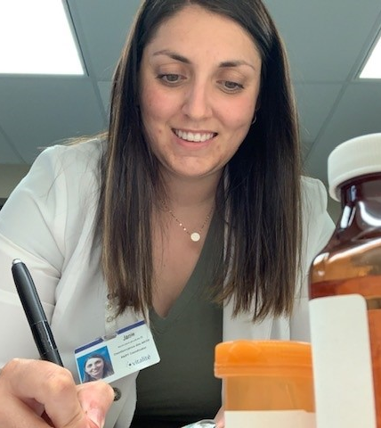
Janie
2008
Diploma from CCNB Campbellton
2008
Community Pharmacy
2009
Hospital Pharmacy Technician, Chaleur Regional Hospital Bathurst NB
2015
Education to become registered
2017
Registered Pharmacy Technician
2018
Pharmacy Coordinator, Chaleur Regional Hospital, Bathurst NB
2022-Present
Regional Quality Program Coordinator, Pharmacy Services, Vitalité Health Network
Notes:
Janie is a Registered Pharmacy Technician and Regional Quality Program Coordinator for Pharmacy Services at Vitalité Health Network in New Brunswick.
In 2008, she graduated from the pharmacy technician program from the Collège Communautaire du NB in Campbellton.
She began her career in 2008, working in a community pharmacy.
The following year, she found her true passion working as a pharmacy technician at the Chaleur Regional Hospital in Bathurst, NB.
In 2015, she jumped on the opportunity to start the process of becoming a Registered Pharmacy Technician.
In May 2017, she became one of the first Registered Pharmacy Technicians in Vitalité. Janie has always seen the potential for her profession, and she encouraged her coworkers to get on board with licencing.
Janie discovered that she had leadership skills after her supervisor gave her the opportunity to work and lead the implementation of automated dispensing cabinets in her region. Being able to share her knowledge, explain new processes and answer questions from her colleagues and other stakeholders made her realized that she really enjoyed it and that leadership skills came naturally for her.
In 2018, she accepted the position of Pharmacy Coordinator at the Chaleur Regional Hospital, a position she held for 4 years. During these years, she also had the chance to lead implementation projects, to precept pharmacy technician's students and to support her team.
In April 2022, she embarked on a new journey as the Regional Quality Program Coordinator for Vitalité. This new role was a big challenge for her, but she was ready to start this new opportunity. Still to this day, Janie loves sharing with others and participating in different pharmacy initiatives.
Janie is also past-president and now vice-president of the program advisory committee for the pharmacy technician program at the community college in Campbellton
Her regional role with Vitalité gives her the chance to use her leadership skills when leading projects and participation in other pharmacy initiatives. Her satisfaction at work keeps increasing as she reaches new personal and professional goals.

Slide 4
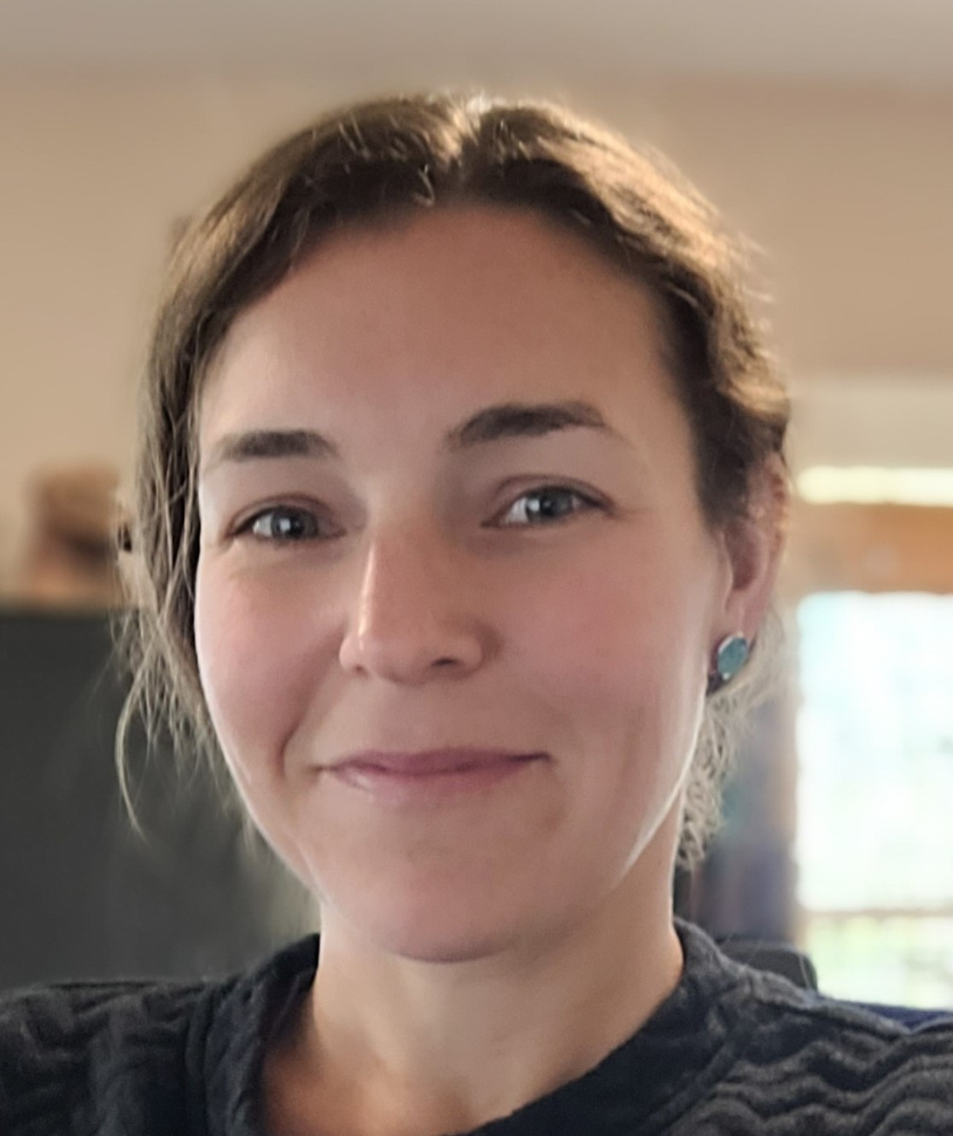
Aimee
2007
NBCC Pharmacy Technician program
2008
Community pharmacy
2008–2017
Hospital Technician + education to become registered
2017–2022
Pharmacy Coordinator at Saint John Regional Hospital
2022–Present
Acting Regional Compounding Supervisor for Horizon Health
Notes:
Aimee is a Registered Pharmacy Technician and Acting Regional Compound Supervisor for Pharmacy Services at Horizon Health Network in New Brunswick.
In 2007, she graduated from the pharmacy technician program at the New Brunswick Community College in Saint John New Brunswick.
She began her career in 2007, working in a community pharmacy and later that year started working at the Saint John Regional Hospital.
Between 2014 and 2017, she continued her education and became a registered pharmacy technician.
Aimee has since pushed for advancements of the pharmacy technician profession and advocates for it whenever she can.
In December 2017, she began a position as a Pharmacy Coordinator at the Saint John Regional Hospital. During this time, she led a team technicians and assistants, planned and implemented many operational projects and took every opportunity that came her way to advance her knowledge. She began getting involved in committees such as the pharmacy Quality Improvement committee, NBCC Program Advisory Committee and the local pharmacy social committee. During this time, she found a passion for process improvement and change management and achieved her Lean Six Sigma Green Belt.
In April 2022, she began the position of Acting Regional Compounding Supervisor for Horizon Health. Over the last 18 months, with the help of all the amazing pharmacy employees and leaders at Horizon Health, Aimee has created and implemented a non-sterile compounding program aligned with NAPRA standards across the region and has now switched focus to sterile compounding where she will work to standardize sterile compounding practices at Horizon Health.
The role Aimee has lead herself to with Horizon Health gives her more schedule flexibility, portability, and autonomy. She is truly passionate about the work she is doing and her overall satisfaction at work continues to improve. Her work-life balance is exactly where she needs it to be to maintain healthy relationships at work and at home with her family.

Slide 5
Storytime! How our Paths Crossed: A Story of Networking and Collaboration
First Pharmacy Coordinators in NB required to be registered as Pharmacy Technicians.
We collaborated and formed a working group to advocate for the Pharmacy Technician profession in hospitals across the province.
First met in person in May 2019: working group for Pharmacy Technicians with the NBCP for Jurisprudence Standard Setting
Continuous contact to discuss and collaborate on quality assurance details especially for sterile and non-sterile compounding.
Notes:
Janie
Aimee and I are both located on opposites side of New Brunswick! You must wonder how we met? So, here’s a little story time on how Aimee and I met, It’s a great story of networking and collaboration!
Since we were the first to be in a position the needed licensure in hospitals in New Brunswick, we met a couple time virtually as we collaborated to advocate for the profession in our respective health authorities.
We both participated in the Jurisprudence Standard setting working group for pharmacy technicians with the New Brunswick College of Pharmacists in May 2019.
We now frequent each other’s Teams chats to collaborate on quality assurance details especially for sterile and nonsterile compounding!
We always have good conversation, and we share ideas with each other which is super useful!

Slide 6
Introduction
•What is your WHY?
How do you feel, why are you where you are?
YOU have the power to lead a happier work life!
So, What exactly is Leadership?
Oxford Dictionary definition
•It’s so much MORE!
Taking Risks, Challenging the status quo,
MOTIVATING OTHERS to achieve something new and better!
& that’s why we are here!
Notes:
Aimee
It is your calling, your purpose, your vision of your life and work, the core source of your motivation.
•If you are feeling overwhelmed, anxious or unfulfilled (all things I felt before taking the lead in where my career patch was going), its most likely because you don’t have a clear understanding of your why.
•Of all the different types of work around you, why do you choose what you are doing right now? (Probably something we don’t think about enough)
•Needed a job out of college to pay the bills? Just fell into this career path? – tell my story, father wanted me to go to college, applied for PE and PT. Got accepted to PT. Worked for 10 years feeling unfulfilled and not wanting to go to work.
•^
•Your why comes from within you. When I was able to realize this, my career started to flourish. You have the steering wheel to take your career where you want it to go. I started seeking out mentors and began mentoring students. My satisfaction at work was improving greatly! Which In turn meant my home life satisfaction improved as well (because lets face it, leaving work at work and home at home just isn’t reality).
•9 out of 10 workers who have a mentor say they are happy in their job!
•BONUS-There are all kinds of studies out there showing that a high sense of purpose leads to a happier and longer life!
^
•LEADERSHIP- The action of leading a group of people or an organization.
•It’s so much more than this!
^
•Leaders pursue innovation not as an obligation but because they enjoy it. They measure success by looking at the teams achievements.
•They set goals and concentrate on their teams development while working towards organizational goals.
•Leaders are not always people who hold higher ranks in an organization.
^
•So we are here today to motivate you and share ways that you can become a leader and more satisfied in your workplace, without necessary being the successful applicant to a job posting!
•
•So we will give you some tips and tricks on how to get involved in those leadership type roles and responsibilities within your workplace and in turn beef up your profile so you can be an ideal candidate for defined leadership positions if you choose to pursue.
So I'll pass it back over to Janie who will talk about leadership roles.

Slide 7
Leadership Roles
Defined Roles
Non-Defined Roles
Manager
Supervisor/Coordinator
Compounding Supervisor
Pharmacy Program Instructor
Project Lead
Committee
Council
Student Preceptor
Notes:
Janie
When Aimee and I started brainstorming for this presentation, we’ve listed the different leadership roles that we commonly see in our pharmacies.
We decided to separate them into 2 categories:
The defined roles : they are usually pretty easy to identify like a manager or a supervisor.
and the non-defined roles : like being a project lead or a member of a committee.
Let’s start with some defined roles.​
We are beginning to see more pharmacy professionals, across the country holding a supervisor, coordinator and even managers positions.
All those roles, along with working through day-to-day operations with regard to staffing, scheduling and work rotations; you’ll also have the pleasure of helping employees grow and crush their career goals.
This can be very rewarding work, but it does come with its challenges which we will discuss a bit later. ​
​
The next defined role is another type of supervision.
As you might all know, NAPRA standards for sterile and non-sterile compounding requires a lot of work to implement. NAPRA also mention that a pharmacy technician or pharmacist can be designated as the compounding supervisor.
The size of this role will depend on whether you are working for a corporation, health care system or a community pharmacy.
It can be a part time or a fill time job depending on the activities in your pharmacy. In that role, you will be responsible to ensure your pharmacy is complying with all the standards including that all compounding personnel are up to date on certifications, compounding areas and controlled rooms are maintained and cleaned appropriately, completing risk assessments, creating master formulas, and much more.​
​The last defined role that I want to talk about is being an instructor for a pharmacy programs.
​That role provides an opportunity to lead and tech pharmacy students.
It also requires that you are up to date on all the most recent best practices and standards, and you will need to keep the program aligned with changing practices.
You’ll be challenged with constant learning and rewarded by seeing students succeed.​
​
Now, let’s move on to non-defined roles.​
​Non-defined leadership roles are very important in our day-to-day practice, and something to keep in mind is that everyone can be asked to fill one of these roles without being in a formal position.
So, have you ever thought of being involved in projects, in a committee or even precepting student? ​
Filling one of these roles is a great opportunity to show your leadership skills!
Ok, so let’s says you want to be involved in a project, it can be as simple as leading a small process improvement project​ or just by being involved in a working group!
Example:
Implementing or reviewing a new process around controlled medications, or
Helping your manager/supervisor with the implementation of NAPRA standards…​
We all know that constant process improvement and workflow changes can be a big task and is mandatory to ensure patient safety.
And as we know, recommendations and new standards requires lots of work in all pharmacy team – and we sure love having help and feedback so the implementation goes smoother.
​
Have you ever been in a committee?
Why don’t you start up by being part of a committee within your pharmacy?
If one is already in place, reach out to the chair and see how you can get more involved. ​
It does not need to be a committee that is related to pharmacy. It could be your departmental social or wellness committee.
There might be other committees where you can get involved as well such as the program advisory committee with your local college or university.
Pharmacy professionals can also be involved in different committee within your respective college of pharmacists.
Reach out to them and show your interest! ​
​
Lastly, precepting students is another type of leadership and influencing.
Choosing to precept students provides an opportunity to share, teach, increase your own knowledge, and serve as a role model.
Although this role can come with challenges, it is crucial in preparing graduates for the future of the health care system.​
​
As you can see, there is a lot of different forms of leadership whether you are in a defined role or not. Remember that possibilities are endless!

Slide 8
How to Get Involved and Take Opportunities Be a Team Player!
Self-Awareness
Honesty
Collaborative Spirit
Good Communication
Responsibility and Reliability
Empathy
Humility
Positive Attitude
Notes:
Aimee
Leadership role or not, #1 is to be a team player
Whether you’re a brand new employee, have been there since the beginning or anywhere in between; assess how well you play with other team members. An effective team player will stand out to management and is sure to shine when seeking someone to fill that lead role in a project or a more defined role like supervisor or manager.
Here are some top qualities of a team player:
Self Awareness- A grounded, realistic person who knows themselves and their place and accounts for the impact they make on others. Example: I acknowledge when I have made a mistake and don’t take it personally when someone calls me out.
Honesty- Honesty doesn’t simply mean not lying. By “honest,” we mean that someone speaks the truth proactively and doesn’t wait to be confronted. Example: If I forget to do something or accidentally cause harm, I own up to it. I don’t try to get away with it or blame someone else.
Collaborative spirit- Able to work with different kinds of people towards a shared goal, even if sometimes they have to make compromises. They’re good contributors to all team tasks. Example: I Show up and don’t let my work fall on other team members
Good Communication- Effective communication is a cornerstone of any collaboration, impacting the work environment and outcomes every day. Communication skills can make or break collaborations. A couple examples of what this looks like: 1. I speak my mind openly and directly- no mind games or passive aggression
2. I check in often and give a heads up about anything you may want to know
3. I am easy to reach and don’t become unavailable without warning.
Responsibility and reliability- Reliable people show up consistently and always finish their work. These are the people you can give a job to and know for certain that you won’t have to clean up after them – they won’t forget important details or leave you hanging. Examples:
1. I communicate my availability up front when asked to do something
2. If I have a problem, I let you know ahead of time and not at the last minute
3. I ask relevant questions proactively to make sure I am on the right track
Empathy- Empathy is the ability to put yourself in another person’s shoes and understand their feelings, ideas, experiences, and struggles – and show compassion. Examples:
1. I notice when a team member is starting to struggle before they burn out.
2. I am willing to support those who need it and show compassion during hard times
Humility- Humility is often mistaken for weakness and overlooked as a desirable team-player quality at work. But in reality, any employee, especially a team leader, should have it. Humble people aren’t in it for appearances. When they receive praise, for example, they remember to credit others – most of the time, a work win is a team effort, and everyone who participated deserves recognition for their work. You’ll often hear them say “thanks” and “well done” to others Example: If a tip I gave someone worked and they praise me, I may say- Thanks, Glad the tip worked- I learned it from Anna
Positive attitude- Positive people focus on the good things in life. They find a way to improve any situation, look for silver linings, and generally avoid letting things bring them down for too long. Example: I don’t dwell on what I can’t change. Instead, I focus on what’s in my control and put in the work to make it better.
So- clearly, teamwork is a big one in becoming an ideal candidate for a leadership role, no matter the scope.

Slide 9
Get Involved and Take Opportunities
Volunteer
Express interest
Seek learning opportunities
Precept students
Notes:
Along with being a good team player, Here are some other tips on getting more involved with leadership.
Don’t look at this as “More work on your plate”, Think of it as climbing the latter to success and contentment within your career. P.S. Although it is a nice bonus, Success isn’t defined by a higher paycheck.
Volunteer to help with projects- Are you in the loop with up-and-coming projects? Maybe you’ve heard your manager talking about something they are working on? Or maybe you have an idea for a project that could help the day-to-day operations at your pharmacy. Whatever it is, Let your manager or project lead know that you are interested in helping. You’ll be able to offer ideas and suggestions from your perspective and let your team player skills shine while working within the project team. This will make you an ideal candidate for a lead the next time a project comes up.
Once you’ve tuned in your team player skills and have helped with a project or two- no matter the size, anything from reviewing a document that was sent out for feedback or taking 5 minutes to complete a survey sent out by the project team to co-leading or leading a project from start to finish; let your manager know that you are interested in advancing your career in leadership. Some tips for having the conversation:
Let them know why your interested- Feel like you have more to give, Have a personal interest in a leadership role that’s coming up
Let them know you understand what would be involved, why you would enjoy it, and evidence that you would be good at it (Example- a project that you lead or co-lead successfully)
You'll be persuasive if you can show that you understand what you would be responsible for and that your eager to do these tasks and understand that it comes with challenges. Giving your manager the heads-up so they are aware and can inform you of upcoming opportunities. Every great leader needs a mentor.
Ultimately, growing your career is on you. If you’re lucky, you work for an organization that provides opportunities for learning and growth. Ask your manager about opportunities that are available to you related to your day-to-day practice or advancing it. Take advantage of these opportunities!
If there are none available through your organization, seek them out on your own. In the new virtual world, the opportunities for learning are endless. If you’re a member of Pharmacy associations or societies, they likely have some opportunities available on their websites. Continuous learning is not only a requirement of a registered HCP, but also shows your committed to your work and life long learning and are striving to do your best. It’ll also look nice on your resume ;)
Precept students- This itself is a form of leadership, as Janie discussed earlier, but it will also help you towards becoming the ideal candidate for that designated leadership position you’ve got your eyes on! Stepping up to foster a positive learning environment for students shows your committed to your profession and are willing to go the extra mile to help others. Bonus- you’ll also learn and grow from precepting students. You may be surprised how much new knowledge they bring with them. This will build on your team player skills.

Slide 10
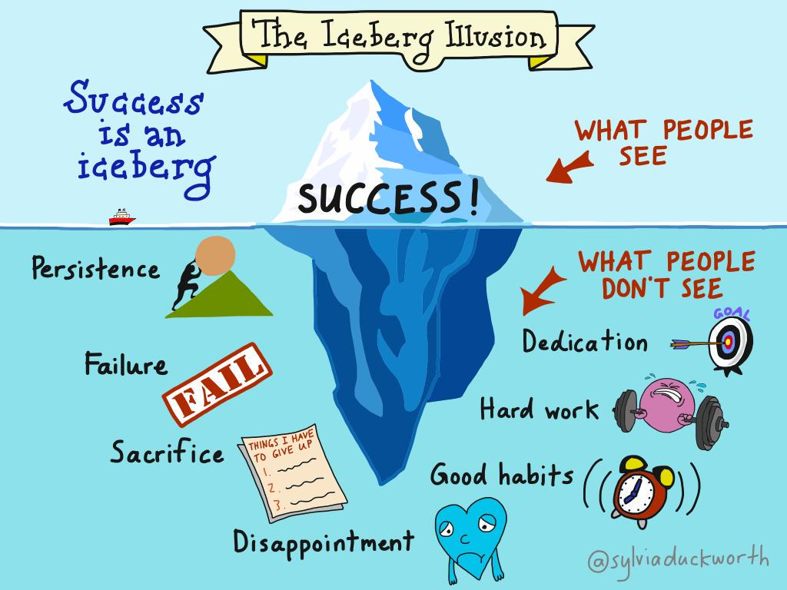
Notes:
If you’ve got a professional goal, don’t give up!
Keep pushing forward.
Remember that self-doubt is common, and success is difficult.
Our failures are important for learning and growth.
Showing you can overcome challenges will get you even one step closer to your goal!​
Aimee and I both love this image because it speaks for itself.
Behind each individual success, there is a lot of work that people don't see.
This is the iceberg illusion.
Success comes from dedication, hard work, good habits, disappointment, sacrifices, failure, and persistence.

Slide 11
What are the benefits of being a leader?
Relationship
Growth
Satisfaction
Vision
Notes:
What are the benefits of being a leader?​
​
The first benefit is the Relationship with People –
Making connection and networking with people in the industry is a benefit for yourself but also for you as part of a team.
Good relationship between team members is essential to create a sense of belonging.
Strong social connexion at work have shown happier and healthier workers both mentally and physically.
A strong connexion with your team members will help facilitate relationships and create a safe environment for sharing and improvement. ​
​
The next benefit is the Vision –
Being in a leadership position, you can share your vision with your team, and together, you’ll be able to work towards common goals.
This will also help your team and colleague to stay motivated and on track to achieve this common goal.​
​
The third one is Growth –
Take any opportunities to improve your knowledge and grow – any webinar, elearning, conference you take is an opportunity to improve your knowledge and gaining new skills that you can then after share with your colleagues as their coach. ​
​
And Lastly, Satisfaction –
It is always a feeling of accomplishment when you can roll out a new project. Patients, pharmacy staff and other health professional can benefit from process improvement.
A factor of satisfaction can be to have a flexible schedule and autonomy.
As a leader, don’t hesitate to show your satisfaction to your team.
Just by telling them they are doing a good job on a regular basis, your team will feel valued, and they will appreciate your feedback!
Being a leader is a fulfilling role for many reasons, as mentioned previously, making connexion with people, like your team members or other stakeholders.
Being in a leadership role, you most likely act as a coach or a mentor for some people. This is so fulfilling knowing that you're making a difference in someone else journey and that you have an impact on their future, whether it's a student, a new employee or a colleague.
People who enjoy their roles are more likely to be positive, optimistic, motivated and can make appropriate decisions.
​
As you can see, there is many benefits of being a leader. In conclusion, you can improve communication, create a better workplace, improve productivity, motivates employees, set good example for other and inspires hard work. ​
​
Now we will discuss some of the challenges of leadership, and you will notice that there may be some cross over between benefits and challenges.

Slide 12
Challenges
Effectiveness
Collaboration
Conflict
Inspire
Notes:
Ok, so now, what are the challenges of being a leader?
The first one in our opinion would be Effectiveness –
You'll need to be extra efficient in things like time management, prioritizing, strategic thinking, decision-making and getting up to speed with the leadership role.
These are all skills pharmacy professionals use frequently but leading a group and keeping the team on track throws a whole new spin on it.
It can take some time to get used to it.
By that we mean that sometimes you'll need to be available after hours, you may need to stay late to finish up a priority task, answer call on Saturday morning to walk an employee through a problem.
You'll need to occasionally decide if home or work is priority.
Again, with experience and a well-rounded team, these situations will become less and less, but when you first start, this can be very challenging.​
The second challenge is Inspire or Inspiring people -
Some people can be inspired easily while other people might need some guidance and encouragement.
Learning to work with different personalities effectively can be a challenge but once you start learning about motivating others and coaching and mentoring it gets easier.
You'll need to understand what they want to achieve so you can inspire them better.
Another challenge is collaboration –
When you are working on a project of implementing a change, it is important to make sure relationships are maintained and you got buy-in from other Departments, groups or individuals.
If you miss and important group or individual, big gaps in the process can happen.
But don't worry to much about it, people are usually pretty forgiving, and you can always adjust after the fact- but I'll tell you from experience, its not a great feeling when you realize you missed someone important, likely not for them either... ​
Lastly Conflicts –
Yikes.. We've all seen it, maybe even been involved in it.
When leading, if conflicts are not handled correctly, they can be extremely damaging to the workplace and lead to stress to many employees. It can sometimes be hard to know how to handle the situation between two employees or yourself and an employee.
If it happens to you, don’t hesitate to take a pause, ask about the problem, listen to what people have to say and then you can talk about it and bring up solutions.
The main thing to remember is to try to create a safe space for ideas to be shared and ensure that conflicting ideas are channeled into productive discussion that allows for growth.
Also, make sure you consider everyone's point of view and don’t be afraid to change your approach if theirs is better.​
​
The list goes on of challenges you'll face as a leader, but as with anything, over time you will build confidence and be able to tackle any situation... or with a mentor and the help of the whole team, be able to navigate through tough situations.

Slide 13
How you'll Benefit Personally
Qualities align with personal values
Decision making
Helping others
Time management
Notes:
Aimee
Lets talk about how what we've learned here can benefit you personally.
Qualities that we discussed as being important to get on board with leadership at work, will also transfer over to having better relationships outside the office. Think of your friends and family members. Hopefully they treat you with respect, are honest, loyal and positive :).
As you work towards a leadership role at work and take opportunities for learning and growing professionally, you build on these qualities and will learn how to be more present in your personal relationships.
You'll become a better decision maker. Leading a team at work and being a decision maker will ensure you sharpen your skills on identifying risks and making smart choices. Again, something that is important in personal life as well. If you are out with your family and have a hungry child and typically like to go sit at a fancy restaurant and wait 45 minutes for a nice meal? A smarter choice here (and I speak from experience) is to choose somewhere quicker to avoid the chaos of a cranky child.
It will become second nature to better understand others points of view. Teams are made from all sorts of different people and personalities. You'll become better at identifying when something is wrong and be able to intervene effectively before it's to late. A nice quality to bring into your personal life, when you can identify when a friend or family member needs someone to talk to, some time alone, or a hug.
Learning about time management... goes without saying.. Is there always a pile of laundry waiting to be folded or dishes to be put away? You'll learn more effective ways to prioritize and make up time to get these tasks done while still leaving time to spend doing things that bring you joy.
So.. It is pretty clear to see that Mentoring, Leading and Learning can benefit you both professionally and personally and really go hand in hand.
I took this from an article I found on under30CEO.com on leadership and happiness:
"Happiness is a great leadership quality because, if you lead by example, your colleagues will learn from you how to be happier themselves.
If you take off work regularly to spend time with your family and do things you enjoy, those you manage are more likely to do the same.
So go on the hikes. Take the road trip with your family, or set sail on a cruise. Find ways to be adventurous on your own terms.
Happiness in your workplace and in your life will make you a better leader. That’s the connection, and so if you seek out happiness for the sake of others and not yourself, you’ll become the greatest type of leader."

Slide 14
Take-Aways
Leadership comes in many shapes and sizes
Team Player skills are key
Step up and don't be shy
Benefits and challenges are intertwined
Benefit personally and professionally by taking the lead!
Notes:
We are almost at the end of our presentation, so we wanted to highlight a couple things for you this afternoon:​
Leadership comes in many shapes and sizes and people will be different in what type of leading role will work for them.​
Team player skills are key to having a satisfying career​
Step up and don't be shy. Put yourself out there, we all have the capability to be great leaders​
Benefits and challenges cross back and forth. What may be seen as a benefit to one, may be seen as a challenge to another. And every situation is different in some way.
You'll see benefits at home and at work if you take the lead in your own profession and where you want it to go!​
​
AIMEE:
One last point to share so it doesn’t get lost. We need to remember who we are and what we stand for. As pharmacy health care professionals. We have an obligation to make patients our number 1 priority and to not cause harm. Being a leader in healthcare can be a bit tricky. You need to ensure patient care is not being compromised when leading teams and changes. It takes understanding why you're doing something and being able to effectively communicate that to your team so everyone is working towards that shared goal of the best possible care for our patients.​
​
We understand that a leadership role is not appealing for everyone, but we really wanted to get one thing across:
We ALL have a leading role to play in our pharmacy profession, be it precepting students, presenting on a topic of interest to colleagues, being a member of a committee, or being in a defined manager position.
You are a leader and are also part of a team that is working towards a shared goal, Let your skills shine!​
​

Slide 15
References
Nine in 10 workers who have a mentor say they are happy in their jobs (cnbc.com)
Find Your Why to Get Unstuck | Life Skills That Matter
What is Leadership? Definition, Meaning & Importance (emeritus.org)
The Top 6 Leadership Challenges Around the World | CCL
How to Deal with These 17 Common Leadership Challenges (betterup.com)
What Is Leadership? | Definition by TechTarget
The Connection Between Leadership and Happiness - Under30CEO
The Iceberg Illusion & Why Mistakes Matter | theLLaBB
3 Charts | A Sense of Purpose Helps You Live Longer | Visualized Science (clearvuehealth.com)
Interactive presentation software - Mentimeter

