Slide 1
Do we Cross that Bridge? Perioperative Bridging Anticoagulation in Patients with Atrial Fibrillation Krista Doiron, BSc, BSs (Pharm) Bryanne MacNeil, BSc, BSc (Pharm)

Slide 2
Learning Objectives
Describe the benefit of anticoagulation for the thromboembolic risk associated with atrial fibrillation
Discuss therapeutic options for perioperative bridging anticoagulation
Compare current literature on perioperative bridging with recent evidence
Apply knowledge of perioperative bridging in moderate risk patients to patient case

Slide 3
A Glance at Atrial Fibrillation
Non-valvular Atrial Fibrillation (AF)
Most common type of arrhythmia and affects approximately 350,000 Canadians
3 to 5 times increased risk of stroke
Long-term use of anticoagulant minimizes the risk of subsequent thromboembolic events
Provide demonstrated benefit
Heart and Stroke Foundation
Clinical Interventions in Aging 2013
Notes:
Atrial Fibrillation is the most common type of arrhythmia and affects approximately 350,000 Canadians
After an episode of atrial fibrillation, patients are at a 3 to 5 time increased risk of subsequent thromboembolic events, including stroke
Many patients receive long-term treatment with an oral anticoagulant to minimize their risk of a subsequent thromboembolic event
Numerous clinical trials have demonstrated the benefit of these agents in patients with atrial fibrillation at moderate to high risk of thromboembolism

Slide 4
Warfarin use in AF
Warfarin is still commonly used in patients treated for AF
Ideal management of periprocedural anticoagulation remains controversial
Approximately one in six warfarin-treated patients with AF affected with this clinical scenario each year
N Engl J Med. 2015
Notes:
Although the direct oral anticoagulants (DOACs) have become the preferred treatment option in this patient population, warfarin is still commonly used in patients treated for atrial fibrillation
Issues with warfarin in this patient population include the ideal management of periprocedural anticoagulation, and the optimal therapy regimen remains controversial
Each year, this common clinical scenario affects approximately one in six warfarin-treated patients with atrial fibrillation

Slide 5
Perioperative Bridging Regimens
Standard Therapy Regimen:
Stop warfarin 5 days before an elective procedure to allow its anticoagulant effect to wane
Resume after the procedure, when hemostasis is secured
5 to 10 days of treatment required to attain therapeutic levels
Thrombosis Canada 2015
Notes:
Temporary interruption of warfarin around the time of the procedure is widely practiced, and this can occur with or without bridging therapy in the interim
Warfarin treatment is typically stopped 5 days before an elective procedure to allow its anticoagulant effect to wane; it is resumed after the procedure, when hemostasis is secured, at which point 5 to 10 days of treatment is required to attain therapeutic levels
Bridging is accomplished by giving a short-acting anticoagulant (usually a low-molecular weight heparin (LMWH)) around the time of the surgery while the warfarin is interrupted in order to reduce the patients’ risk of developing a thrombosis

Slide 6
Perioperative Bridging Regimens
Optional Bridging Therapy Regimen:
Begin a low-molecular weight heparin 3 days before the procedure
Stop 12-24 hours before surgery to allow anticoagulant effect to wane
Resume after the procedure, when hemostasis is secured
Continue until warfarin reaches therapeutic levels
Thrombosis Canada 2015
Notes:
Optional bridging therapy begins with a low-molecular weight heparin 3 days before the procedure. Stop the LMWH 12-24 hours before surgery to allow anticoagulant effect to wane. Resume after the procedure, when hemostasis is secured. Continue until warfarin reaches therapeutic levels.

Slide 7
Bridging Debate
Concerns over periprocedural bleeding complications
Significantly higher in patients that use bridging therapy
Risk stratification difficult
Traditional guidelines vs. recent evidence
N Engl J Med. 2015
Notes:
The controversy is due to concerns over periprocedural bleeding complications that have been demonstrated in clinical trials to be significantly higher in patients that use bridging therapy compared to those who do not. Patients are stratified based on their bleeding risk, but for many patients it remains unclear whether bridging should or should not be recommended.
Traditionally, guidelines recommend bridging therapy for certain patients who are at a moderate to high risk of thromboembolism, however recent evidence reveals this may not be necessary

Slide 8
Patient Case
MR is a 76 year old female with history of AF on chronic warfarin therapy
Stable on the same warfarin dose for the past 8 months
No history of bleeding or thrombotic complications
Other comorbidities include: congestive heart failure (EF 30%), hypertension, hypothyroidism, osteoarthritis and type II diabetes
Non-smoker and does not drink alcohol
Notes:
MR is a 76 year old female with a history of atrial fibrillation
On chronic warfarin therapy for the past 2 years with a most recent therapeutic INR of 2.4 (target 2.0-3.0)
Patient has been stable on the same warfarin dose for the past 8 months
No history of bleeding or thrombotic complications
Other comorbidities include congestive heart failure (EF 30%), hypertension, hypothyroidism, osteoarthritis and type II diabetes
She is a non-smoker and does not drink alcohol

Slide 9
Patient Case
Current Medications:
Lisinopril 10 mg once daily
Carvedilol 25 mg twice daily
Furosemide 40 mg once daily
Warfarin 2 mg once daily
Levothyroxin 50 mcg once daily
Alendronate 70mg once weekly on Sundays
Metformin 500 mg twice daily
Notes:
MR’s current medications include:

Slide 10
Patient Case
MR recently had a fall that fractured the radius in her lower right arm. She requires an open reduction with plate implant and her family doctor is wondering about perioperative anticoagulation recommendations.
Do you think she requires bridging therapy?
Notes:
MR recently had a fall that fractured the radius in her lower right arm. She requires an open reduction with plate implant and her family doctor is wondering about perioperative anticoagulation recommendations.
Do you think she needs bridging therapy? Show of hands…

Slide 11
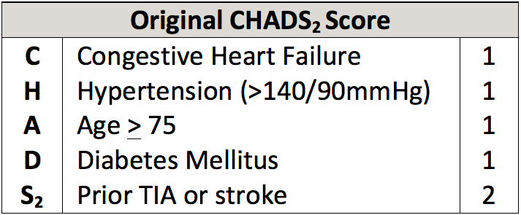
Risk Stratification
CHEST 2012
Notes:
When looking at risk stratification for MR based on the original CHADS2 score, she has CHF, Hypertension, Age over 75, and iDM, giving her a CHADS2 score of 4 and putting her at a moderate risk for thromboembolism. We assume then that she would also be at a moderate risk for thromboembolism perioperatively, although the chance of having an event in the small time frame is very small. This is the measurement that was used in the BRIDGE trial that we are looking at later, however it is important to note that this is not the most up to date scoring method and the new CHEST guidelines use a new CCS algorithm for determining whether a patient should use anticoagulation long-term.
Therefore MR has a moderate risk level for perioperative thromboembolism and may be a candidate for bridging therapy

Slide 12
Don’t cross that Bridge!
N Engl J Med. 2015
Notes:
“I don’t think we should cross that bridge just yet!”
First, we’re going to look at the BRIDGE trial or “Perioperative Bridging Anticoagulation in Patients with Atrial Fibrillation”
Primary outcome = thromboembolism or major bleed

Slide 13
BRIDGE Trial
Randomized
Double-blind
Placebo controlled
1884 patients with AF on warfarin therapy
Randomized to receive either bridging therapy or no bridging
N Engl J Med. 2015
Notes:
The bridge trial was a randomized, double-blind placebo controlled trial that addressed the question as to whether or not patients with A.Fib treated with warfarin undergoing an elective or invasive procedure or surgery required bridging during their interruption of warfarin therapy before and after the operation.
1884 patients with A.fib on warfarin therapy
Randomized to receive either bridging therapy or no bridging
Bridging ( LMWH- daltaparin)
Placebo

Slide 14
BRIDGE Trial
Relevant Inclusion Criteria
18 years of age or older
Chronic atrial fibrillation or flutter
Warfarin for ≥3 months to target INR 2-3
Elective procedure/surgery requiring warfarin interruption
≥1 CHADS2 risk factor
N Engl J Med. 2015

Slide 15
BRIDGE Trial
Relevant Exclusion Criteria
Mechanical heart valve
Stroke, systemic embolism or TIA within 12 weeks
Major bleeding within 6 weeks
CrCL < 30 mL/min
Plt < 100 x 109/L
Planned cardiac, intracranial, or intraspinal surgery
N Engl J Med. 2015

Slide 16
BRIDGE Trial
Study Size
6585 assessed for eligibility
1884 included/randomized
Study Population
Sex: 73% male
Race: 91% Caucasian
Age: mean 72 years
Weight: 96 kg
CHADS2 score: mean 2.3 (~38% with score ≥3)
Notes:
•Sex: 73% male; Race: 91% Caucasian; Age: mean 72 years; Weight: 96 kg • CHADS2 score: mean 2.3 (~38% with score ≥3) o Distribution: 1 (23%); 2 (39%); 3 (25%); 4 (11%); 5 (3%); 0 or 6 (< 1%) o CHF 32%; HTN 87%; DM 41%; stroke 10%; TIA 8%
*934 patients assigned to receive dalteparin
*950 patients assigned to no bridging therapy

Slide 17
N Engl J Med. 2015
Notes:
*Warfarin treatment was D/C 5 days before the procedure, and administration of study drug was initiated 3 days before the procedure.
Warfarin treatment was restarted on the evening of or the day after the procedure , and the study drug restarted 12 to 24 hours after a minor procedure and 48 to 72 hours after a major procedure.
*Administration of the study drug was continued after the procedure until the INR was 2.0 or higher on one occasion
* The final patient follow-up occurred 30 days after the procedure

Slide 18
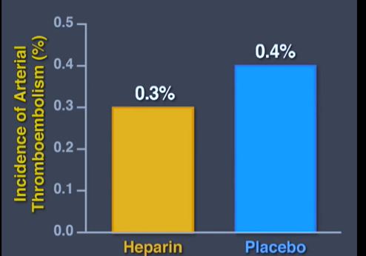
BRIDGE Trial RESULTS
N Engl J Med. 2015
Notes:
Of the 1884 patients enrolled in the trial, 71 discontinued participation and did not provide outcome data.
At 30 days after the procedure, the incidence of arterial thromboembolism was 0.4% in the no-bridging group and 0.3% in the bridging group.
Patients in whom arterial thromboembolism occurred had a mean CHADS2 score of 2.6 and 5 out of the 7 events occurred after a minor procedure.

Slide 19
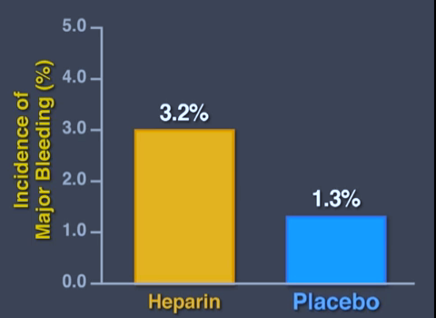
BRIDGE Trial RESULTS
N Engl J Med. 2015
Notes:
*Major bleeding occurred in 1.3 % of the patients in the no-bridging group and in 3.2% in the bridging group, which indicated that no bridging was superior to bridging with regard to major bleeding.
*RR was 41%
*none of the major bleedings were fatal
*there was a significant reduction in minor bleeding in the no-bridging group compared to the bridging group
*there was no significant difference between the groups in rates of AMI, DVT, PE or death

Slide 20
BRIDGE Trial
Authors Conclusions:
Nonbridging noninferior to bridging for ATE risk, and superior to bridging with regard to bleeding risk
Unable to generalize in CHADS2 ≥3 or patients undergoing certain high-risk procedures
Benefits may be more pronounced in high-risk procedures that have higher associated bleeding risk?
Nonbridging confers additional advantages cost-savings and convenience for patients
Notes:
First study assessing perioperative risk of ATE and rates of bleeding with anticoagulation bleeding in AF. • Demonstrated that nonbridging was noninferior to bridging in terms of ATE risk, and superior to bridging with regard to bleeding risk. • Unable to generalize to those with CHADS2 ≥3, patients undergoing certain high-risk procedures, or those with mechanical valves, etc. • Forgoing bridging reduced the risk of major bleeding by 1.9% and minor bleeding by 8.9% (NNT=53 and 12, respectively) in patients undergoing low-risk procedures. • Benefits may be more pronounced in high-risk procedures that have higher associated bleeding risk? • Nonbridging confers additional advantages in terms of cost-savings and convenience for patients. • Consistent with 2012 ACCP Chest guidelines recommendations (no bridging for patients at low risk for ATE) • Applicability to DOACs?

Slide 21
BRIDGE Trial
Unanswered questions
Time spent in therapeutic INR in both groups
Characteristics of patients who had a major bleed
Adherence to therapy
Notes:
Thank you for that. Although this was a well conducted study – there does remain some unanwered questions such as:
So lets look elsewhere and see what other

Slide 22
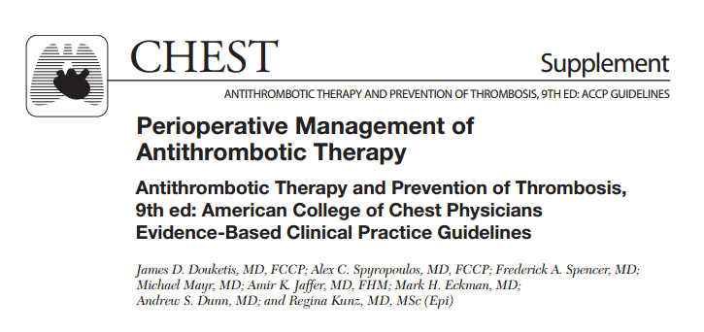
Cross that Bridge!
CHEST 2012
Notes:
“CROSS IT”
The need for bridging in patients with Afib is based on risk stratification according to the CHADS2 score.
*Low risk (CHADS2 score of 0-2) don’t require bridging we already know that.
*High risk (CHADS2 score 5-6) have typically received bridging
*the controversy comes from moderate risk patients (CHADS2 score 3-4).
*According to the the 2013 Chest Guidelines on Perioperative Management of Antithrombotic Therapy state they say patient within the moderate-risk stratum undergoing surgeries or procedures associated with a low risk for bleeding in whom bridging may be considered include patients with A.fib and a CHADS2 score of 3-4 or prior thromboembolism during interruption of warfarin .

Slide 23
Current Guidelines
Risk stratification
Low Risk (CHADS2 0-2) = No bridging
High Risk (CHADS2 5-6) = Bridging typically recommended
Moderate Risk (CHADS 3-4) = ???
Current guidelines consider bridging to be an option for these patients
Notes:
The need for bridging in patients with Afib is based on risk stratification according to the CHADS2 score.
*Low risk (CHADS2 score of 0-2) don’t require bridging we already know that.
*High risk (CHADS2 score 5-6) have typically received bridging
*the controversy comes from moderate risk patients (CHADS2 score 3-4).
*According to the the 2013 Chest Guidelines on Perioperative Management of Antithrombotic Therapy state they say patient within the moderate-risk stratum undergoing surgeries or procedures associated with a low risk for bleeding in whom bridging may be considered include patients with A.fib and a CHADS2 score of 3-4 or prior thromboembolism during interruption of warfarin .

Slide 24
Cross that Bridge!
Arch Intern Med 2004
Notes:
Krista to add Douketis paper (2004)
This paper from the American Medical Association investigated the efficacy and safety of a standardized periprocedural anticoagulation regimen with LMWH

Slide 25
Douketis et al. 2004
Inclusion criteria:
received warfarin therapy, with a target INR of 2-3.5
mechanical heart valve, chronic AF or a previous stroke or TIA
undergoing an elective surgical or other invasive procedure that requires normalization of INR
Notes:
Study included 650 patients with a mechanical heart valve, chronic a.fib or embolic stroke who required interruption of warfarin therapy because of an invasive procedure.
Patients were included for inclusion if they: 1. received warfarin therapy, with a target INR of 2-3.5
2. had a mechanical heart valve, Chronic a.fib or a previous stroke or TIA with a presumed embolic source and
3. undergoing an elective surgical or other invasive procedure that requires normalization of INR
* the primary outcomes were thromboembolism, major bleeding and death.
Thomboembolism was defined as a stroke or transient ischemic attach, ACS or systemic embolism involving a limb or viscera that was ascertained on the basis of clinical findings and objective diagnostic testing.

Slide 26
Douketis et al. 2004
Primary outcomes:
thromboembolism
major bleeding
death
Notes:
* the primary outcomes were thromboembolism, major bleeding and death.
Thomboembolism was defined as a stroke or transient ischemic attach, ACS or systemic embolism involving a limb or viscera that was ascertained on the basis of clinical findings and objective diagnostic testing.

Slide 27
Douketis et al. 2004
Arch Intern Med 2004
Notes:
*Warfarin was stopped 5 or 6 days before the procedure, and patients received subcutaneous dalteparin , 100 IU/kg twice daily, starting 3 days before the procedure.
*The risk of post-procedural bleeding determined post procedural anticoagulant management. For example, in patients undergoing a non high bleeding risk procedure who had adequate post procedural hemostasis, warfarin was resumed on the evening of the procedure and dalteparin was resumed on the next day and continued until the INR ratio was 2 or more.
*if post procedural hemostasis was not secured, the resumption of dalteparin was delayed.
*in patients undergoing a high bleeding risk procedure, warfarin was resumed on the evening of the procedure but daleparin was not given after the procedure.

Slide 28
Douketis et al. 2004
=2
=2
=4
=2
Arch Intern Med 2004
Notes:
In 108 patients undergoing a high-bleeding risk procedure who received only preprocedural dalteparin, there were 2 nonfatal major bleeding episodes (1.85%), and 2 deaths possibly due to thromboembolism.
In 542 patients undergoing a non-bleeding risk procedure who were scheduled to received preprocedural and post procedural dalteparin, there were 4 major bleeding episodes, none of which were fatal, 2 thromboembolic events.
In conclusion patients at increased risk for arterial thromboembolism who require temporary interruption of warfarin therapy, a standardized bridging anticoagulation regimen with LMWH was associated with a low risk of thromboembolic and major bleeding complication in the immediate periprocedureal period.

Slide 29
Clinician Update
Circulation 2012
Notes:
In 2012 The American heart association had a clinician update that stated when the thromboembolic risk is deemed to be moderate to high, bridging therapy with parenteral anticoagulants is justified. After warfarin discontinuation, a daily therapeutic dose of LMWH is initiated once the INR falls below the therapeutic range.
*post operatively warfarin should be cautiously restarted as soon as feasible.
I appreciate that the bridge trial was the first randomozed clinical trial done in a fib patients. There are papers and guidelines that suggest bridging may still be necessary. The BRIDGE trial does not necessarily speak to patients with a CHADS score above 2 so can we use the information from the BRIDGE trial for these patients?

Slide 30
The Rebuttal
1. Was the trial necessary?
Already know that patients with AF have a low risk for stroke during interruption. Was the BRIDGE study necessary?
2. Alternatives to warfarin
Will emerging alternatives to warfarin make the BRIDGE study irrelevant?
Notes:
Recent studies that indicate patients with AF may have a low risk for stroke during interruption of warfarin for surgery/procedure and that such patients may not require bridging anticoagulation with LMWH or heparin. If this is the case, does it not make the BRIDGE study unneccessary.
Will emerging alternatives to warfarin make the BRIDGE study irrelevant?

Slide 31
Rebuttal #1
Was the trial necessary?
Studies were retrospective
Patients who did not receive bridging may have been in a lower risk group
Studies are not a substitute for well-designed clinical trial
Notes:
These studies reported that the risk for stroke appeared low when bridging was not given during warfarin interruption. However, these studies do not make BRIDGE study unnecessary based on 1.) theses studies were retrospective, meaning patient data and outcomes were collected after warfarin interruption and surgery. It is possible that outcomes were not reliably captured. 2.) patients who did not receive bridging may have been a lower risk group and may have had a low risk for stroke. In fact, some patients in both studies did not receive bridging and in the study by Wysokinski et al, a pre-specified sub-group of patients did in fact receive bridging. And lastly, these studies are not a substitute for a well-designed clinical trial that will determine if bridging is needed.

Slide 32
Rebuttal # 2
Alternatives to Warfarin?
Increased patient expense
Reluctance to switch therapies
Bridging in these patients deemed not necessary
Notes:
In regards to emerging alternatives to warfarin, the new oral anticoagulants will not have a negative impact on the BRIDGE trail because if newer drugs are as effective and safe as warfarin to prevent stroke in AF they will be more expensive and it is likely that warfarin will continue to be widely used. Even if the cost of newer drugs is paid by a third party many patients who have been comfortable using warfarin for many years may be reluctant to switch to a newer “less trusted” alternative.
In general, the rapid offset and onset of action of NOACs obviates the need for ‘heparin bridging’ as is done in selected warfarin treated
patients. Thrombosis Canada

Slide 33
Pearls
In adults with atrial fibrillation and CHADS2 score < 3 undergoing low-risk procedures, forgoing bridging may be a reasonable option to reduce the risk of bleeding without increasing the risk of thromboembolism.
Patients with CHADS2 score ≥3 still need to be addressed on a case by case basis
More research required
Not all patients addressed by the BRIDGE trial
Notes:
Not black and white, however the evidence that it coming back is pointing to the fact that we do not need to bridge patients as often and that there are potential risks in doing so. That’s why it is so important to always be looking at the most up to date evidence and critically appraising all the information in order to make the most informed decisions with your patients.
Chads score was 4 which we mentioned was moderate, but what about bleeding?
This is where judgement also comes into play. Any other meds that may increase bleeding? Her age? Health status?

Slide 34
Patient Case
MR recently had a fall that fractured the radius in her lower right arm. She requires an open reduction with plate implant and her family doctor is wondering about perioperative anticoagulation recommendations
Notes:
Not that black and white. Most patients fall within the intermediate category. Most times the decision to bridge will be based on patient factors, Dr doing the surgery and clinical judgement- all taking into consideration the CHADS score.
MR is a 76 year old female with a history of atrial fibrillation
On chronic warfarin therapy for the past 2 years with a most recent therapeutic INR of 2.4 (target 2.0-3.0)
Patient has been stable on the same warfarin dose for the past 8 months
No history of bleeding or thrombotic complications
Other comorbidities include congestive heart failure (EF 30%), hypertension, hypothyroidism, osteoarthritis and type II diabetes
She is a non-smoker and does not drink alcohol
Current Medications:
Lisinopril 10 mg once daily
Carvedilol 25 mg once daily
Furosemide 40 mg once daily
Warfarin 2 mg once daily
Levothyroxin 50 mcg once daily
Alendronate 70mg once weekly on Sundays
Metoprolol 500 mg twice daily

Slide 35
What would you do?
Notes:
For our patient, we opted not to bridge this time as she is fairly stable, has no prior history of thromboembolism and is undergoing a low risk procedure.
What would you have done?
This is where judgement also comes into play. Any other meds that may increase bleeding? Her age? Health status?

Slide 36
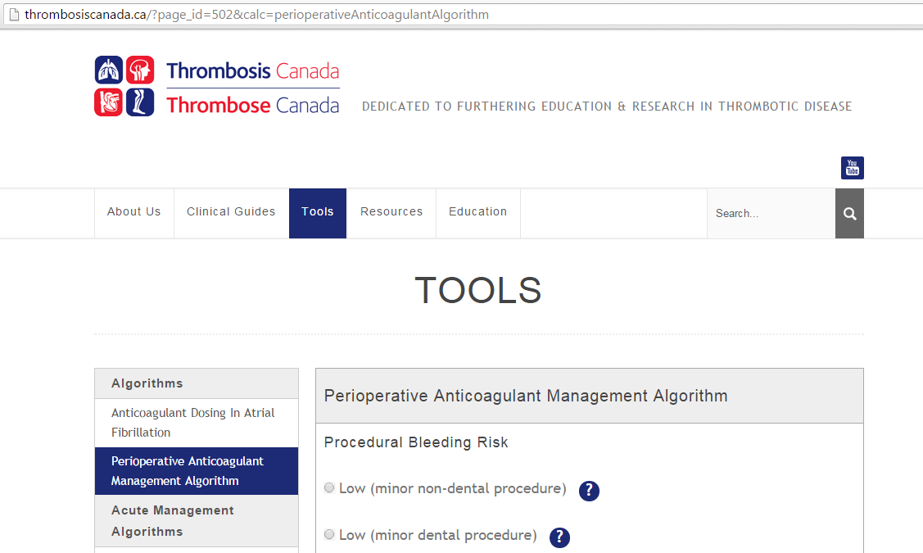
Helpful Tools
Thrombosis Canada

Slide 37
Learning Objectives
Describe the benefit of anticoagulation for the thromboembolic risk associated with atrial fibrillation
Discuss therapeutic options for perioperative bridging anticoagulation
Compare current literature on perioperative bridging with recent evidence
Apply knowledge of perioperative bridging in moderate risk patients to patient case

Slide 38
QuestionS

Slide 39
References
Amin A. Oral anticoagulation to reduce risk of stroke in patients with atrial fibrillation: current and future therapies. Clinical Interventions in Aging. 2013;8:75-84. doi:10.2147/CIA.S37818.
Douketis JD, Johnson JA, Turpie AG. Low-molecular-weight heparin as bridging anticoagulation during interruption of warfarin: assessment of a standardized periprocedural anticoagulation regimen. Arch Intern Med. 2004 Jun 28;164(12):1319-26.
Douketis JD, Spyropoulos AC, Kaatz S, Becker RC, Caprini JA, Dunn AS, Garcia DA, Jacobson A, Jaffer AK, Kong DF, Schulman S, Turpie AG, Hasselblad V, Ortel TL; BRIDGE Investigators. Perioperative Bridging Anticoagulation in Patients with Atrial Fibrillation. N Engl J Med. 2015 Aug 27;373(9):823-33.
Eikelboom JW, Hirsh J, Spencer FA, Baglin TP, Weitz JI. Antiplatelet drugs: Antithrombotic Therapy and Prevention of Thrombosis, 9th ed: American College of Chest Physicians Evidence-Based Clinical Practice Guidelines. Chest. 2012 Feb;141(2 Suppl):e89S-119S. doi: 10.1378/chest.11-2293. Review.
Heart and Stroke Foundation. Atrial fibrillation - Be pulse aware. Accessed Oct 2015. http://www.heartandstroke.com/
Piccini JP, Holmes DN, Ollis DM, Fraulo ES, Thomas L, et al. (2011) Patterns of Atrial Fibrillation and Treatment Strategies Vary According to Provider Specialty Across Community Practice Settings: Findings From the ORBIT-AF Registry. Circulation 124: A16415.
Questions about the Rationale and Justification of the Bridge Study. (2015).
Thrombosis Canada. Peri-operative Management Of Patients Who Are Receiving A New Oral Anticoagulant (Dabigatran, Rivaroxaban, Apixaban). Accessed November 2015. http:www.thrombosiscanada.ca
Thrombosis Canada. Perioperative Coagulation Management Algorithm. Accessed October 2015. http:www.thrombosiscanada.ca
Wysokinski WE, McBane RD 2nd. Periprocedural bridging management of anticoagulation. Circulation. 2012 Jul 24;126(4):486-90.

